Slide 1
CCS AS A KEY ENABLER TO DEVELOPING A LOW CARBON ECONOMY
BRAD PAGE
CEO, Global CCS Institute

Slide 2
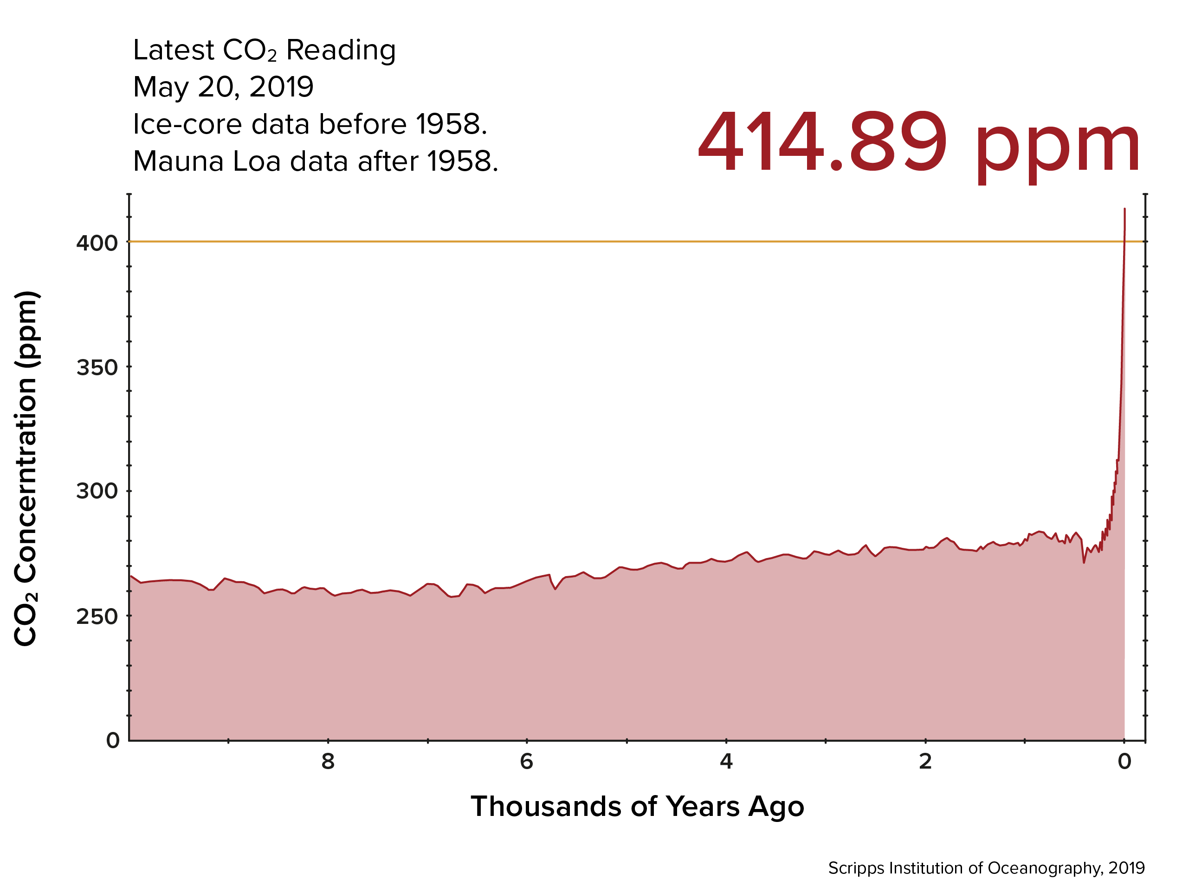

Slide 3
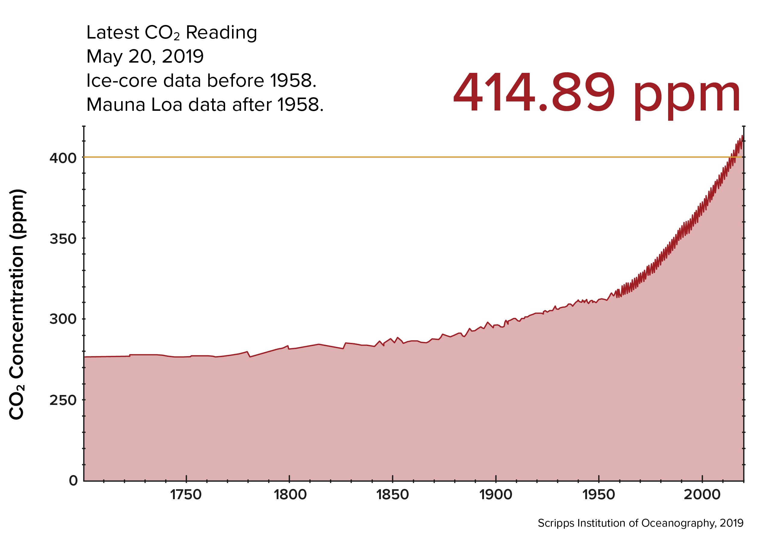

Slide 4
Thank you
globalccsinstitute.com

