Slide 1
China's CCUS and China Australia S&T Cooperation
Qiang Wang
Chinese Embassy in Canberra

Slide 2
CCUS In China
China CCUS Technology Development Roadmap released by the Ministry of Science and Technology (MOST) in 2011 and 2019 respectively.
Goals for CCUS technology development in China by 2020, 2030 ,2045 and 2050 were proposed, priority technologies, early opportunities were identified, and pertaining actions were proposed.

Slide 3
2011~2015 12th Five Year Plan CCUS Technology Development Planning released in 2013 by MOST.
17 national research projects funded by 973 and 863 Programmes in CCUS theoretical studies, key technology and full chain demonstration.

Slide 4
Based on the success of major demonstration like Shenhua 100,000 Ton storage, Shengli Oilfield CO2 EOR and Huaneng Group Green Coal Fired Power generation projects, the13th Five Year Plan (2016~2020) witnessed remarkable increase in R&D and demonstration in full chain CCUS key technologies

Slide 5
Roadmap 2019
Released by the Ministry of Science and Technology of China in May 2019

Slide 6
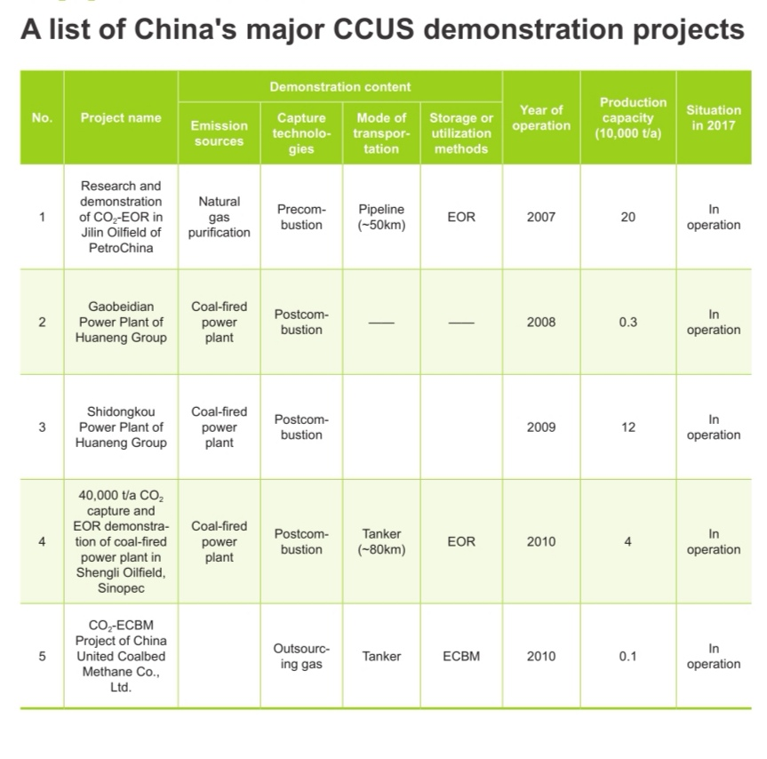

Slide 7
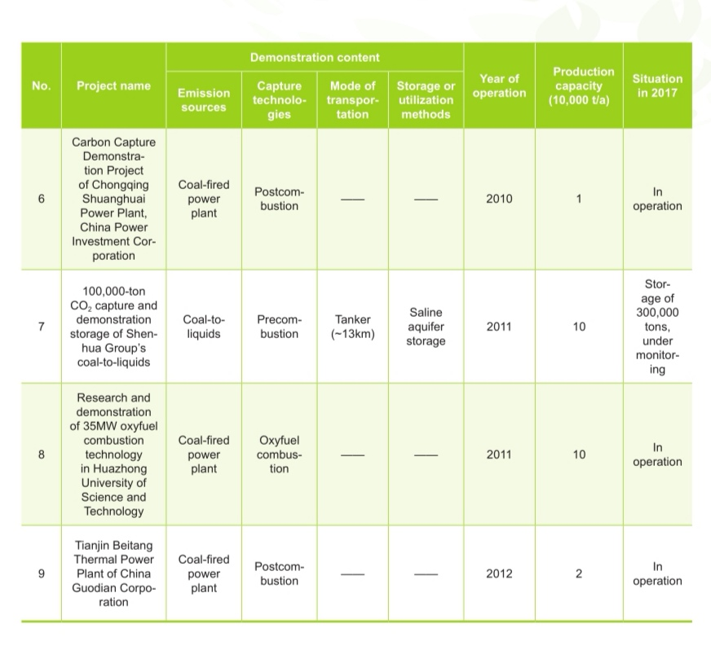

Slide 8
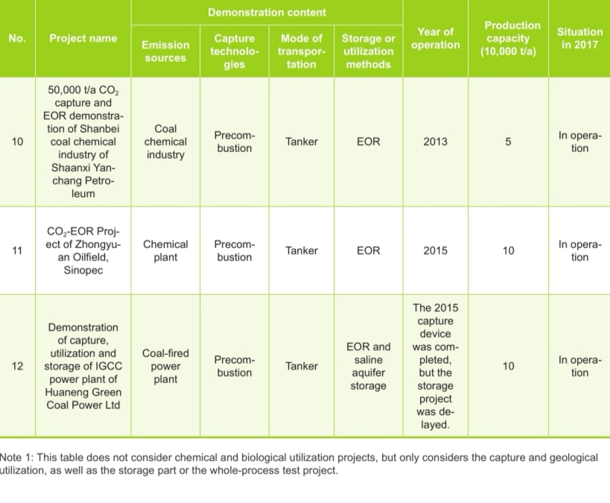

Slide 9
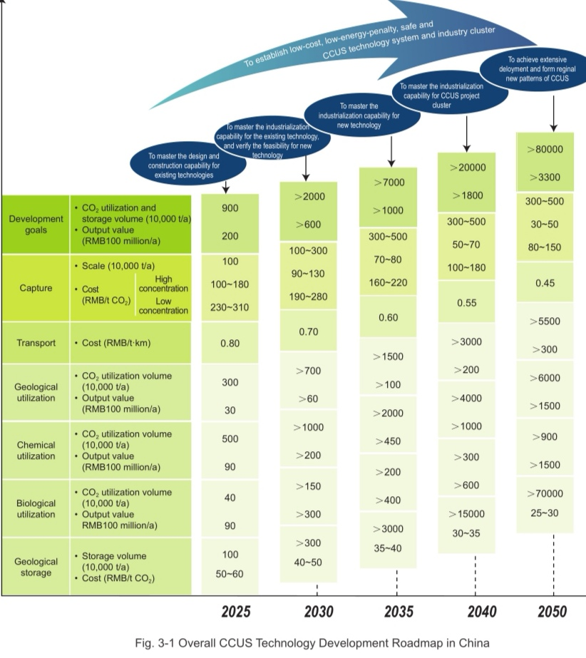

Slide 10
China CCS Industrial Innovation Alliance
GCCSI cooperation
CSLF CEM MI
Bilateral cooperation with EU US Australia Italy
CAGS, NZEC

Slide 11
Challenges
high cost, high energy consumption, safety reliability and financing difficulties for demonstration, attractiveness droping

Slide 12
Proposals
Promote the acceptance of CCUS technology and combine its development goals with specific national goals.
CCS only serving CO2 emission reduction is not good for the comprehensive development of CCUS technology. Only from the perspectives of sustainable economy, environmental protection energy security, can the adaptability and attractiveness of CCUS be fully enhanced.

Slide 13
lowering cost and energy consumption through R&D and demonstration
subsidies will not solve problems alone. Only through R&D and break through in major obstacles and bottlenecks can cost and consumption problems be solved.

Slide 14
Establish the platform for cooperation and exchange in CCUS
The benefits of implementing CCUS are global. A viable mechanism for sharing technology and expertise will greatly enhance the efficiency of R&D input and accelerate the technology progress and large scale commercialisation of CCUS.

Slide 15
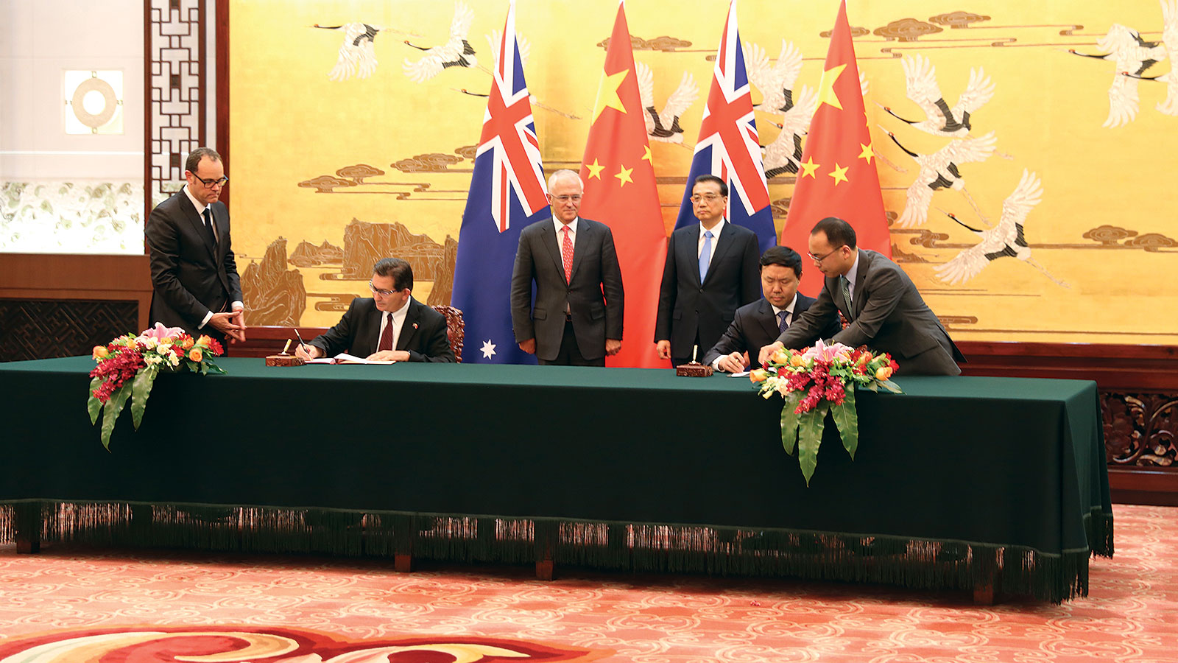
China-Australia S&T Cooperation

Slide 16
China Australia Partnership
Australia China Science and Research Fund
Joint Science and Technology Commission
Young Scientist Exchange Programme
Science Policy Symposium
Joint Research Centres
SKA & MWA
Geoscience

Slide 17
China Australia Partnership
G20 Science Ministers Meeting
CEM & Mission Innovation
APEC Clean Energy Working Group
Climate Change Ministerial Meeting
China Australia Innovation Dialogue (2019?)
China Australia Ministerial Energy Dialogue (2019?)

Slide 18
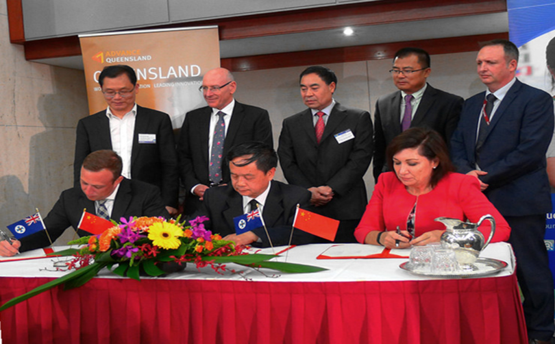
Torch Innovation Precincts NSW & Queensland

Slide 19
Thanks for your attention!
Qiang Wang
Consellor for Science and Technology
Chinese Embassy in Australia
T: 02 6228 2968 Email mostwang@gmail.com

