Slide 1
Proposed CCS Policy Framework: Australian CCS Network
david byers, ceo, co2crc ltd.
APAC CCS Forum
Brisbane, 31 May2019

Slide 2
The climate policy quandary…
Perception of a near-term apocalypse (‘climate emergency’) is narrowing policy options we are willing to consider:
IPCC (1.5 degree report) : ‘12 years to save the planet’ cf. ‘12 years for the degree of economic transformation reqd. to reach 1.5 degrees.’
Lofty promises made while drastic cuts are prohibitively expensive and technologically challenging.
The current climate/energy policy debate is over-simplified with a single (‘simple’) solution identified:
Rapidly deploy 100% renewables (wind and solar power plants) with the goal of eliminating fossil fuels on the timescale of 1-2 decades
GCC is not a simple problem with a simple solution to be delivered according to an arbitrary timeline/deadline
A complex problem that needs many pathways to ‘solution’ → Maximise options to create better long-term approaches (energy security, reliability, cost still matter)
Requires substantial research, development and experimentation; new technologies and combinations of technologies
Carbon Capture Utilisation and Storage has a central role to play
It’s emissions, stupid!
Meet global emissions reduction targets while maximising options for supply of cost-effective, high performance, widely available energy

Slide 3
Climate ‘emergency’
Greenpeace, 19/05/19: ‘This was a climate election, held in the shadow of multiple climate disasters, from the fires in Tasmania to the drought in the interior, the heat waves in our cities, the bleaching of the Great Barrier Reef and the storms and floods in Queensland. Climate damage is hurting Australian families and is destroying the places we love.’
ACF, 19/05/19: “At some point Australia must reconcile the action needed to halt the climate crisis and crash of nature with our deficient national plans and policies.”

Slide 4
Australian CCS Network
Network Members:
Roundtable Discussions: Australian Government (senior officials); Feb/March 2019

Slide 5
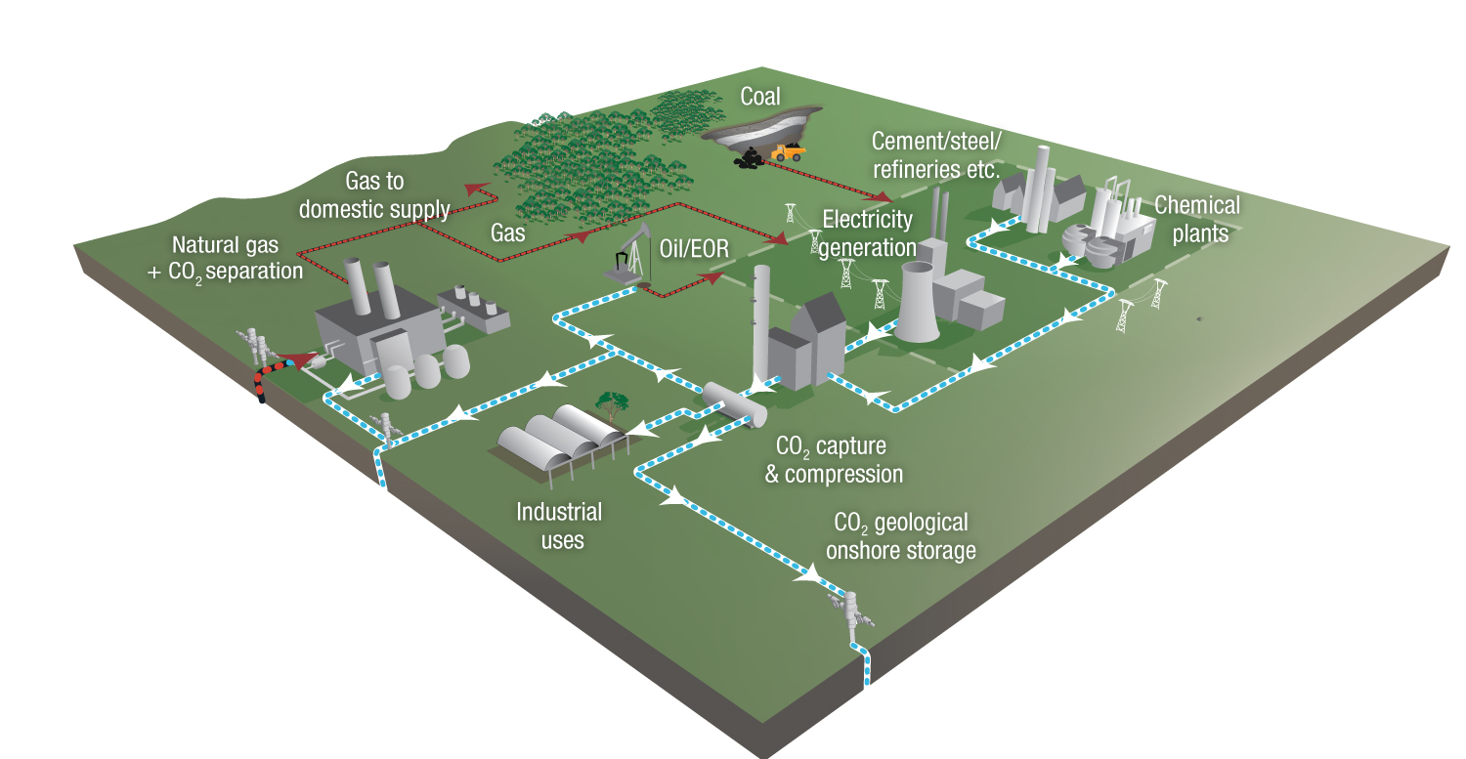
Roundtable Discussion Topics: Australian CCS Network – Australian Government
1. Developments in CCS research and development
2. CCS policy
Incentives to accelerate CCS projects
Principles for an Australian CCS Policy Framework
Specific proposals for Australian CCS
Tax Credits
Australian Carbon Credit Units (ACCUs)
Project Finance
Hard to Reduce Risks
(Government)

Slide 6
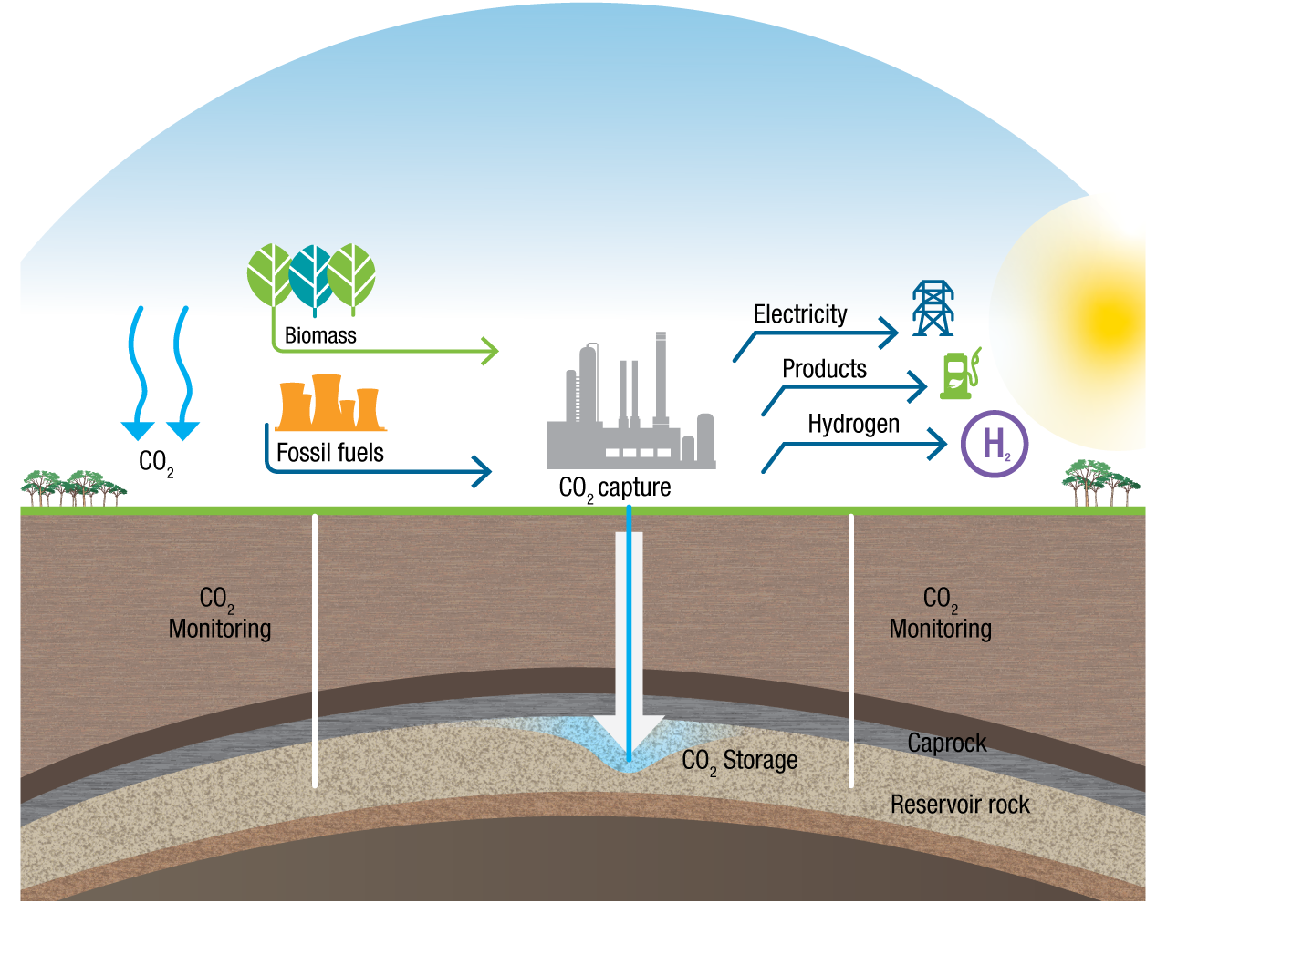
Key Messages to Government: CCS
A proven, safe technology; globally stored >200MT CO₂ since 1970’s
A key enabler for future fuels/industries in Australia including:
High CO₂ natural gas developments
Enhanced Oil Recovery (enhance energy security)
Coal gasification → Hydrogen production
Internationally accepted within the UNFCCC and IPCC as a key part of the lowest cost path solution to limit global warming to 2ºC
Can achieve major emission reductions from multiple sectors (power, LNG, steel, chemicals, fertilizer, aluminum)
Modified after GFZ Potsdam, 2018
Australia must incentivise CCS to ensure that our emission intensive industries have a continued licence to operate and contribute to Australia’s economy and wealth

Slide 7
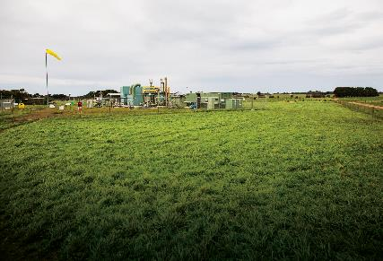
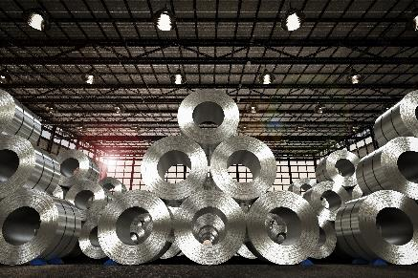
Principles for an Australian CCS Policy Framework
Putting a value on reducing emissions so private sector makes rational choices to invest
Need policy parity with other low emission technologies for least cost GHG reduction in Australia
Long-term policy commitment is required for long-term investment
International competitiveness for Australia’s emission intensive industries.

Slide 8
Tax Credits that value carbon stored
The US Example: Internal Revenue Code
45Q Tax Credit for Storage of CO₂
Basis:
A CCUS tax credit applied to both storage (US$50/T) and CO₂-EOR (US$35/T).
Applied to new build and retrofit CCS projects with construction commencing before 2024.
Provides certainty as finance and timeframes are fixed, reducing risk and lowering the cost of capital.
Likely Outcome:
Increased royalty revenue from EOR.
Net CO₂ emission reduction associated with these projects
Catalyst for CCS projects and advanced R&D investment.
A tax credit scheme can generate a strong business case for CCS, giving policy confidence to investors.
An appropriate, targeted tax credit value, could incentivise CCS in the emerging wave of high emission intensity industries like hydrogen, high CO₂ natural gas developments, and EOR.
Recommendation – Evaluate the introduction of a tax credit scheme for storage and CO₂ EOR taking lessons from the US 45Q tax credit scheme.

Slide 9
Australian Carbon Credit Units (ACCUs) and CCS
The Climate Solutions Fund - Emissions Reduction Fund (ERF) incentivises emission reductions by awarding ACCUs for verified tCO₂-e reduced or stored. Sell credits to CER or on secondary market.
Many opportunities for land sector to earn ACCU’s (reforestation, revegetation carbon sinks). While no barrier exists to CCS projects, there is no approved methodology that can accommodate CCS or CO₂-EOR.
Recommendations –
Develop a methodology ( new) crediting CCS Project- related emissions reductions as ACCUs.
Allow emissions reductions through CO₂-EOR projects to be credited as ACCU’s, by amending the current definition of “captured for permanent storage” to recognise the permanency of the stored CO₂. Remove conflicts between Commonwealth and State legislation in the recognition of emissions abatement by CO₂-EOR.
A Carbon Storage Unit?

Slide 10
Clean Energy Finance Corporation (CEFC) Amendment Bill 2017
The CEFC concessional finance reduces the cost of debt, a cost-effective policy support mechanism for capital intensive clean energy investments.
In March 2017, a CEFC Amendment was proposed to remove the prohibition to invest in CCS technologies (still to be considered).
This amendment provides policy parity with other low emission sources, potentially stimulating CCS.
Recommendation – Re-introduce the CEFC Amendment (Carbon Capture and Storage) Bill into Parliament as a priority with the objective of removing the arbitrary prohibition on investment in CCS by the CEFC.

Slide 11
Hard to Reduce Risks
While the private sector is very effective in managing technical, construction and operational risks, ‘Hard to Reduce’ risks require government policy assistance. These include:
Cross Chain risk: Government to be first investor establishing transport and storage infrastructure for an anchor customer (remove one source, one sink, one pipeline reliance for investors)
Industrial Hubs risk: low emissions industrial precincts remove economic and social risk to community associated with closure of facilities
Long-term liability for CO₂ stored: Transfer of long term liability for stored CO₂
Recommendation - Governments to actively manage ‘hard to reduce’ risks including cross-chain risks, low emissions industrial hubs, long-term liability for stored CO_{2,} and other risks which contribute significantly to the cost of capital.

Slide 12
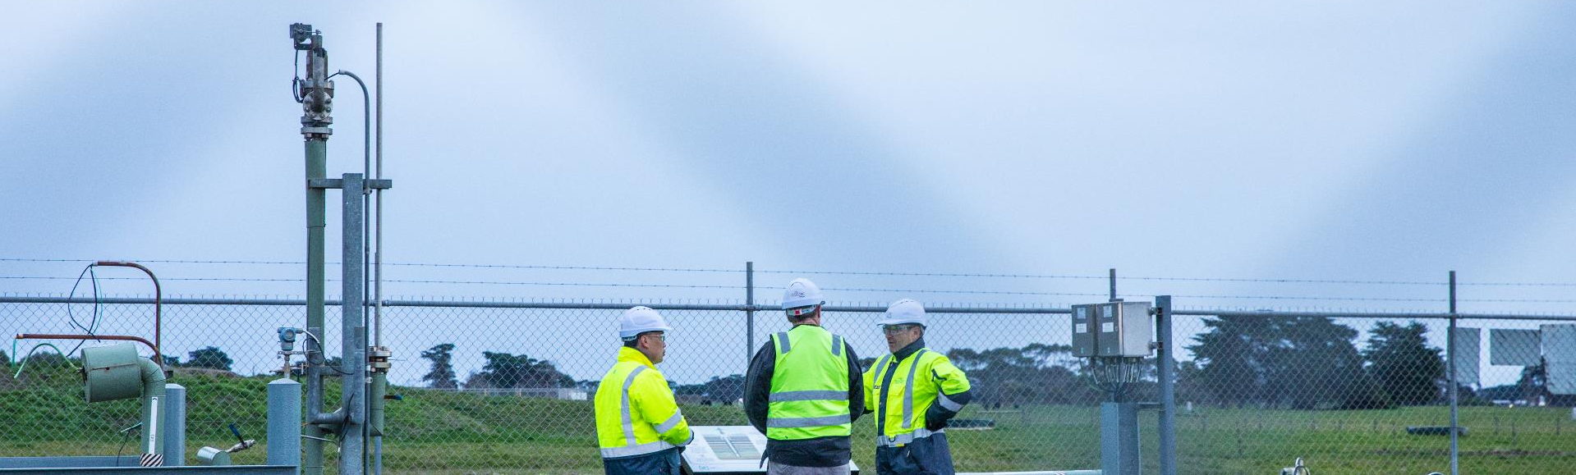
Summary
A starting point to raise profile of CCUS
Government plays vital role in providing a clear, stable and supportive policy framework for CCS.
Stimulate greater investment in CCS projects through economic incentives (CCS policy framework)
Improve attractiveness of CCUS for meeting national/international emissions reduction targets while maximising resources sector (jobs/investment/exports) opportunity for Australia

Slide 13
CO2CRC acknowledges and appreciates the strong relationships it has with industry, community, government, research organisations, and agencies in Australia and around the world
© CO2CRC Limited 2019

