Slide 1
Update for GCCSI Forum
May 2019

Slide 2
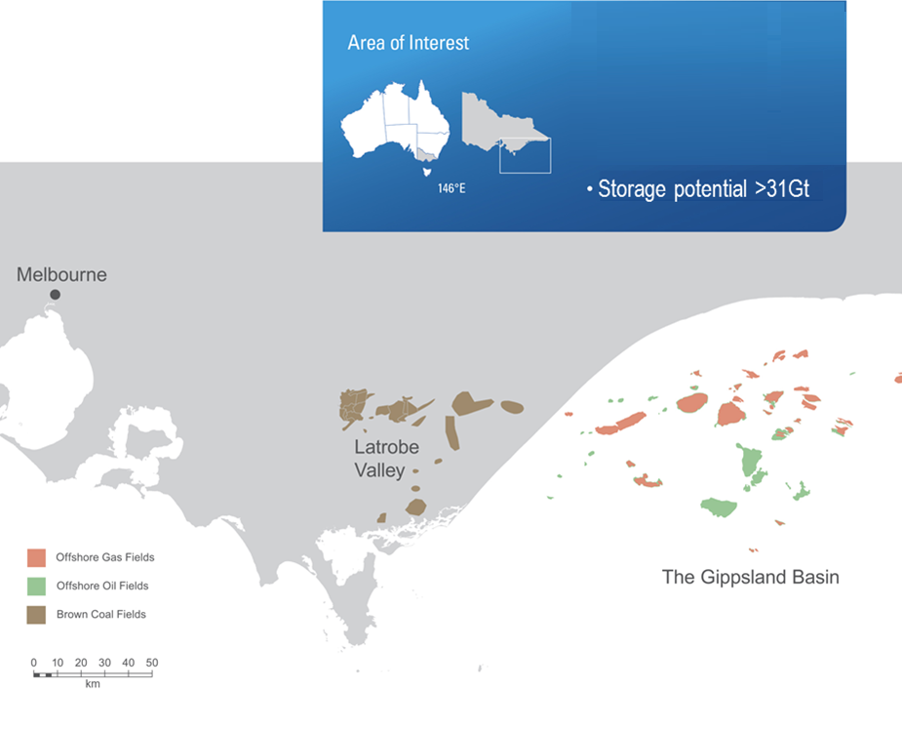
CarbonNet Project
  Carbon Capture and Storage (CCS) critical to decarbonise economies- increasing acknowledgement globally
  Investigating the feasibility for a commercial-scale, multi-user CCS network in Gippsland, Victoria, Australia
  Jointly funded by the Australian and Victorian Governments since 2010
  Significant research investment to support CarbonNet (eg via ANLEC R&D)
  CO2CRC is CarbonNet’s lead research organisation
  Knowledge sharing via GCCSI
  Working collaboratively with industry to secure customers and investors in a CCS Service

Slide 3
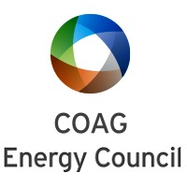



Opportunities enabled by CCS: Hydrogen
Japanese Government has adopted a Hydrogen Society and Basic Hydrogen Strategy.
Council of Australian Governments (COAG) agreed to develop an Australian Hydrogen Strategy by December 2019
CSIRO Hydrogen Roadmap
and Chief Scientist have
confirmed opportunities:
domestic
export
Lowest cost clean hydrogen
Growing industry interest

Slide 4
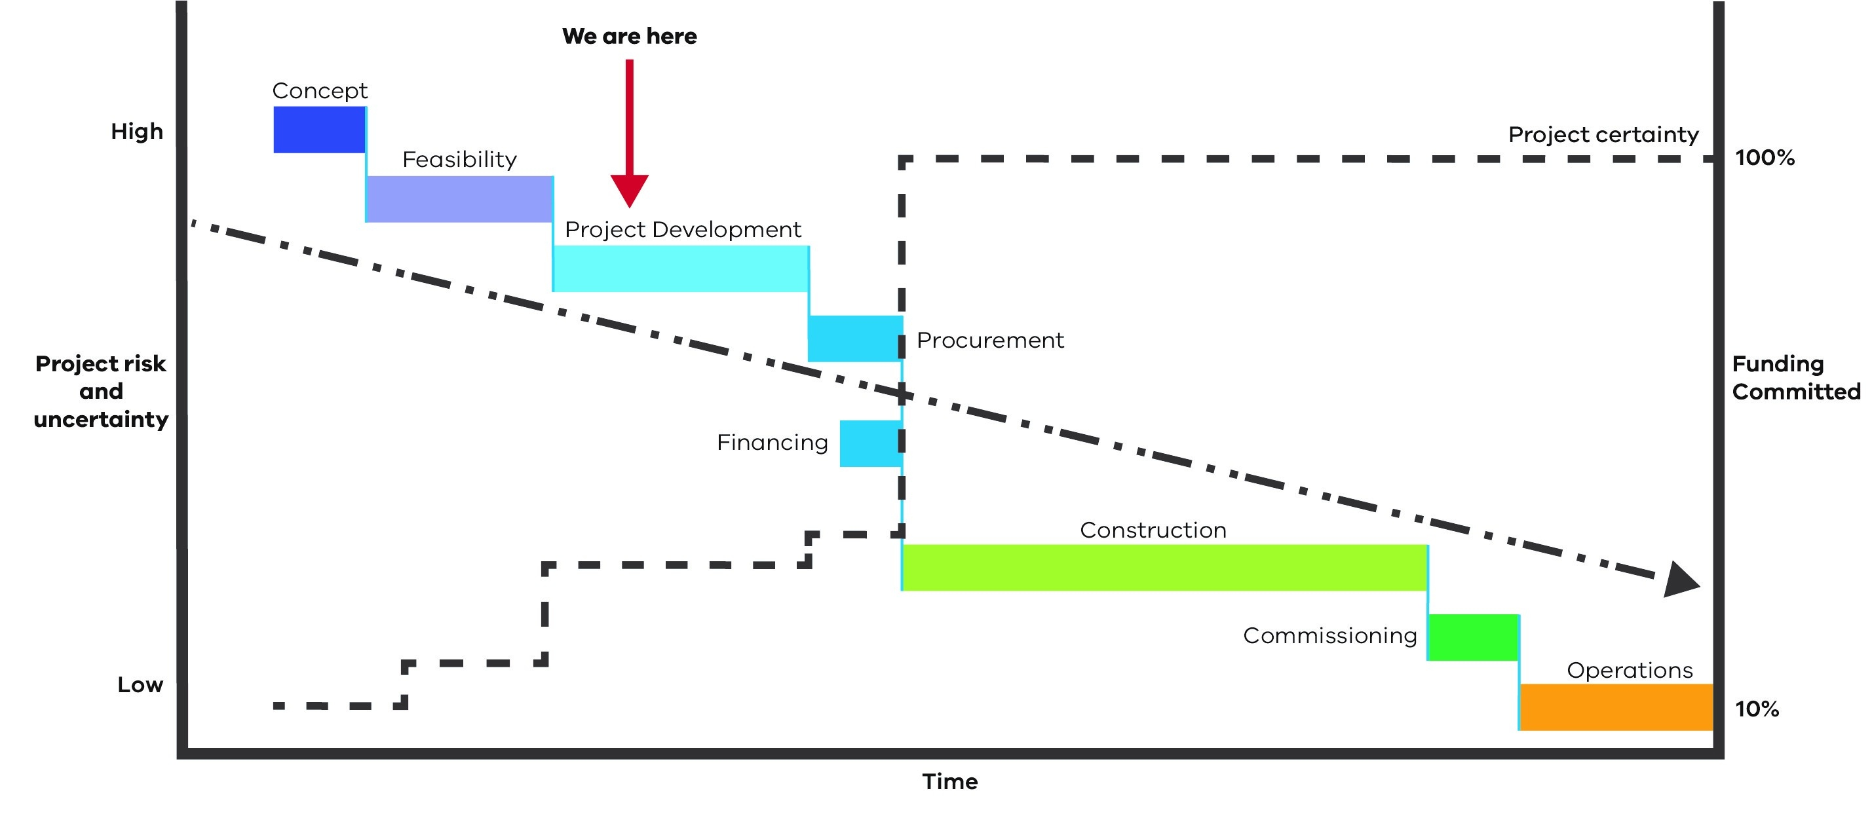
CarbonNet is in Stage 3
Project Development and Commercial Establishment

Slide 5
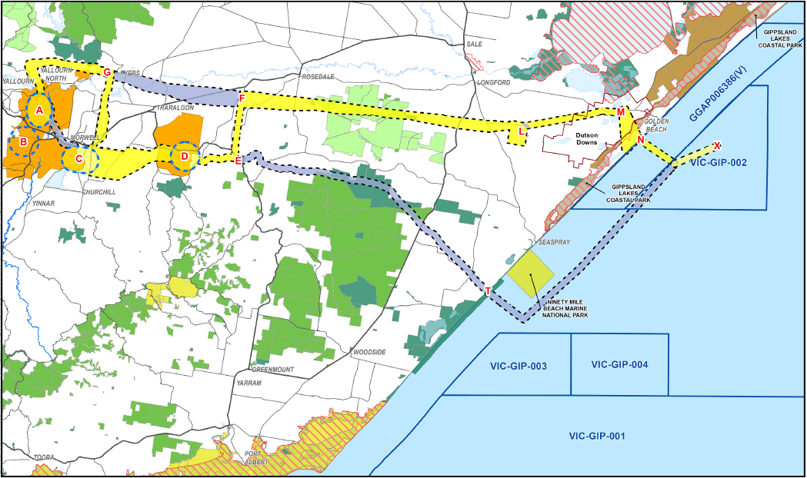

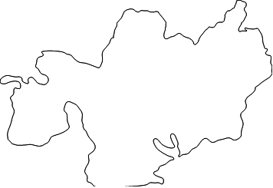

CarbonNet Stage 2 –
Feasibility Study Options

Slide 6
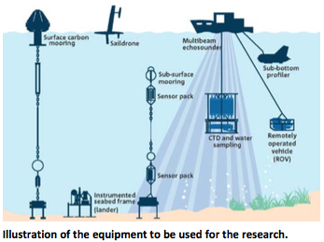
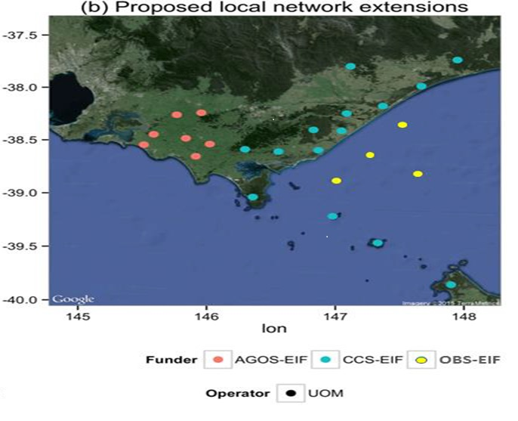
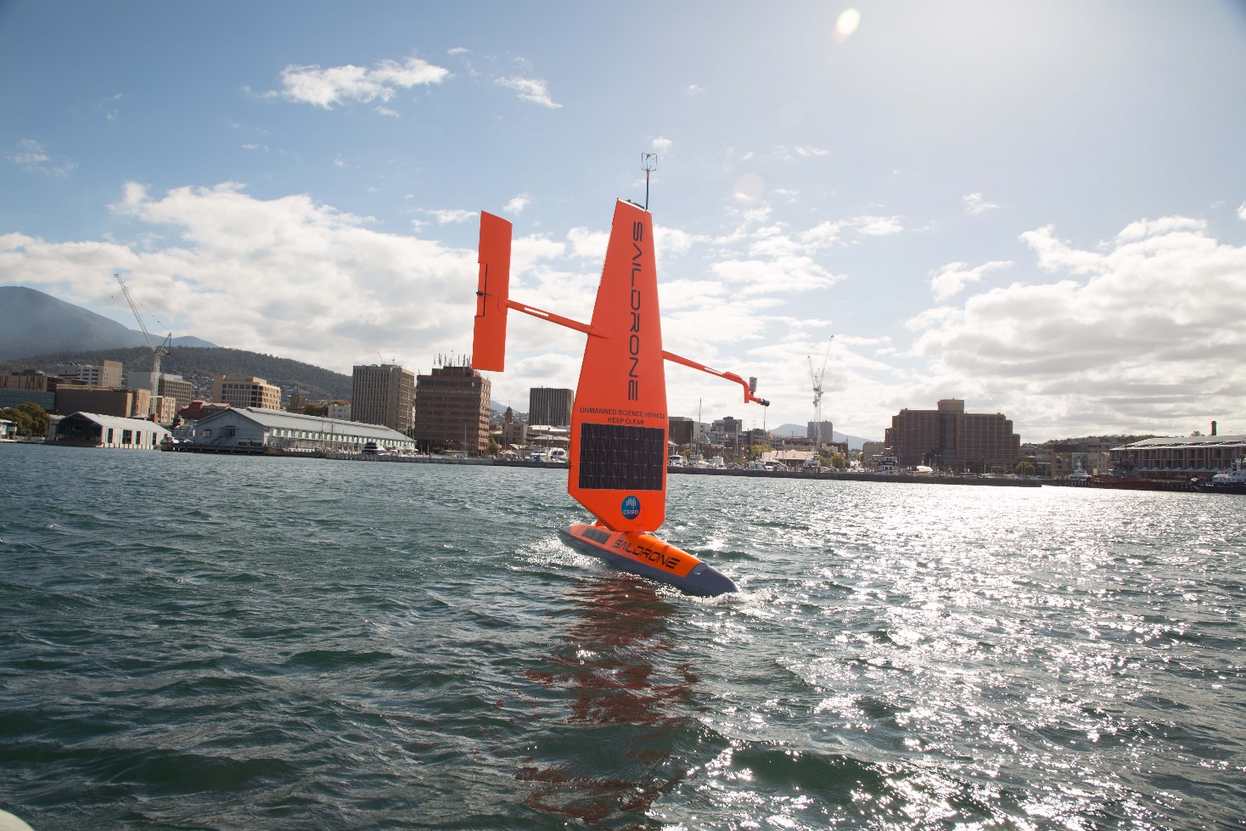
CarbonNet Current Stage 3 - Next Steps
Stakeholder and community engagement:
  supported by CO2CRC and CSIRO
  enewsletter, direct mail out, adverts
  briefings to key stakeholders and local media
  information sessions and CCS into schools
  community reference group, sentiment survey
GipNet validating environmental monitoring technologies:
  Commonwealth Education Investment fund assets
  Research led by CO2CRC with ANLEC R&D funding
  CSIRO, UoM, UoW equipment deployed

Slide 7
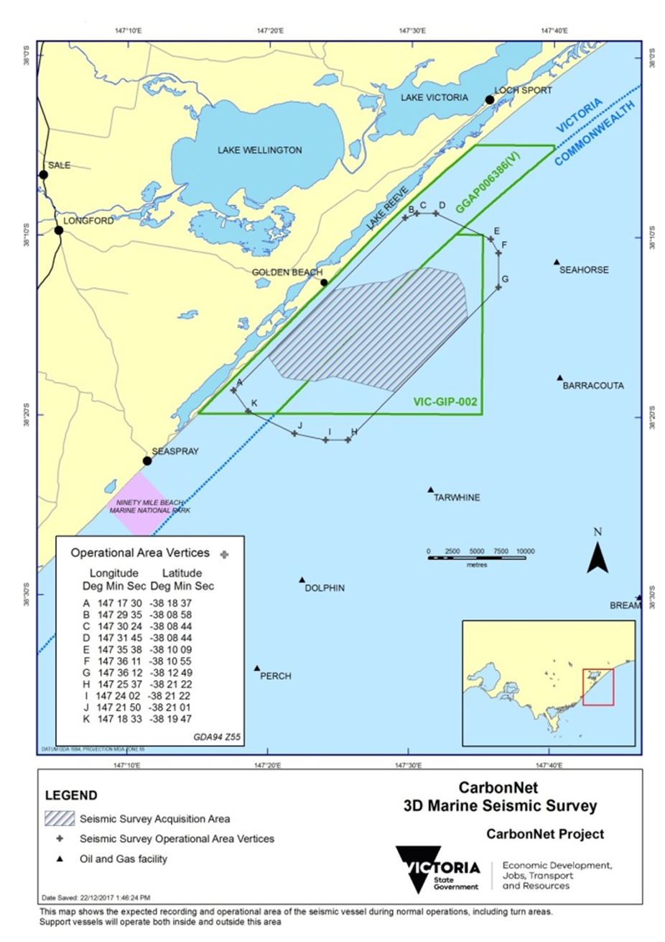
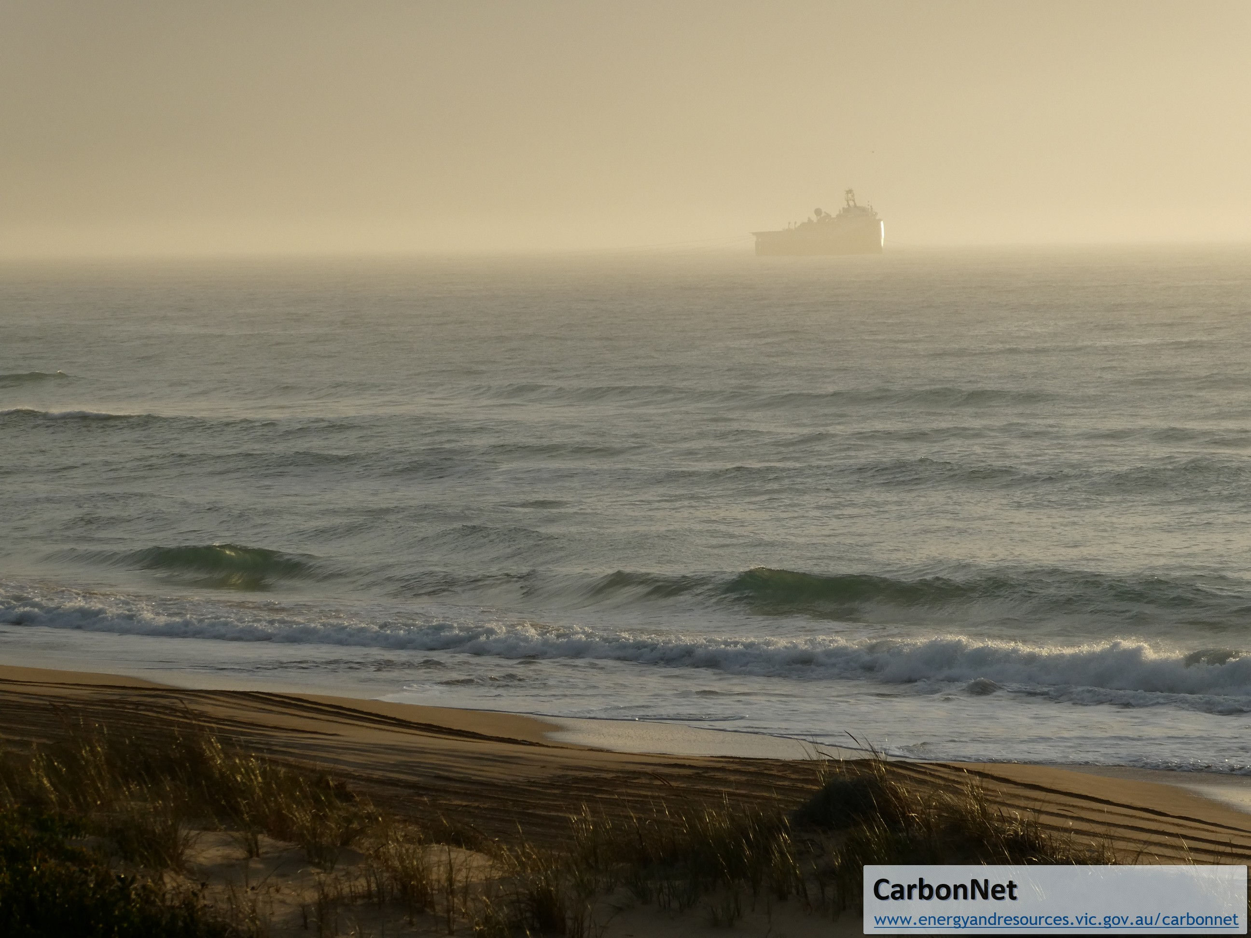
Pelican Storage Site Appraisal
Marine Seismic Survey - Feb 2018
Extensive stakeholder engagement
On time and budget, very high quality data, processing complete
Environmental monitoring (fisheries) completed with support of independent panel
Monitoring results show no impacts to fisheries from CarbonNet’s seismic survey

Slide 8
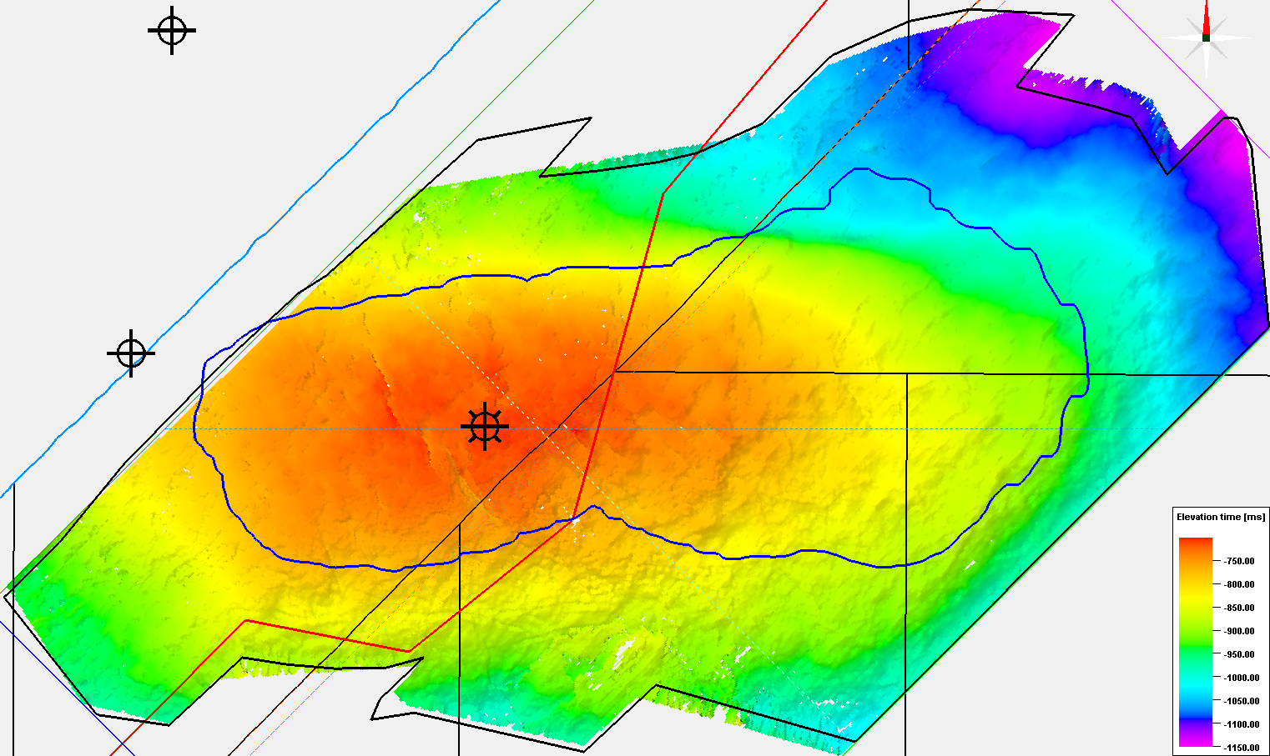
Seismic Interpretation: Structure – horizon close to top of seal
The new seismic data confirms the integrity of the Pelican structural closure
Detailed fault seal and facies mapping analyses informing an updated declaration of storage application
Reducing uncertainties, increasing confidence

Slide 9
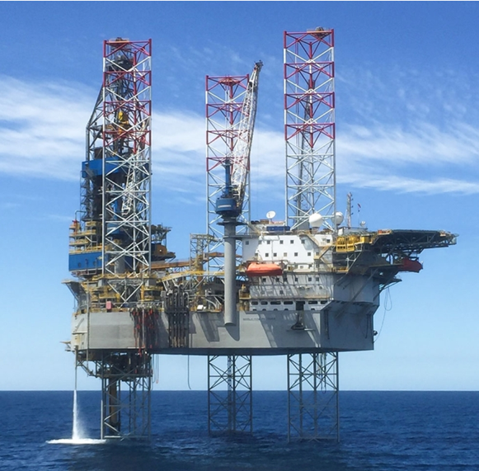
Pelican Storage Site Appraisal
Offshore Appraisal Well
Two Phases of Activity:
Geotechnical and Geophysical investigations (2019)
Drilling Appraisal Well (2019/20)
Offshore Appraisal Well:
Commonwealth waters, approximately 8 km offshore
>2 months operation
to collect rock samples and formation logs for validation of geology & uncertainty reduction
to inform an Injection License application
Environmental and Regulatory Approvals obtained:
NOPTA & NOPSEMA regulated
For each phase of activities
Informed by stakeholder consultation
Informed by risk and impact assessments
Noble’s Tom Prossor Jack Up Rig contracted

Slide 10
Commercialisation Pathway
  Term sheet negotiations with foundation customer commenced
  Global market soundings commenced in March 2019
  EOI for project developers and other customers planned mid 2019
  Declaration of Storage for Pelican in 2020
  Injection Licence for Pelican in 2021
  Transition to Private Sector in 2021
  Targeting CarbonNet FID in 2025

Slide 11
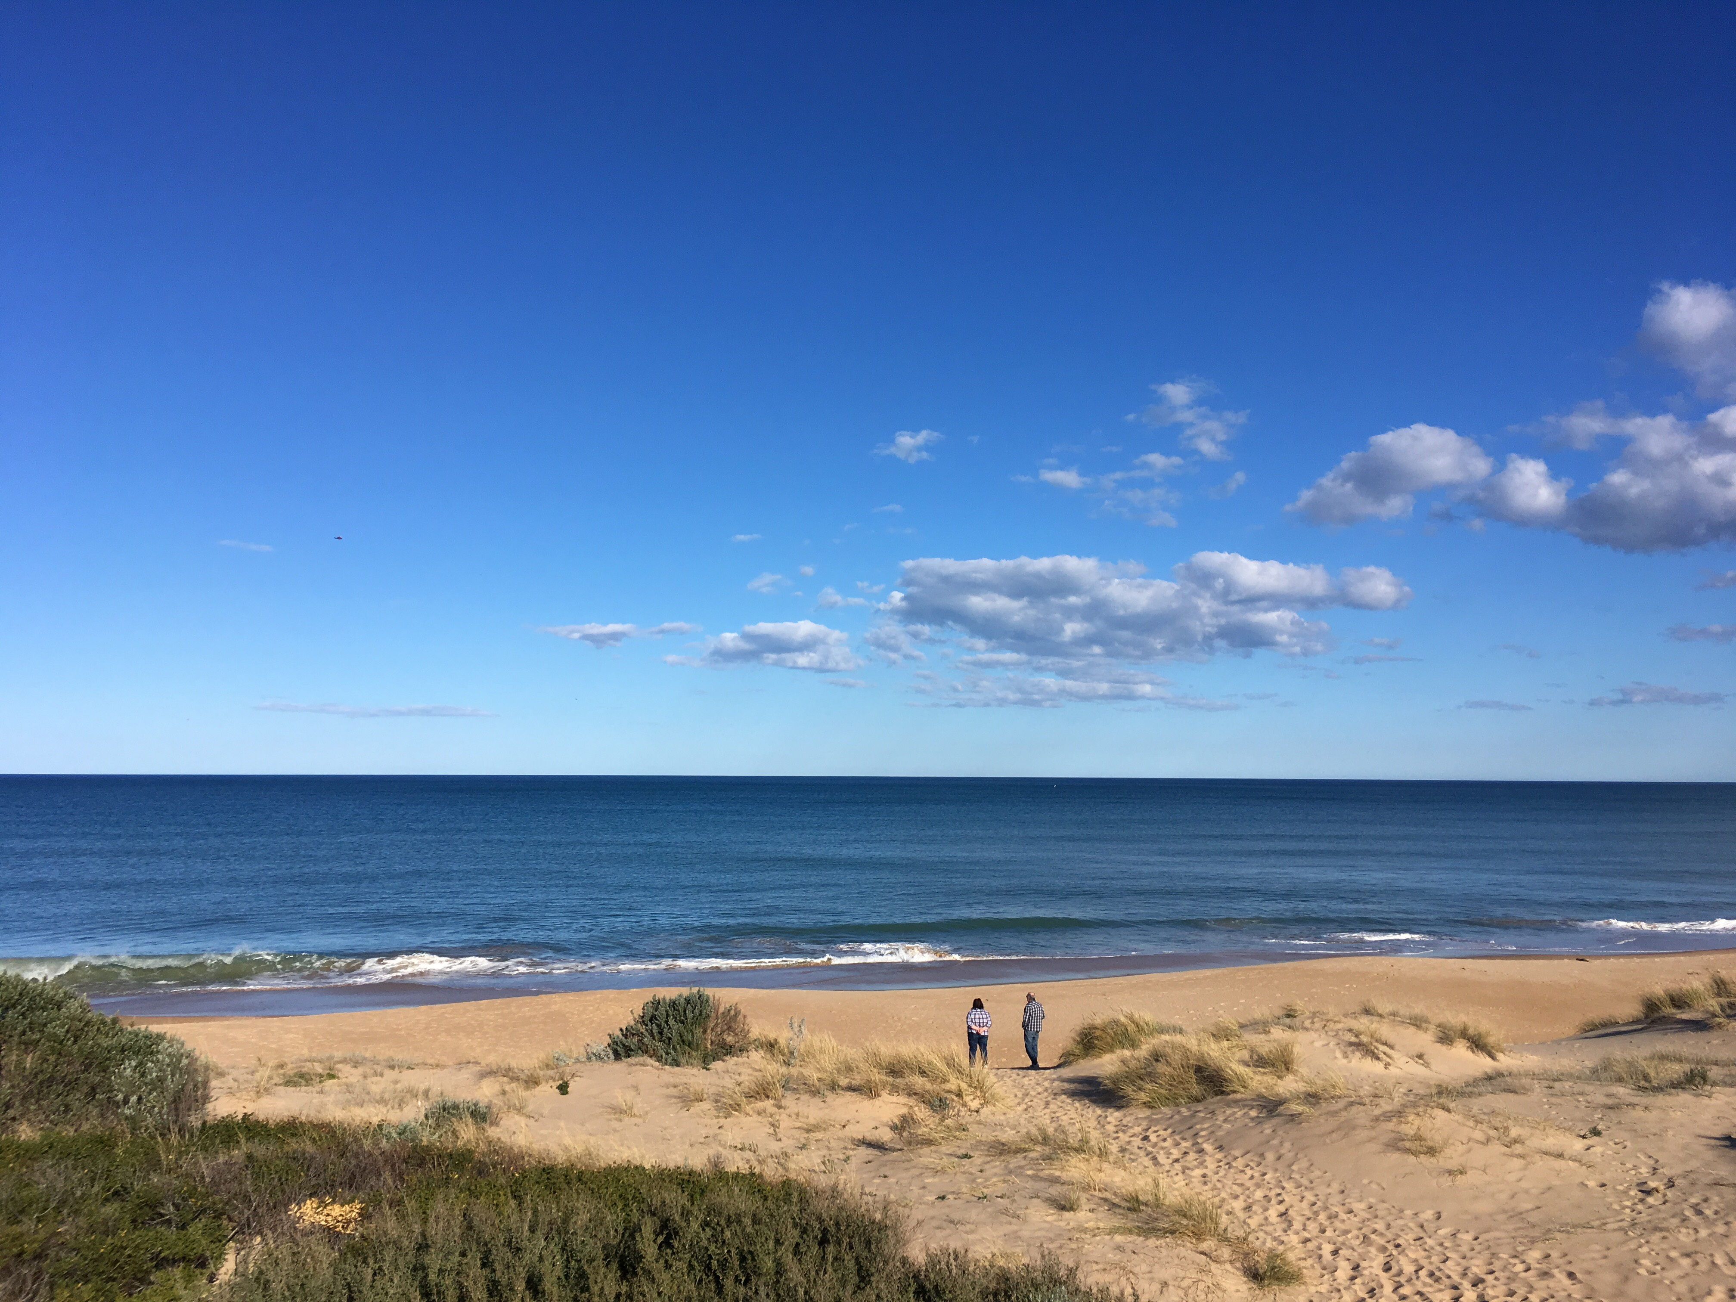
Contact CarbonNet:
W: www.earthresources.vic.gov.au/carbonnet
E: carbonnet.info@ecodev.vic.gov.au
P: 136 186

