Slide 1
Impact of Rising community expectations on climate change
2019 CCS Forum
Brisbane, Australia
31 May 2019
Alex Zapantis
General Manager - Commercial

Slide 2
Panel Members
Alex Zapantis, General Manager Commercial, GCCSI
Josh Cosgrave, Senior Adviser Low Emission Technology, MCA
Sybil Dixon, Senior Investment Analyst, UniSuper
Tomonori Tatsumi, Director, Japan Bank for International Cooperation (JBIC)

Slide 3
Divestment Campaign Launch: 2012
In 2012, 350.org and Bill McKibben launched the Fossil Free campaign calling on investors to “immediately freeze any new investment in fossil fuel companies, and divest from direct ownership and any commingled funds that include fossil fuel public equities and corporate bonds within 5 years.”

Slide 4
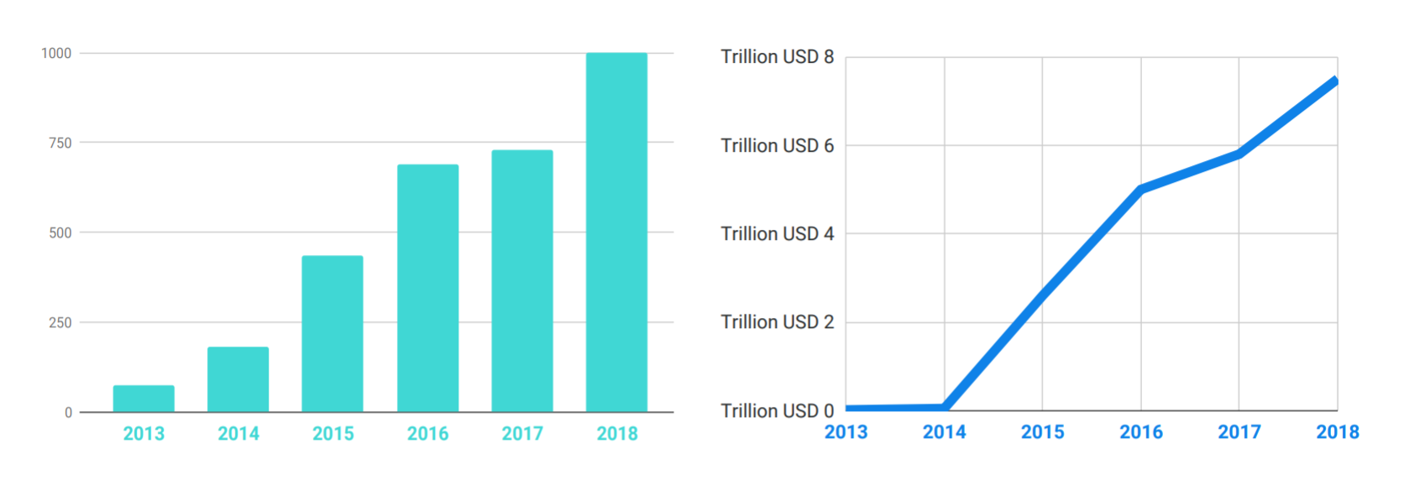
As of 21 January 2019, 1024 institutions have committed to divesting (full or partial) fossil fuel assets
Number of Institutional Divestment Commitments
Value of Assets under Management
Value of divestments ~USD40B
Source: https://gofossilfree.org/divestment/commitments/

Slide 5
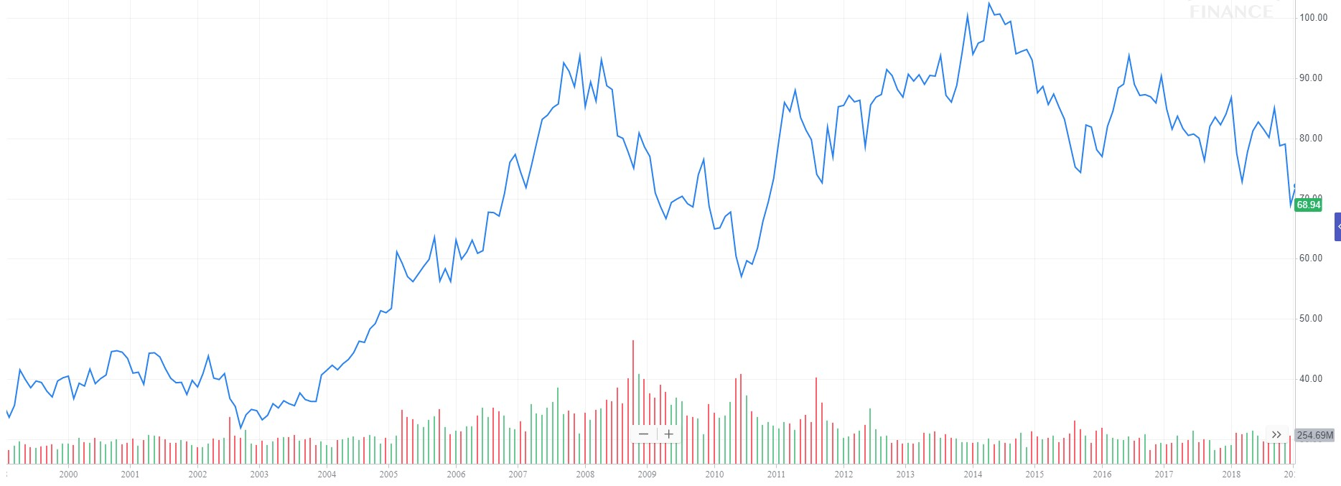
No apparent impact on Exxon share price
Individual divestment events
Exxon
December 1998 to
December 2018
Oil Price
Source: Indexmundi.com; Yahoo.finance.com
Hansen, T & Pollin, R 2018, Economics and Climate Justice Activism: Assessing the Fossil Fuel Divestment Movement, Political Economy Research Institute, University of Massachusetts Amherst, Working Paper Series # 462

Slide 6
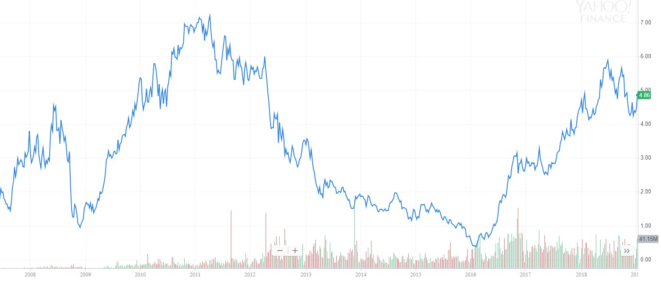
No apparent impact on Whitehaven coal share price
Whitehaven
Coal
Individual divestment events
December 2008 to
December 2018
Aus. Thermal
Coal Price
Source: Indexmundi.com; Yahoo.finance.com
Hansen, T & Pollin, R 2018, Economics and Climate Justice Activism: Assessing the Fossil Fuel Divestment Movement, Political Economy Research Institute, University of Massachusetts Amherst, Working Paper Series # 462

Slide 7
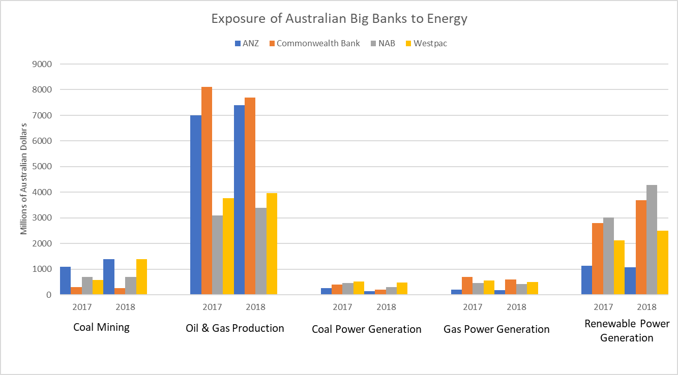
Australian Big Banks Increasing Exposure to Renewables
In 2018, Australian big banks total exposure
Coal: AUD4.9B
Renewables: AUD11.6B
Year | 2017 | 2018 |  | 2017 | 2018 |  | 2017 | 2018 |  | 2017 | 2018 |  | 2017 | 2018
AUDB | 2.68 | 3.77 |  | 21.98 | 22.46 |  | 1.65 | 1.13 |  | 1.94 | 1.71 |  | 9.08 | 11.57
Source: https://www.marketforces.org.au/big-four-banks-increase-fossil-fuel-exposure/

Slide 8
Divestment Campaign Conclusions:
The divestment campaign has had no material impact on the value of fossil fuel equities since it was launched in 2012.
The divestment campaign has not yet peaked – it is still growing.
There are some restrictions on debt finance for coal fired power stations and coal mine developments. Renewables are attracting a growing proportion of debt finance.
Significant indirect impacts
Stigmatisation of the fossil fuel industry
Adverse policy development/more difficult approvals & conditions
Increased litigation
Increase difficulty accessing resources (land, people)
Source: Hansen, T & Pollin, R 2018, Economics and Climate Justice Activism: Assessing the Fossil Fuel Divestment Movement, Political Economy Research Institute, University of Massachusetts Amherst, Working Paper Series # 462

Slide 9
Investigation of the link between CCS, ESG & financial performance
Underlying Hypothesis
Investment in CCS
Credit Ratings
?
WACC¹
?
?
?
ESG Risk/Performance
?
Financial Performance
ESG Ratings
1. Weighted Average Cost of Capital

Slide 10
Key Findings
Demand for information on ESG risk and performance is growing strongly.
ESG performance or risk assessment is now mainstream, and impacts credit ratings and the cost of capital.

Slide 11
Key Findings
The impact of CO₂ exposure and climate risk on assessments of ESG risk is rising. Ratings agencies consider:
CO₂ footprint in upstream or downstream value chain
Effectiveness of climate risk mitigation strategy and governance

Slide 12
Key Findings
CCS investments will positively influence ESG ratings, where they are;
material to revenues and/or
deliver a material reduction in carbon dioxide emissions to which the company is exposed and/or
are perceived to materially mitigate the company’s long term climate risk or transition risk

Slide 13
Thank you
globalccsinstitute.com

Slide 14
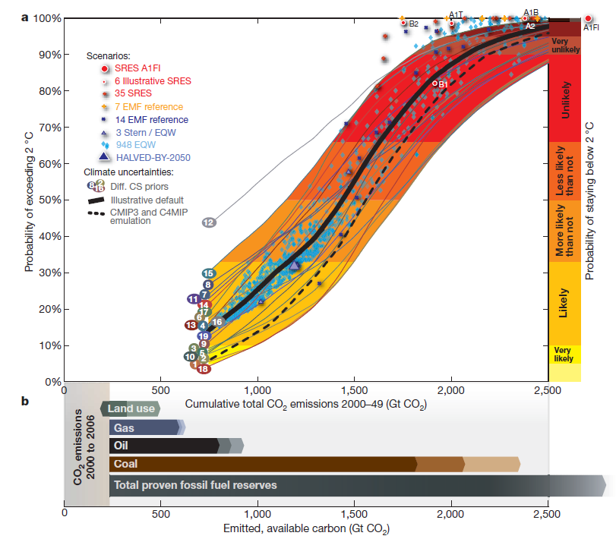
Divestment Campaign Evolution
2009: Meinshausen et al,
Carbon budget = 886Gt CO2 (80% probability)
Total proven reserves of fossil fuels = 2800Gt
2011: Carbon Tracker
Updated Meinshausen’s calculation
Introduced “Carbon Bubble”
2012: Bill McKibben, ‘Global warming’s terrifying new math’, RollingStone magazine
Declares fossil fuel industry “Public Enemy Number One”
Climate Elites
Financial Elites
General Public

Slide 15
Potential Impacts of a Divestment Campaign
Direct Impacts
Indirect Impacts
Reduced demand for shares
Stigmatisation
Increased cost of debt/equity
Decline in share price
Reduced ability to finance new capital expenditure due to lack or cost of debt finance or high discount rate
Erosion of political capital and social license to operate
Adverse policy and regulatory environment
Increased difficulty recruiting/retaining talent
Increased perception of risk - reduced expectation of future profits
Increased difficulty accessing resources/land
Source: Adapted from Ansar, A. Caldecott, B. &Tilbury, J 2013, Stranded assets and the fossil fuel divestment campaign: what does divestment mean for the valuation of fossil fuel assets?, Smith School of Enterprise and the Environment, Stranded Assets Program, University of Oxford

Slide 16
Value of Divestments: approximately $40 billion
A detailed analysis of the divestment commitments using data from March 2018:
796 institutions with a total of $6.5 trillion in assets under management have made full or partial divestment commitments
Total value of divestment commitments is $36.1 billion which is approximately
0.6% of the value of their assets under management
0.7% of the value of all fossil fuel companies
Source: Hansen, T & Pollin, R 2018, Economics and Climate Justice Activism: Assessing the Fossil Fuel Divestment Movement, Political Economy Research Institute, University of Massachusetts Amherst, Working Paper Series # 462

Slide 17
Method
Phase One: Literature Review
Phase Two: Interviews
Two Ratings Agencies
One Bank
One company with a large CO₂ footprint

Slide 18
Econometric Analysis of the 11 largest Oil Divestment Events (78% of total value of divestments) to assess the impact of specific divestment events on oil share prices
Results for Oil/Gas:
In 4 of 6 regression analyses: divestment events had no statistically significant impact on oil share prices.
In 2 of 6 regression analyses: divestment events had a statistically significant positive impact on Exxon’s share price.
Conclusion of Hansen et al.:
Oil share prices have not been negatively affected by any single divestment event or by the combined impact of all the divestment events included in the model.
Source: Hansen, T & Pollin, R 2018, Economics and Climate Justice Activism: Assessing the Fossil Fuel Divestment Movement, Political Economy Research Institute, University of Massachusetts Amherst, Working Paper Series # 462

Slide 19
Econometric Analysis of the 12 largest Coal Divestment Events (78% of total value of divestments) to assess the impact of specific divestment events on coal share prices
Results for coal:
Individual divestment events produce a mixture of statistically significant negative and positive impacts on coal share prices.
Conclusion of Hansen et al.:
There is weak evidence that divestment events have contributed to lowering some coal share prices.
Note that the study focused on US coal equities, that have been significantly impacted by loss of market share due to low gas prices, and have less access to Asian markets.
Source: Hansen, T & Pollin, R 2018, Economics and Climate Justice Activism: Assessing the Fossil Fuel Divestment Movement, Political Economy Research Institute, University of Massachusetts Amherst, Working Paper Series # 462

Slide 20
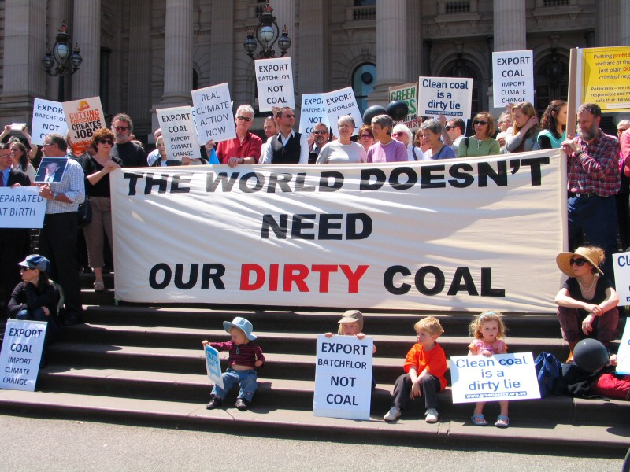
Coal is the primary target of divestment
A detailed analysis of the divestment commitments using data from March 2018:
Only $11.5 billion of the total of $36.1 billion in divestment commitments are for full divestment from all fossil assets (i.e. coal, oil and gas)
All divestment commitments include coal
Source: Hansen, T & Pollin, R 2018, Economics and Climate Justice Activism: Assessing the Fossil Fuel Divestment Movement, Political Economy Research Institute, University of Massachusetts Amherst, Working Paper Series # 462

Slide 21
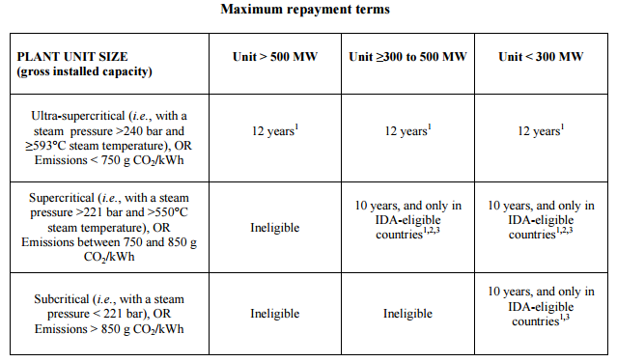
Debt finance for coal projects is being restricted
OECD Export Credit Policy on Coal fired power stations
November 2015
Decreasing thermal efficiency
Countries with < 90% electrification rate (e.g. India, African nations, ASEAN)
Source: OECD 2015, Sector Understanding on Export Credits For Coal-Fired Electricity Generation Projects, 27 November 2015

Slide 22
Debt finance for coal projects is being restricted
World Bank | Will only support coal power projects in rare circumstances where there is no viable alternative
European Bank for Reconstruction and Development | Coal plant must: Be the least carbon-intensive of the realistically available options use best available techniques (BAT)…. in order to ensure that it achieves the lowest feasible carbon intensity comply with the IED (EU Industrial Emissions Directive, (2010/75/EU) requirements in relation to carbon capture and storage readiness.
Société Générale, Crédit Agricole, BNP Paribas, Barclays, Morgan Stanley, Credit Suiss, Deutsch Bank, HSBC… | Will not lend to Abbot Point coal terminal expansion
Citigroup, Goldman Sachs, JPMorgan Chase… | Will not finance Adani Carmichael project

Slide 23
Question:
Is support for CCS an effective risk mitigation strategy for companies with a large carbon dioxide footprint?

Slide 24
Key Findings
ESG investments must meet expectations of financial return.
Material investments in CCS must be NPV positive at the appropriate discount rate.
Government policy and regulation play a critical role in determining the financial return for climate related ESG investments, and thus also play a critical role in how those investments are considered by ratings agencies.

Slide 25
Key Findings
The underlying hypothesis was incorrect
Investment in CCS
Credit Ratings
✔
WACC¹
?
✔
?
✔
ESG Risk/Performance
✔
Financial Performance
ESG Ratings

Slide 26
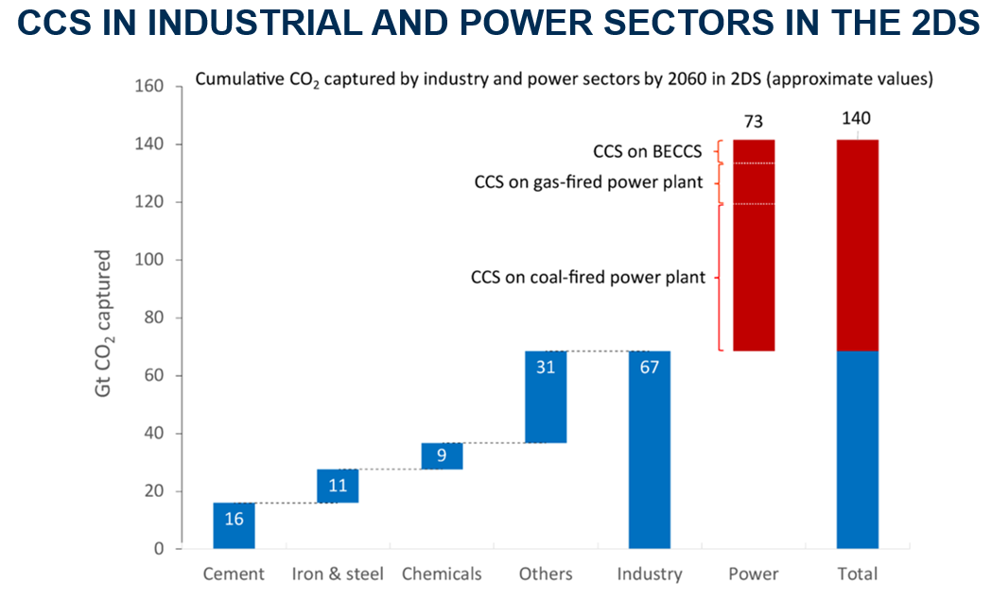
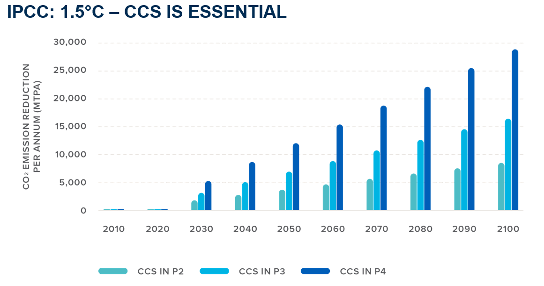
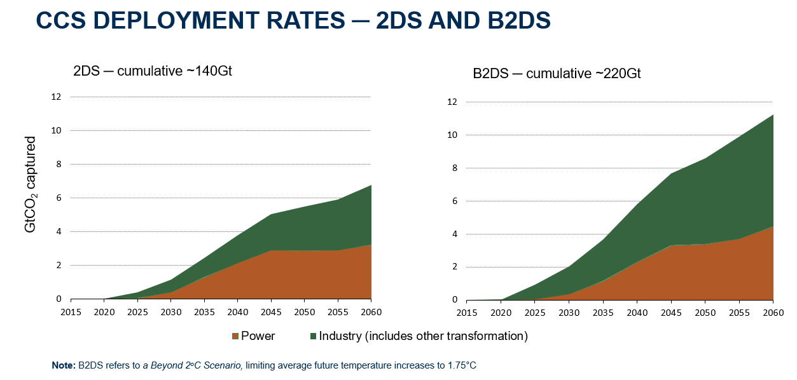
CCS is required to meet targets…
…but is there a business case for investment today?

Slide 27
Investigation direct of link between CCS, ESG & financial performance
Environment Social Governance (ESG) Risk
Ratings agencies now publishing ESG Ratings of Companies
Use ESG to explore the business case for investing in or supporting CCS

Slide 28
Summary of Findings
Demand for information on ESG risk and performance is growing strongly, driven by:
Advocacy by environmental NGOs
Investors concerned about ESG risks affecting return on investment

Slide 29
Summary of Findings
ESG performance or risk assessment is now mainstream, and impacts credit ratings and the cost of capital.
Poor performance or high risk increases cost of capital
ESG Ratings are not yet validated, or sufficiently granular to be broadly accepted as reliable predictors of the cost of capital or of future financial performance.
Lack of standardisation

Slide 30
Summary of Findings
Current investment in CCS is similar to investments in renewable technologies a decade ago; immaterial in financial terms and thus of no significant direct consequence to ESG Ratings. However, the expectation is that as investment in CCS grows and becomes material, its impact will follow a similar path to investments in renewable technologies, delivering a clear positive impact on ESG ratings.

Slide 31
Overall Conclusions
Expectations of civil society for action to mitigate climate change are rising. Climate related risk for fossil fuel industries is expected to continue to rise.
Direct financial impacts of the divestment campaign are currently insignificant, although weak evidence of immaterial negative impact on the coal sector is emerging.
Indirect impacts of the stigmatization of fossil fuel related industries are rising, and are influencing ESG assessments/ratings by credit rating agencies.
Immaterial (to the balance sheet) investments in CCS to mitigate climate risk are justified to enhance reputation, deliver on values, implement long term risk management strategy etc. However, only significant investments that deliver material reductions in CO₂ footprint will positively influence ESG assessments and WACC.
Material investments in CCS must be NPV positive – improving ESG performance or social licence to operate is insufficient.
Government policy and regulation is critical to enabling material private sector investment in CCS.

