Slide 1

APAC CCS Forum
Low Emissions Intensity Cement and Lime (LEILAC) Project
Capturing CO₂ from Lime and Cement Production
Dr Phil Hodgson
CEO and MD Calix Limited

Slide 2
IMPORTANT NOTICE AND DISCLAIMER
This presentation has been prepared by Calix Limited (ABN 36 117 372 540) (“Company”).
SUMMARY INFORMATION
This presentation contains summary information about the Company and its subsidiaries (“Calix”) and their activities current as at 22nd August, 2017. The information in this presentation is a general background and does not purport to be complete.
NOT FINANCIAL PRODUCT ADVICE
This presentation is for information purposes only and is not a prospectus, product disclosure statement or other offer document under Australian law or the law of any other jurisdiction. This presentation is not financial product or investment advice, a recommendation to acquire Calix securities or accounting, legal or tax advice. It has been prepared without taking into account the objectives, financial or tax situation or needs of individuals. Before making an investment decision, prospective investors should consider the appropriateness of the information having regard to their own objectives, financial and tax situation and needs and seek legal and taxation advice appropriate to their jurisdiction. Calix is not licensed to provide financial product advice in respect of Calix securities. Cooling off rights do not apply to the acquisition of Calix securities.
FINANCIAL DATA
All dollar values are in Australian dollars ($ or A$) and financial data is presented as at or for the year ended 30 June 2017 unless stated otherwise.
Past performance
Past performance information given in this presentation is given for illustrative purposes only and should not be relied upon as (and is not) an indication of the Company's views on its future financial performance or condition. Investors should note that past performance, including past share price performance, of Calix cannot be relied upon as an indicator of (and provides no guidance as to) future Calix performance including future share price performance.
FUTURE PERFORMANCE
This presentation contains certain "forward-looking statements". The words "expect", "anticipate", "estimate", "intend", "believe", "guidance", "should", "could", "may", "will", "predict", "plan" and other similar expressions are intended to identify forward-looking statements. Indications of, and guidance on, future earnings and financial position and performance are also forward-looking statements. Forward-looking statements, opinions and estimates provided in this presentation are based on assumptions and contingencies which are subject to change without notice, as are statements about market and industry trends, which are based on interpretations of current market conditions.
Forward-looking statements, including projections, guidance on future earnings and estimates are provided as a general guide only and should not be relied upon as an indication or guarantee of future performance. Such forward-looking statements are by their nature subject to significant uncertainties and contingencies and are based on a number of estimates and assumptions that are subject to change (and in many cases are outside the control of Calix and its directors) which may cause the actual results or performance of Calix to be materially different from any future results or performance expressed or implied by such forward-looking statements. The forward-looking statements should not be relied on as an indication of future value or for any other purpose.. No representation, warranty or assurance (express or implied) is given or made in relation to any forward-looking statement by any person (including the Company). In particular, no representation, warranty or assurance (express or implied) is given that the occurrence of the events expressed or implied in any forward-looking statements in this presentation will actually occur. Actual results, performance or achievement may vary materially from any projections and forward-looking statements and the assumptions on which those statements are based. The forward-looking statements in this presentation speak only as of the date of this presentation. Subject to any continuing obligations under applicable law, the Company disclaims any obligation or undertaking to provide any updates or revisions to any forward-looking statements in this presentation to reflect any change in expectations in relation to any forward-looking statements or any change in events, conditions or circumstances on which any such statement is based. Nothing in this presentation will under any circumstances create an implication that there has been no change in the affairs of Calix since the date of this presentation.
INVESTMENT RISK
An investment in Calix securities is subject to investment and other known and unknown risks, some of which are beyond the control of Calix, including possible delays in repayment and loss of income and principal invested. Calix does not guarantee any particular rate of return or the performance of Calix, nor does it guarantee the repayment of capital from Calix or any particular tax treatment. Persons should have regard to the risks outlined in this presentation and appendices.
NOT AN OFFER
This presentation is not and should not be considered an offer or an invitation to acquire Calix securities or any other financial products and does not and will not form any part of any contract for the acquisition of Calix securities.
This presentation does not constitute an offer to sell, or the solicitation of an offer to buy, any securities in the United States or to, or for the account or benefit of, any 'U.S. person‘ (as defined in Regulation S under the U.S. Securities Act (“U.S. Person”)). The new shares to be offered and sold in the placement (“Offer”) have not been, and none of them will be, registered under the U.S. Securities Act or the securities laws of any state or other jurisdiction of the United States. In addition, Calix has not been, and will not be, registered under the U.S. Investment Company Act of 1940, as amended (the "U.S. Investment Company Act") in reliance on the exception from the definition of “investment company” provided by Section 3(c)(7) thereof. The New Shares to be offered and sold in the Offer may not be offered and sold to, directly or indirectly, any person in the United States or any person that is, or is acting for the account or benefit of, a U.S. Person except pursuant to an exemption from, or in a transaction not subject to, the registration requirements of the U.S. Securities Act and applicable U.S. state securities laws and pursuant to an exception from the registration requirements of the U.S. Investment Company Act provided by Section 3(c)(7) thereof. This presentation may not be distributed or released in the United States or to any U.S Person. The distribution of this presentation in other jurisdictions outside Australia may also be restricted by law and any such restrictions should be observed. Any failure to comply with such restrictions may constitute a violation of applicable securities laws. Offers in Australia of the shares are only being made to persons who are “sophisticated investors” or “professional investors” (within the meaning of section 708(8) and section 708(11) of the Australian Corporations Act (Act) respectively) or otherwise pursuant to one or more exemptions under Section 708 of the Act so that it is lawful to offer the shares in Australia without disclosure to investors under Part 6D.2 of the Act.
NO ADVICE
None of Calix’s respective advisers or any of their respective affiliates, related bodies corporate, directors, officers, partners, employees and agents, have authorised, permitted or caused the issue, submission, dispatch or provision of this presentation and none of them makes or purports to make any statement in this presentation and there is no statement in this presentation which is based on any statement by any of them. For the avoidance of doubt, the advisers and their respective affiliates, related bodies corporate, directors, officers, partners, employees and agents have not made or purported to make any statement in this presentation and there is no statement in this presentation which is based on any statement by any of them. To the maximum extent permitted by law, Calix and its advisers and their respective affiliates, related bodies corporate, directors, officers, partners, employees and agents exclude and disclaim all liability, for any expenses, losses, damages or costs incurred by you as a result of your participation in the Offer and the information in this presentation being inaccurate or incomplete in any way for any reason, whether by negligence or otherwise. To the maximum extent permitted by law, Calix and its advisers and their respective affiliates, related bodies corporate, directors, officers, partners, employees and agents make no representation or warranty, express or implied, as to the currency, accuracy, reliability or completeness of information in this presentation and Calix’s advisers and its affiliates, related bodies corporate, directors, officers, partners, employees and agents, take no responsibility for any part of this presentation or the Offer. Calix and Calix’s advisers and their affiliates, related bodies corporate, directors, officers, partners, employees and agents make no recommendations as to whether you or your related parties should participate in the Offer nor do they make any representations or warranties to you concerning the Offer, and you represent, warrant and agree that you have not relied on any statements made by any of them in relation to the Offer and you further expressly disclaim that you are in a fiduciary relationship with any of them. Statements made in this presentation are made only as the date of this presentation. The information in this presentation remains subject to change without notice. Calix reserves the right to withdraw the Offer or vary the timetable for the Offer without notice.

Slide 3
Cement and Lime Processing Produces Unavoidable CO₂ Emissions
  Around 60% of total CO₂ emissions from the cement and lime industries are released directly, and unavoidably, from the processing of limestone:
    CaCO₃ CaO + CO₂
CCS will need to be applied to 59% of European cement plants to meet the EU’s emission reduction target
The cement and lime industries are under intense competitive and cost pressures
Together, cement and lime are responsible for between 5 to 7 % of global man-made CO₂ emissions, and are the largest industrial source of CO₂
Heat
1 Tonne
Limestone
~0.56 Tonne
Lime
~0.44 Tonne
CO₂

Slide 4
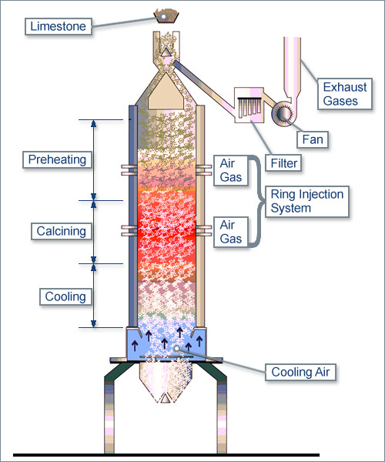
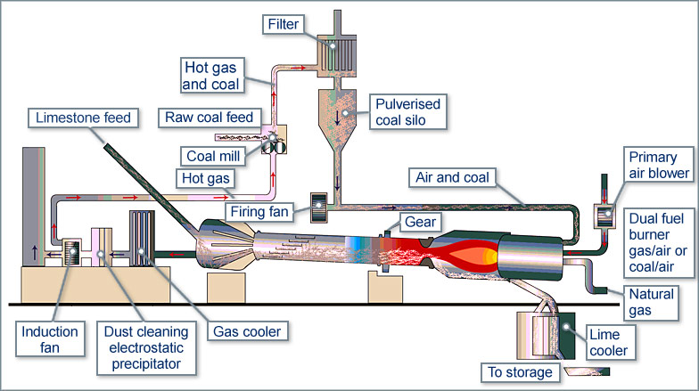
Lime is one of the most important raw materials…
Rotary kiln for
lime production*
  Lime is used in steel manufacture, food and beverage, water treatment, construction, and numerous manufacturing and environmental applications
Shaft kiln for lime production*
*Images courtesy of EULA www.eula.eu

Slide 5
Cement production is 10-fold that of lime, and typically of higher complexity…
Raw Cement Meal
Flue
(mostly limestone)
Stack
  Typical energy use 5 MJ / kg Cement
  Typical wholesale price €60 (USD 67) to €80 (USD 90) per metric tonne
  The most advanced CO₂ abatement technologies include Amine and Oxyfuel, with integrated and end-of-pipe Calcium Looping, Chilled Ammonia and Membrane Assisted CO₂ Liquefaction also being investigated
14 to 33 %
Filter /
CO
ESP /
2
De
-
SOx
Pre
-
Heater
Tower
  CaCO₃ CaO + CO₂
Gas flow
Clinker
Rotary Kiln
Cooler
Solids flow
(clinkering)
Cement Clinker

Slide 6
Amine (“end of pipe”) is one solution for cement CO₂ emissions…
Raw Cement Meal
(mostly limestone)
Filter / ESP
De
-
SOx
  Advantages*
  Ease of Retrofit
  Disadvantages*
  Cost (estimated €80 (USD 90) / T CO₂ avoided)
  Energy (estimated 7 MJ / kg CO₂ avoided)
Pre
-
Flue
Heater
Stack
Tower
Amine
System
CO₂
Gas flow
compression
Clinker
and
Rotary Kiln
Cooler
Solids flow
storage
(clinkering)
Cement Clinker
*Comparison of Technologies for CO₂ Capture from Cement Production—Part 1: Technical Evaluation and Part 2: Cost Analysis Energies 2019, 12(3), 559; https://doi.org/10.3390/en12030559

Slide 7
“Oxyfuel” is potentially lower cost…
Raw Cement Meal
(mostly limestone)
  Advantages*
  Cost (estimated €42 (USD 47) / T CO₂ avoided)
  Energy (estimated 1.63 MJ / kg CO₂ avoided)
  Disadvantages*
  Less easy to retrofit
  Air leakage / ingress
Filter / ESP
De
-
SOx
Air
Separation
Unit
Pre
-
Flue
Heater
Stack
Tower
Amine
System
Or CO₂ Processing Unit
Pure O
2
CO
2
Gas flow
compression
Clinker
and
Rotary Kiln
Cooler
Solids flow
storage
(clinkering)
Cement Clinker
*Comparison of Technologies for CO₂ Capture from Cement Production—Part 1: Technical Evaluation and Part 2: Cost Analysis Energies 2019, 12(3), 559; https://doi.org/10.3390/en12030559

Slide 8
Calix “Direct Separation” is potentially even lower cost…
  Advantages
  Produces pure CO₂ stream for no theoretical thermal penalty
  Can be easily retrofitted in modules (eg 20% of throughput at a time)
  Cost and Energy analysis being determined as part of Project LEILAC
  Easy to electrify
  Disadvantages
  Process CO₂ only (ie 60% of emissions) – for 100% will need fuel-side capture
Raw Cement Meal
Flue
(mostly limestone)
Stack
Filter /
ESP /
De
-
SOx
Pure CO
2
compression
Pre
-
Heater
and storage
Tower
Gas flow
Clinker
Rotary Kiln
Cooler
Solids flow
(clinkering)
Cement Clinker

Slide 9
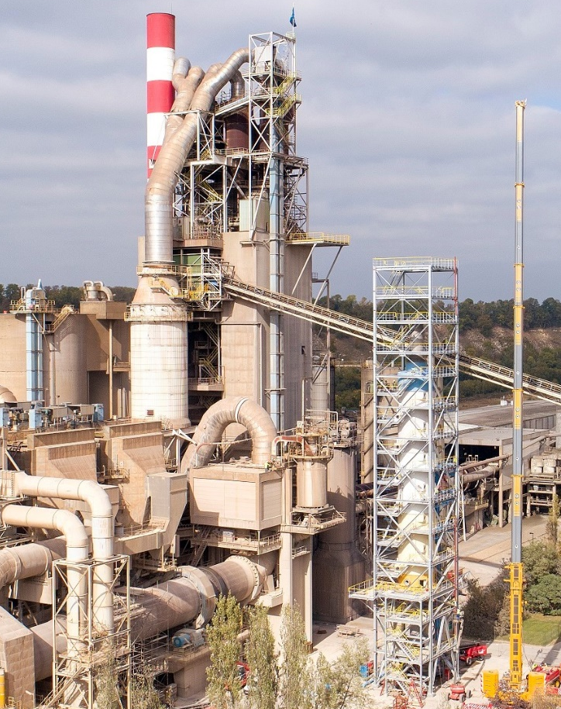










Project LEILAC (Low Emissions Intensity Lime and Cement) is piloting Direct Separation
Consortium:
Pilot plant 10 tph in Lixhe, Belgium
Project commenced January 2016
Construction and commissioning finalised May 2019
Test runs through to end 2020
€21m (USD 23.5m) project funded 57% by European Commission
This project has received funding from the European Union’s Horizon 2020 research and innovation programme under grant agreement No 654465
LEILAC Pilot in Lixhe, Belgium
CO₂ Released
Direct Separation Schematic
Product Accumulation
Nat Gas

Slide 10
Project LEILAC is on-time and on-budget…
2016 | 2017 | 2018 | 2019 | 2020
Pre-FEED and FEED
Detailed design and Pilot construction
Operations and testing
MS1
Pre-FEED Decision
Oct 2016
MS2 Final Investment decision
Jul 2017
MS3 Construction complete
Apr 2019
MS4 Verification complete
Dec 2020
MS5 Roadmap
The pilot has been built on budget and on schedule
Commissioning is complete and “fingerprinting” runs are underway

Slide 11
Construction Video

Slide 12
Project LEILAC will run until end-2020 to fully assess the technology…
Measurements
Calcination level
Surface area
Output reactivity
Energy input
CO2 quality & quantity
Retention time
Heat transfer efficiency
Tube corrosion
Insulation wear & tear
Separation efficiency
Scaling
Creep
A plan for measurement and observation of the plant is in place
An experimental matrix has been developed in collaboration with other partners

Slide 13
Direct Separation technology will require scale-up for addressing cement CO2 emissions….
1
2
3
LEILAC 1
“LEILAC 2”
TECHNICAL OBJECTIVES | Input feed capacity of 10 tph of cement meal, or 8 tph limestone. Efficiently capture over 95% of CO₂ process emissions, and verify that pure CO₂ can be captured. Evaluate and mitigate the major scale-up technical risks. Confirm that the end cement and lime products are not negatively impacted. Life Cycle Analysis Techno-economic analysis
DISSEMINATION | Disseminate data and findings which support the anticipated performance and cost of full-scale application. Share knowledge with public, industry, policy-makers, peer projects, scientific community. Establish a roadmap for the cement and lime industry.
Modular, multi-tube, fuel agnostic integrated demonstration
Technology effectively “de-risked”
Commercial
roll-out

Slide 14
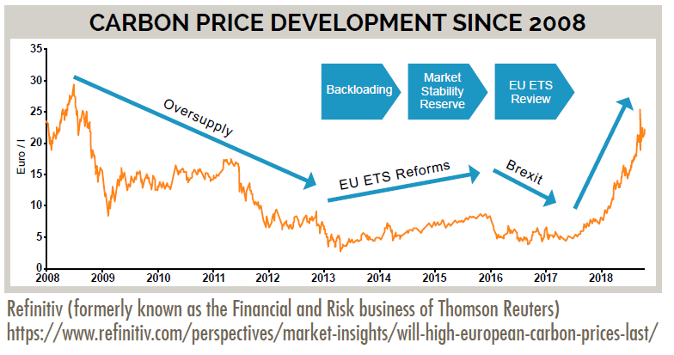
Key Factors for fast innovation on cement and lime CO₂ mitigation in Europe…
CONSISTENT POLICY: Phase 4 of the EU’s CO₂ emissions reduction directive is starting in 2021 – accelerating the reduction in “free” CO₂ allowances
INNOVATION SUPPORT: EU Innovation programs for industrial CO₂ reduction – multiple technology options being pursued
COLLABORATIVE NETWORKS: Increased activity in the European cement and lime industry in CO₂ reduction technologies
European Union Emissions Trading Scheme - “EU ETS”

Slide 15


