Slide 1
The Hydrogen Energy Supply Chain （HESC) Project
The APAC CCS Forum (6th) 2019
Sky Room, Brisbane Convention & Exhibition Centre,
Brisbane, Queensland, Australia
31 May 2019
Mr Yasushi Yoshino
Deputy Senior Manager
Kawasaki Heavy Industries, Ltd.

Slide 2
Contents
Japan’s Basic Hydrogen Strategy
KHI’s hydrogen vision and capabilities
Hydrogen Energy Supply Chain (HESC) Project
The HESC Project and Carbon Capture and Storage (CCS)
Closing remarks

Slide 3
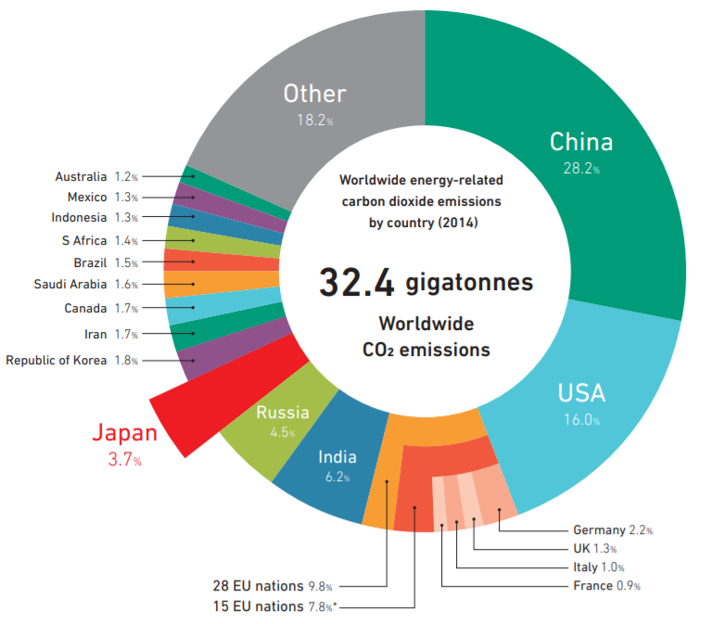
1. Japan’s Basic Hydrogen Strategy
Rationale for a Japanese hydrogen strategy
Japan is facing real challenges regarding energy security and emissions reductions, subsequent to the Fukushima nuclear accident in 2011 and Paris climate targets.
Japan depends on overseas fossil fuels for ~94% of its primary energy supply¹ and accounts for ~3.7% of worldwide CO2 emissions².
6-7%
Japan’s energy self-sufficiency rate (2nd lowest among OECD countries)¹
94%
Japan’s dependence on overseas fossil fuels for its primary energy supply¹
¹ Basic Hydrogen Strategy, Ministry of Economy, Trade and Industry (METI)
² Annual report on the environment in Japan 2017 – Ministry of the Environment, Japan
Source: Annual report on the environment in Japan 2017 – Ministry of the Environment, Japan

Slide 4
1. Japan’s Basic Hydrogen Strategy
Japan’s Basic Hydrogen Strategy 2017
Source: The Basic Hydrogen Strategy Ministry of Economy, Trade and Industry (METI), 2017

Slide 5
Contents
Japan’s Basic Hydrogen Strategy
KHI’s hydrogen vision and capabilities
Hydrogen Energy Supply Chain (HESC) Project
The HESC Project and Carbon Capture and Storage (CCS)
Closing remarks

Slide 6
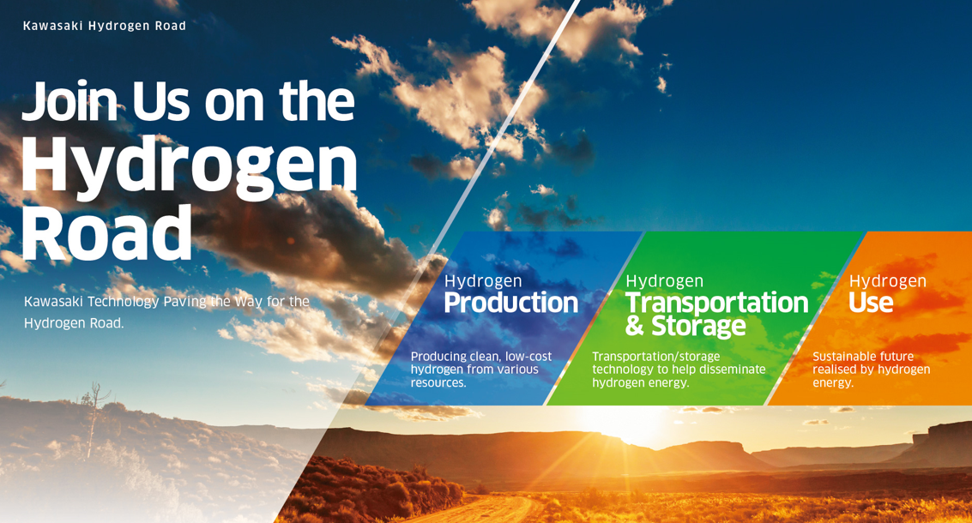
2. KHI’s hydrogen vision and capabilities
Global leader in hydrogen technology
We are building the foundations of a hydrogen market

Slide 7
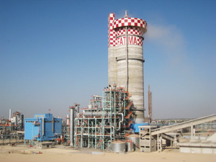
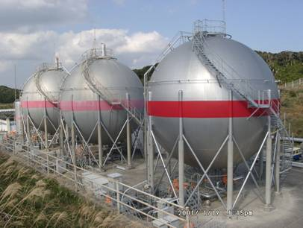
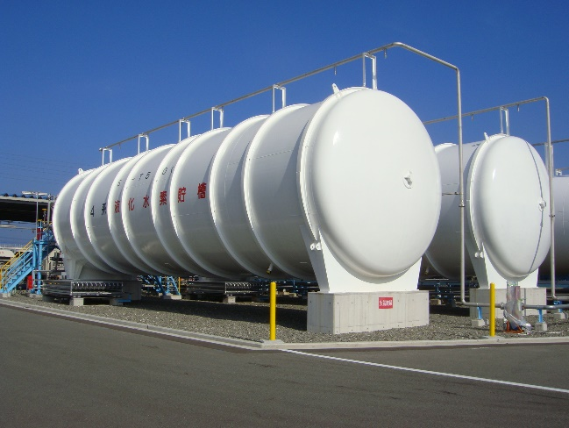
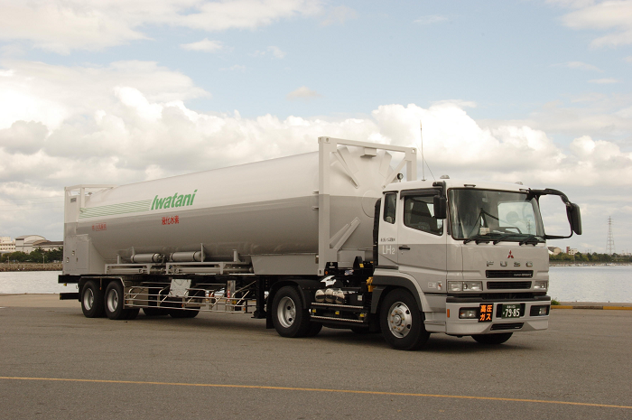
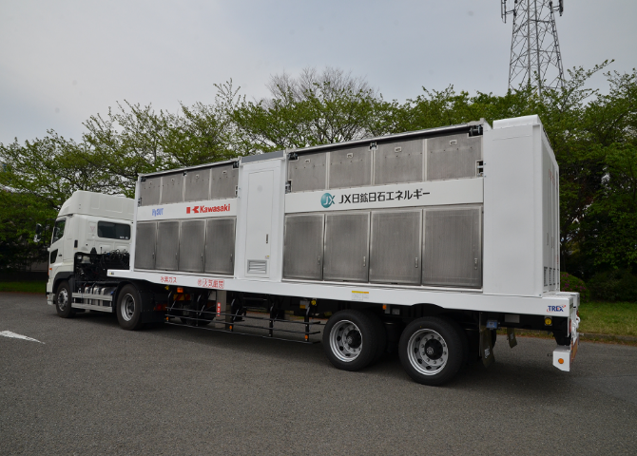
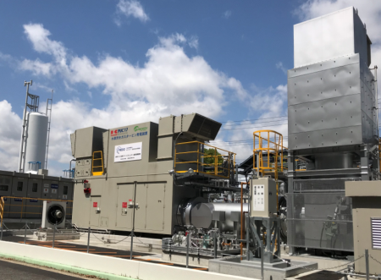
2. KHI’s hydrogen vision and capabilities
Global leader in hydrogen technology
Fertilizer Plant
（Hydrogen production）
H-II rocket fuel
hydrogen storage tank
Liquid hydrogen
storage tank
Liquid hydrogen container
High pressure hydrogen gas trailer
H2 Gas Turbine

Slide 8
Contents
Japan’s Basic Hydrogen Strategy
KHI’s hydrogen vision and capabilities
Hydrogen Energy Supply Chain (HESC) Project
The HESC Project and Carbon Capture and Storage (CCS)
Closing remarks

Slide 9
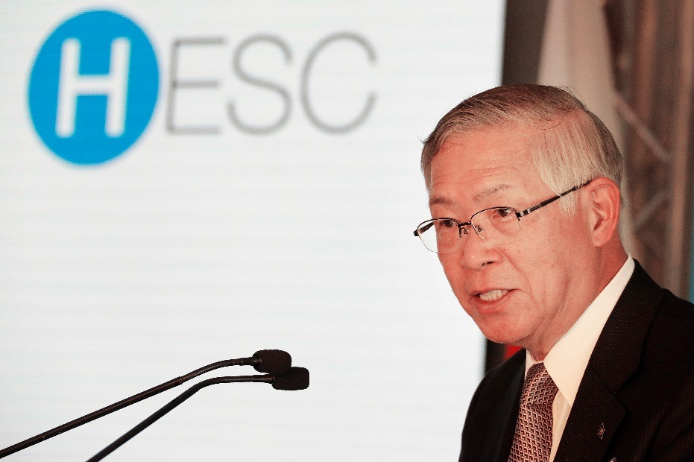
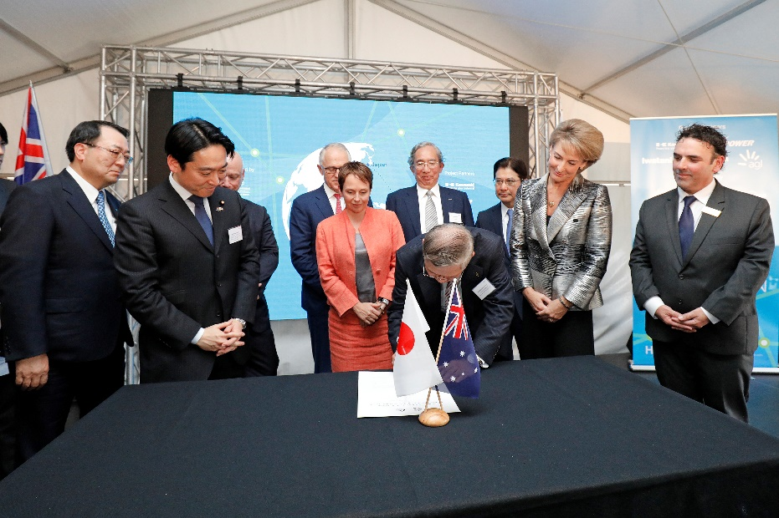
3. Hydrogen Energy Supply Chain (HESC) Project
HESC Project - Overview
The HESC Project is a world-first initiative to establish an integrated supply chain for sustainable hydrogen, produced from Victorian brown coal in the Latrobe Valley, Victoria, to be exported to Japan.
The HESC Project will be developed in two phases:
  Pilot Phase: The pilot phase will demonstrate a fully integrated supply chain between Australia and Japan by 2021.
  Commercial Phase: The commercial phase will be operational targeted in the 2030s.

Slide 10
3. Hydrogen Energy Supply Chain (HESC) Project
Project Timeline
The Commercial Phase of the HESC Project will require a CCS solution
Completed (2017)
Front End Engineering
Design (FEED) study
for Australian portion
2019
Commence
construction
of pilot facilities
in Australia
2018 - 2021
Development of a
commercialisation plan
for the HESC
2030s
Full commercial
operations
2017 - 2018
Regulatory approvals
completed and
Final Investment
Decision (FID)
for pilot plant
2020 - 2021
Pilot Operations
and delivery
of hydrogen
to Japan
2021 – 2030s
Planning,
construction and
commissioning of
the commercial plant
Indicative timeline and milestones
Notes:
The HESC Project is progressing well, with the Pilot Phase targeted for operation in 2020-2021 and with full commercial operations targeted in the 2030s.
As I noted earlier, critical to the Commercial Phase of the HESC Project is a CCS solution.

Slide 11



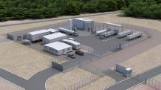



3. Hydrogen Energy Supply Chain (HESC) Project
Pilot Phase - Overview
AGL Loy Yang, Latrobe Valley
Victoria, Australia
BlueScope Western Port
Port of Hastings
Victoria, Australia
SC1-A – Brown coal gasification
(Japanese Funded Portion)
SC3 – Transport
(Pressurised gaseous hydrogen truck)
(Australian Funded Portion)
SC4 – Hydrogen liquefaction
(Australian Funded Portion)
SC5 – Hydrogen loading base
(Australian Funded Portion)
SC2 – Gas Refining
(Australian Funded Portion)
Brown Coal exported to Japan
SC6 – Liquefied hydrogen carrier
(Japanese Funded Portion)
©HySTRA
Kitakyushu, Japan
Kobe, Japan
SC1-B – Brown coal gasification
(20t/d EAGLE II facility)
(Japanese Funded Portion)
SC7 – Liquefied hydrogen unloading terminal
(Japanese Funded Portion)
©HySTRA

Slide 12
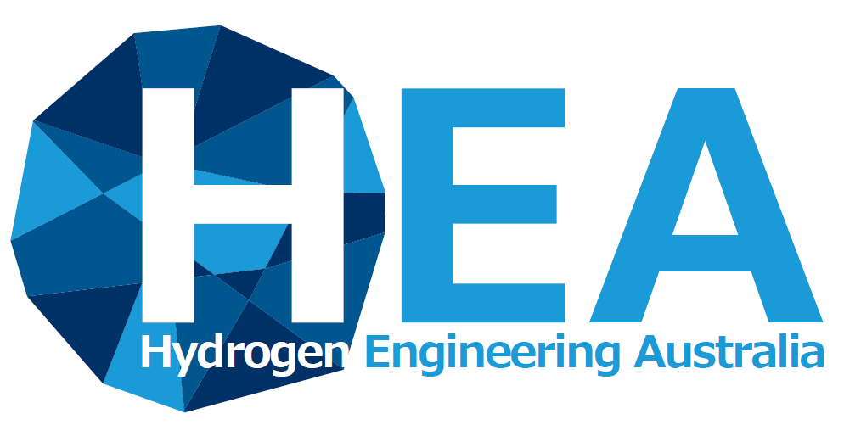








3. Hydrogen Energy Supply Chain (HESC) Project
HESC Project Partners
Australian Funded Portion: Hydrogen Engineering Australia (HEA)
Japanese Funded Portion: Hydrogen Energy Supply Chain Technology Research Association (HySTRA)
Notes:
The HESC Project is being delivered by reputable project partners across two consortiums, an Australian Consortium and a Japanese Consortium, supported by Australian Governments and the Japanese Government respectively.
The Australian consortium will demonstrate the gas refining, transport, liquefaction, storage and loading of liquid hydrogen onto a special carrier in Australia.
The Japanese Consortium, HySTRA, will be responsible for gasification of brown coal for hydrogen production, shipping the liquefied hydrogen to Japan, unloading and storage of liquid hydrogen in Japan.

Slide 13
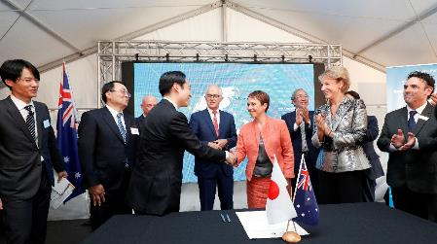
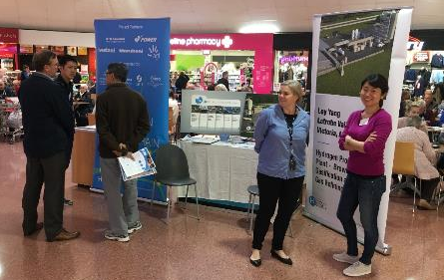

3. Hydrogen Energy Supply Chain (HESC) Project
Progress in Australian Funded Portion
12 April 2018 public launch for Australian Funded Portion
Ongoing community and stakeholder consultation in Latrobe Valley and Port of Hastings
Major Regulatory approvals obtained
Detailed engineering work on-going
Purchase of all major equipment almost finished
Construction to begin from mid-June 2019 soon

Slide 14



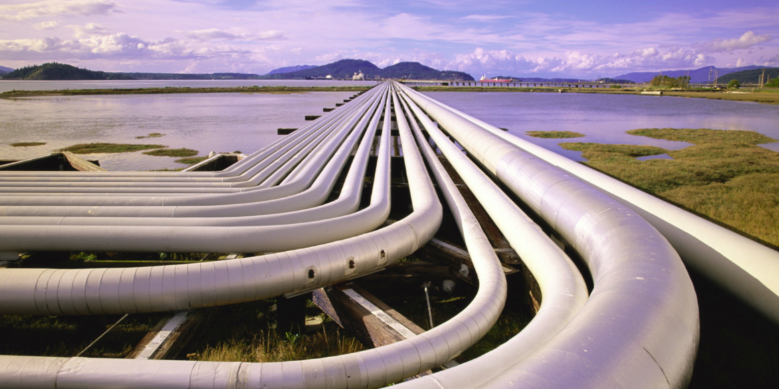

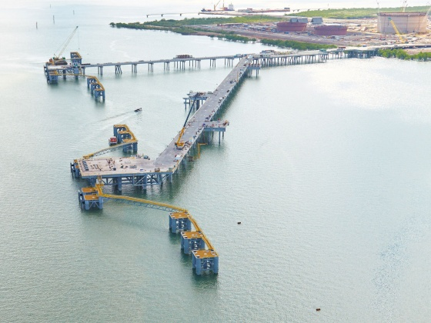
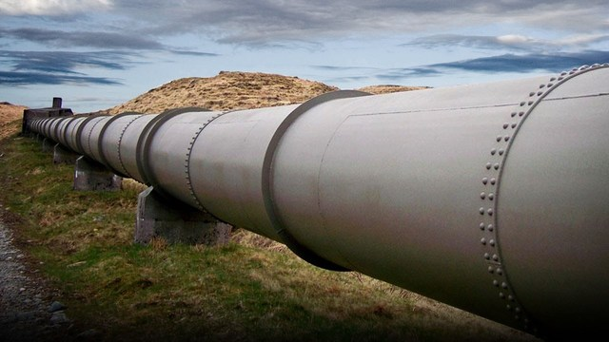
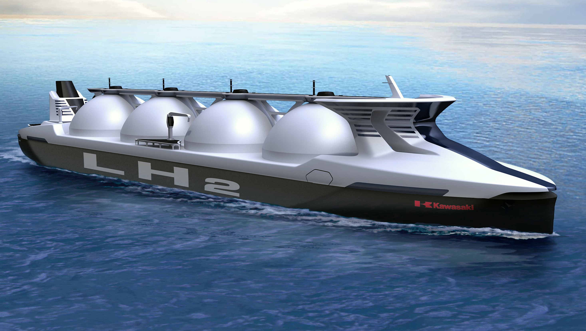
3. Hydrogen Energy Supply Chain (HESC) Project
Commercial Phase
Latrobe Valley –
Victoria, Australia
Port location to be confirmed –
Australia
SC1-A – Brown coal gasification
SC2 – Gas Refining
SC3 – Transport
(H2 pipeline)
SC4 – Hydrogen liquefaction
SC5 – Hydrogen loading base
CO₂
SC6 – Liquid hydrogen carrier
CCS solution
Japan
SC7 – Liquid hydrogen unloading base
©HySTRA

Slide 15
Contents
Japan’s Basic Hydrogen Strategy
KHI’s hydrogen vision and capabilities
Hydrogen Energy Supply Chain (HESC) Project
The HESC Project and Carbon Capture and Storage (CCS)
Closing remarks

Slide 16
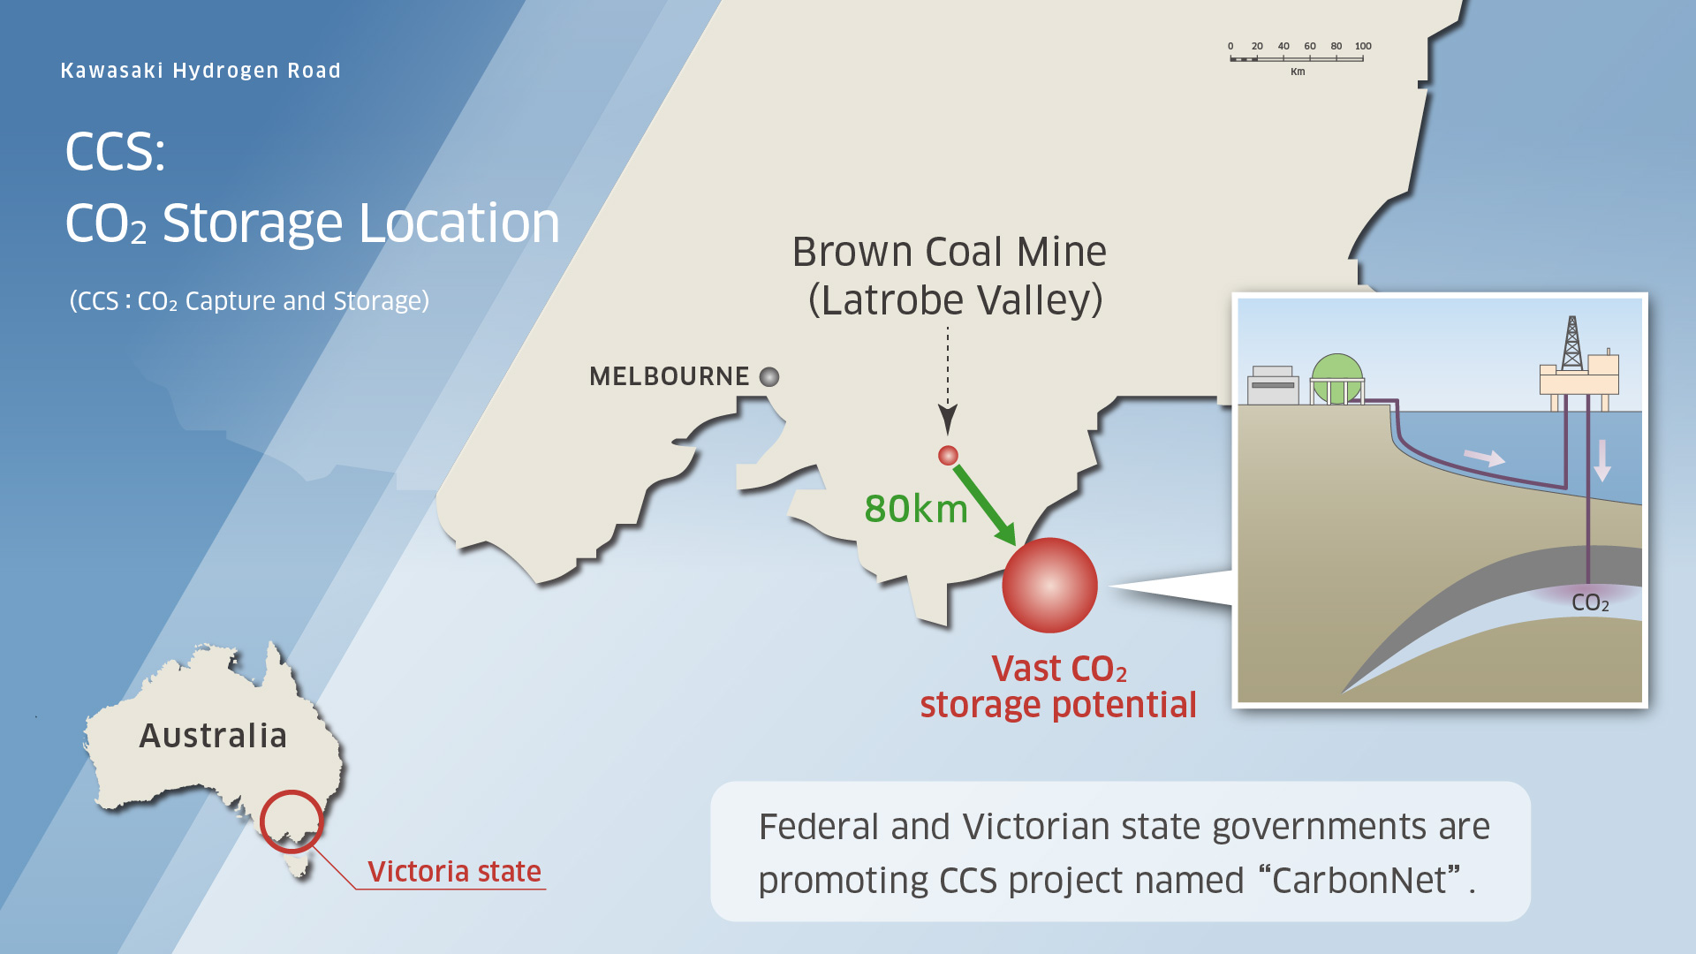
4. The HESC Project and Carbon Capture and Storage (CCS)
The HESC Project will require a CCS solution
The HESC Project concept was developed by linking the two strategic advantages of Victoria – abundant brown coal resources and suitable geological formations for CCS.
CCS is critical to the ability of the HESC Project to supply low-emissions hydrogen.
The Australian and Victorian Governments’ CarbonNet Project presents a prospective CCS solution for the HESC Project.
Victoria

Slide 17
Contents
Japan’s Basic Hydrogen Strategy
KHI’s hydrogen vision and capabilities
Hydrogen Energy Supply Chain (HESC) Project
The HESC Project and Carbon Capture and Storage (CCS)
Closing remarks

Slide 18
5. Conclusions
Advantages of low emissions hydrogen supply chains
Innovation and skills transformation
Improvement of industrial competitiveness
Sustainable and affordable energy supply
Spill over benefits of coal-to-x
“Ultimate clean energy” – no CO₂ emissions when used
Wide application of end uses
Creation of export markets
Job creation
Economic development
Notes:
18

Slide 19
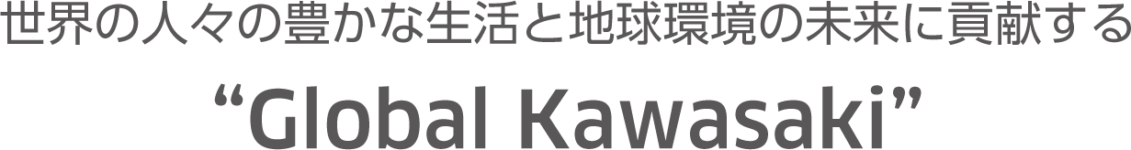
Thank you for listening
Kawasaki, working as one for the good of the planet
Kawasaki Heavy Industries, Ltd.
Corporate Technology Division
1-14-5, Kaigan, Minato-ku, Tokyo 105-8315
http://www.khi.co.jp
Mr Yasushi Yoshino
Deputy Senior Manager
Kawasaki Heavy Industries, Ltd.
Notes:
Thank you very much for listening.
I hope you found the presentation informative and demonstrated Kawasaki’s vision of the “Hydrogen Road”.

