Slide 1


Current Status of CCUS in CNPC
Dr. Ming Xue
State Key Laboratory of Petroleum Pollution Control
CNPC Research Institute of Safety and Environmental Technology
May. 2019

Slide 2
Contents
1. About us
2. CCUS in China - Policy Background
3. CCUS Practice in CNPC

Slide 3

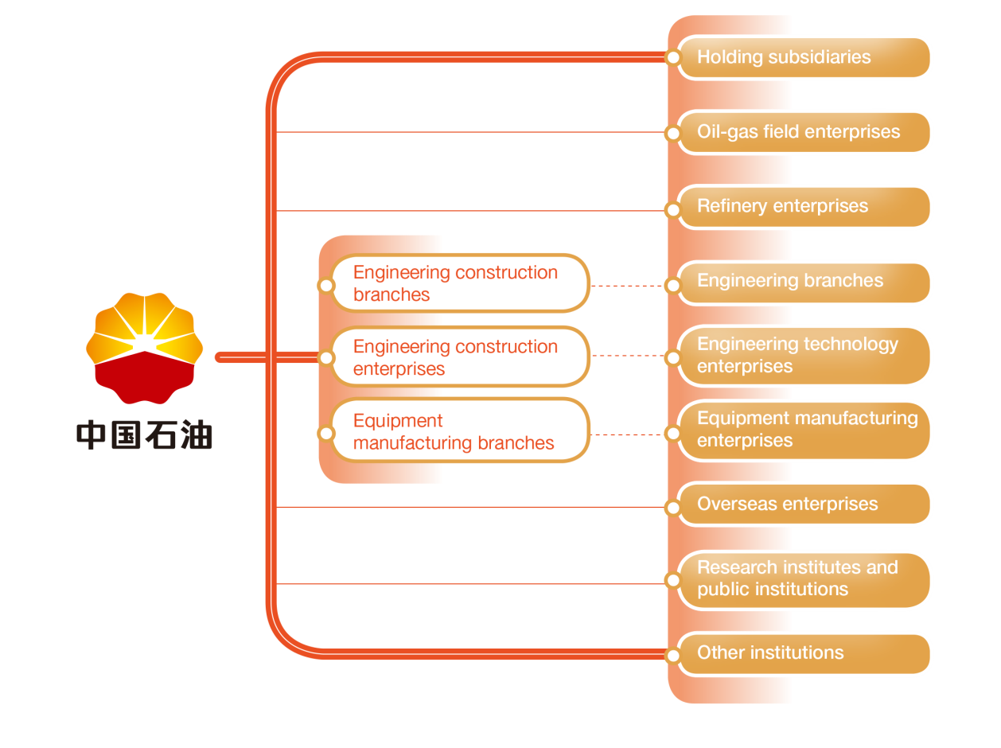

About CNPC
China National Petroleum Corporation (CNPC) is a state-owned enterprise with businesses and operations covering：oil and gas business, engineering and technical services, petroleum engineering construction, equipment manufacturing, financial services, renewable energy development etc.
3
The world's 50 largest oil companies
3
《Fortune》ranking of 500 big companies around the world
Note: Ranking in 2016

Slide 4
About RISE-CNPC
Our responsibility:
1. Safety and Environmental policies, strategic plans, regulations and standards;
2. Management system on health, safety and environment (HSE)
3. Technical evaluation on large scale environmental treatment projects
4. Technical support for large scale new－built projects and acquisitions in HSE
5. Emergency management and accident investigation
6. Research, application and demonstration of basic, and perspective safety and environmental technology in the oil and gas industry
7. HSE information management
8. HSE evaluation, verification, authentication, and consultation

Slide 5
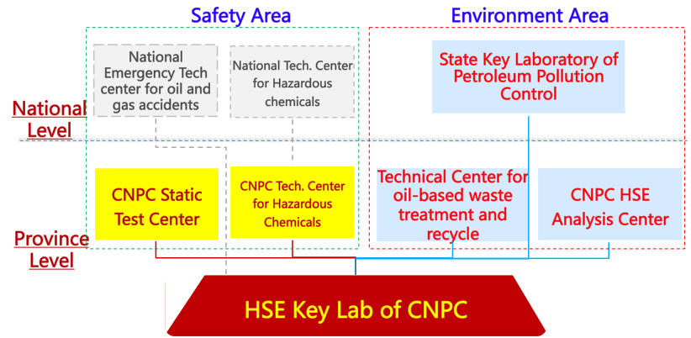
About RISE-CNPC
Our research:

Slide 6
Contents
1. About us
2. CCUS in China - Background
3. CCUS Practice in CNPC

Slide 7
Background - National
Carbon emission peak by 2030 referring to Paris Agreement
National Carbon Market launched on Dec., 2017
CCUS included in the Action Plan for Innovation of Energy Tech Revolution (2016-2030) published by NDRC and NEA
CCUS recommended in tackle climate change during the “13th five year plan” by MST, MEE and BM

Slide 8
Background - National
CCUS could:
Shaping the carbon emission peak after 2030
Large scale low-carbon utilization of coal-generated power station
Guarantee a smooth transition of energy structure in China
Coal
Petro
Gas
Renewable
2013
2014
2015
2016
2017
Projected 2018
Energy consumption composition in China during 2013-2018

Slide 9
Background – Industry&Academy
    The low-emission roadmap published by IEA MIT and Tsinghua Uni. clarified the optimized action matrix of low-carbon development in the oil & gas industry, and highlight CCS as a focus for investment
    Commercialization study by Shell, CNPC, Total and BP, built classification and evaluation system on CO₂ storage potential, provide foundation for CO₂ storage and carbon trade.

Slide 10
Contents
1. About us
2. CCUS in China - Background
3. CCUS Practice in CNPC

Slide 11
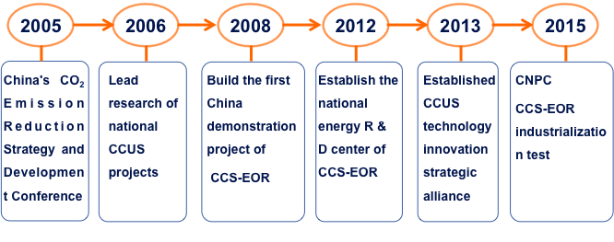
CCUS in CNPC
In 1965, started exploring CO₂ flooding technology.
Since 2006, started a number of CCUS researches.
Now in the phase of industrialization test and lead the industrial CCUS development in China

Slide 12
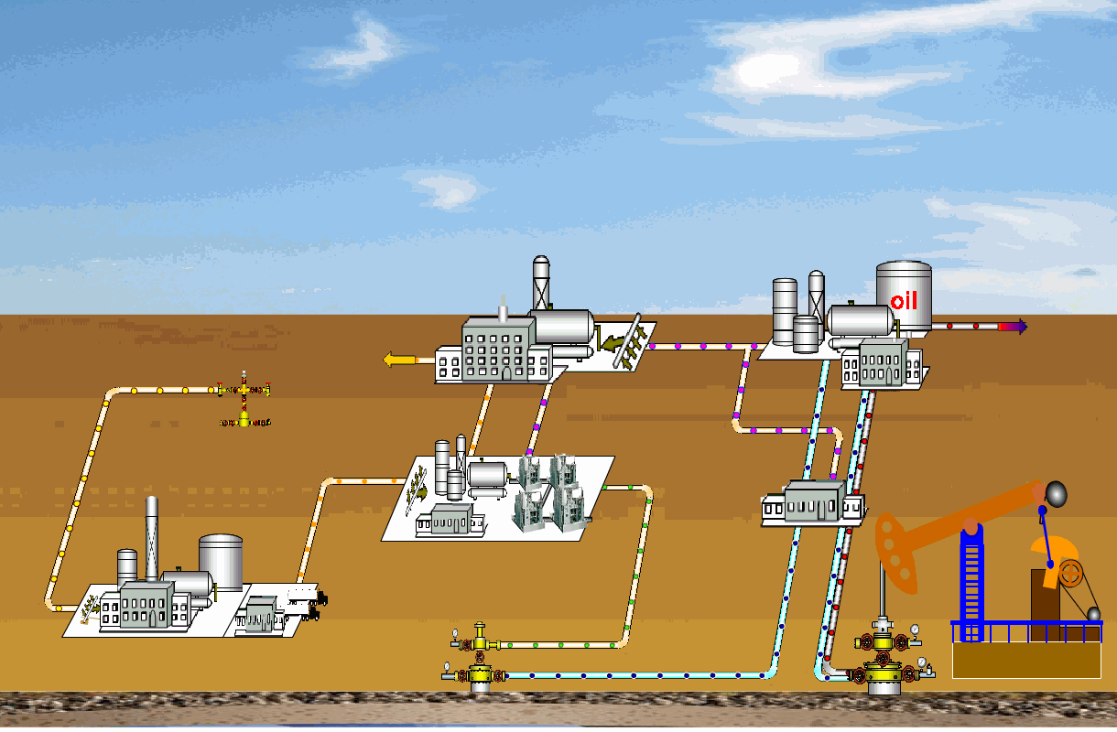
CCUS in CNPC
    First national science and technology demonstration CCS-EOR site in Jilin Oilfield, Songliao Basin
    Integration of CO₂ separation, capture and EOR with annual CO₂ storage capacity of 300 thousand tons with EOR ~15%,
Diagram of CCS-EOR demonstration project
Gas Wells with CO₂
Collected fluid processing system
Cyclic gas injection system
CO₂ pipeline
CO₂ injection system
Metering
CO₂ capture system
Injection well
Production well

Slide 13
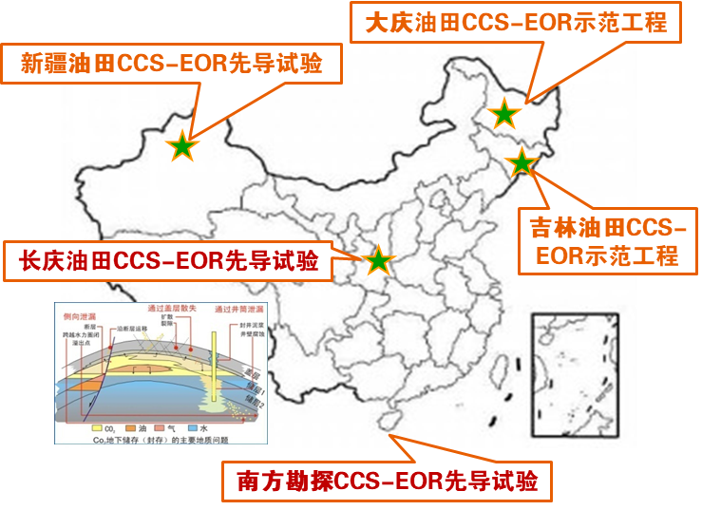
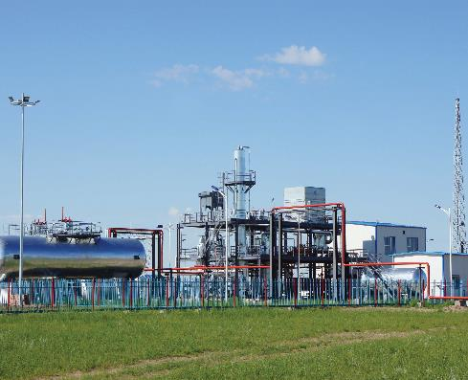
CCUS in CNPC
After the first CCUS base was built in Jilin oilfield, also pilot experiment in Xinjiang oilfield, Daqing oilfield, Changqing Oilfield and Fushan oilfield.

Slide 14
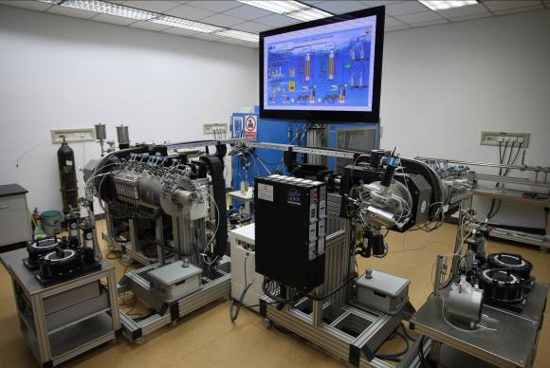
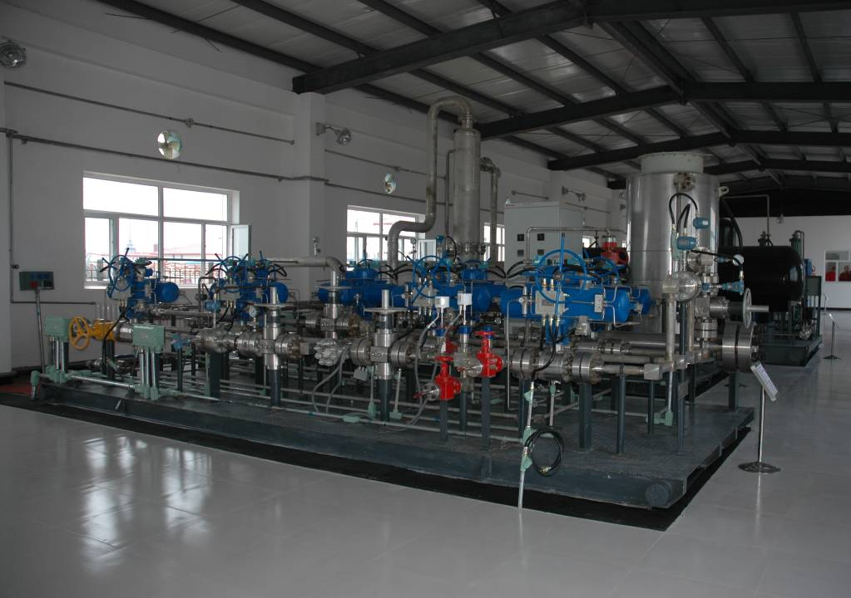
CCUS in CNPC
    In 2012, the national energy R & D center of CCS-EOR technology was established by CNPC, which built world-class experimental simulation equipment
    and formed a professional technical innovation team. It has become the platform of CCS-EOR technology research, development and application in China.
Daqing
Jilin
Jidong
Changqing
Dagang
Laboratory equipment
Pilot test
Demonstration base of oil field

Slide 15
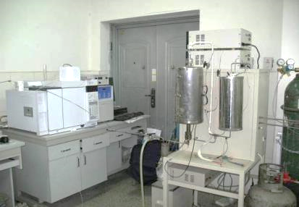
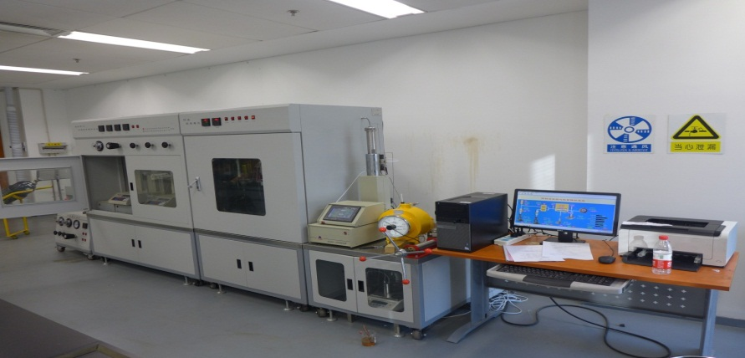
CCUS in CNPC
In the past 5yrs, 4 national key technology or equipment development projects and 3 CNPC key technology projects
Project | Source
Resource recycling and underground storage through CO2-EOR | “973”
Basic research on CO2 reduction, storage and utilization
Key tech research on CO2-EOR and storage | “863”
Demonstration on safety development and utilization of NG containing CO2 | National Key Project
Demonstration project of CO2-EOR and Storage
Integration application of NG containing CO2 and carbon storage | CNPC Key Project
Key tech research on CO2-EOR and storage in Jilin oilfield
Tech research and application of CO2-EOR and storage in Changqing Oilfield

Slide 16
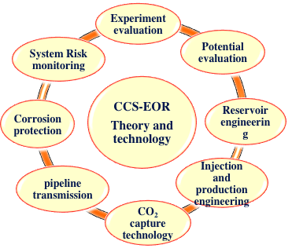
CCUS in CNPC
    CNPC has CCS-EOR pilot and demonstration tests in 5 oil fields
    Both CCS-EOR theoretical and technical system for continental reservoirs in China were built
    37 China invention patents have been awarded, and 24 national industry and enterprise standards have been issued.
Characterize the contribution of C₇-C₁₅ component to CO₂ miscible displacement.
Establish key parameters database of CO₂ miscible displacement in continental oil field and the engineering application system.

Slide 17
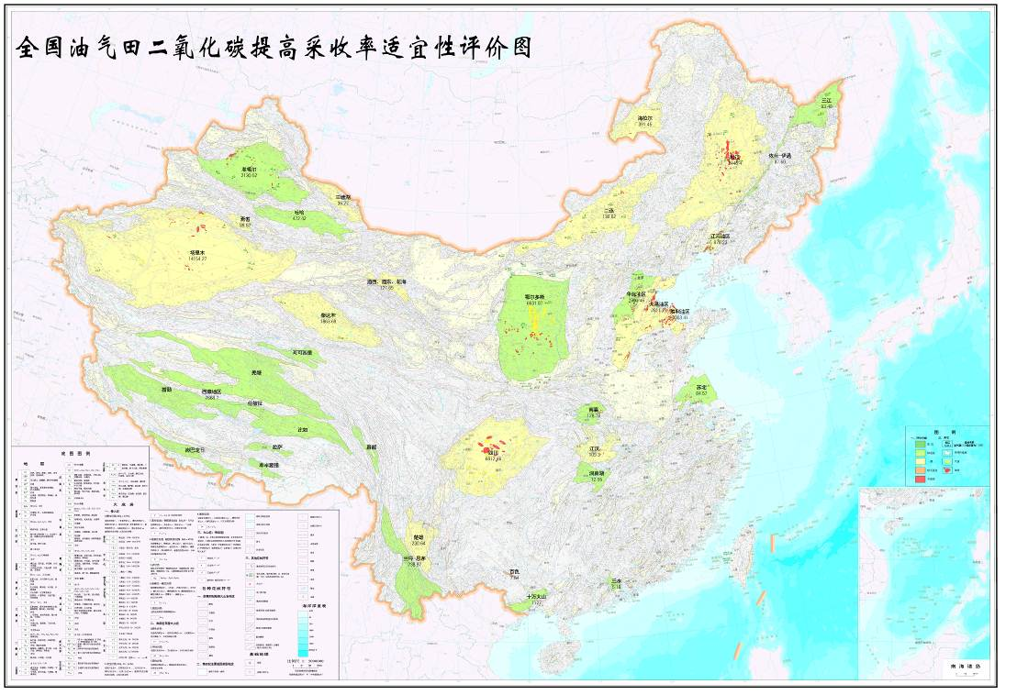
CCUS in CNPC
，The oil reservoirs in China have the potential for CO₂ storage as 13 to 15 billion tons.
National CO2-EOR applicability evaluation

Slide 18
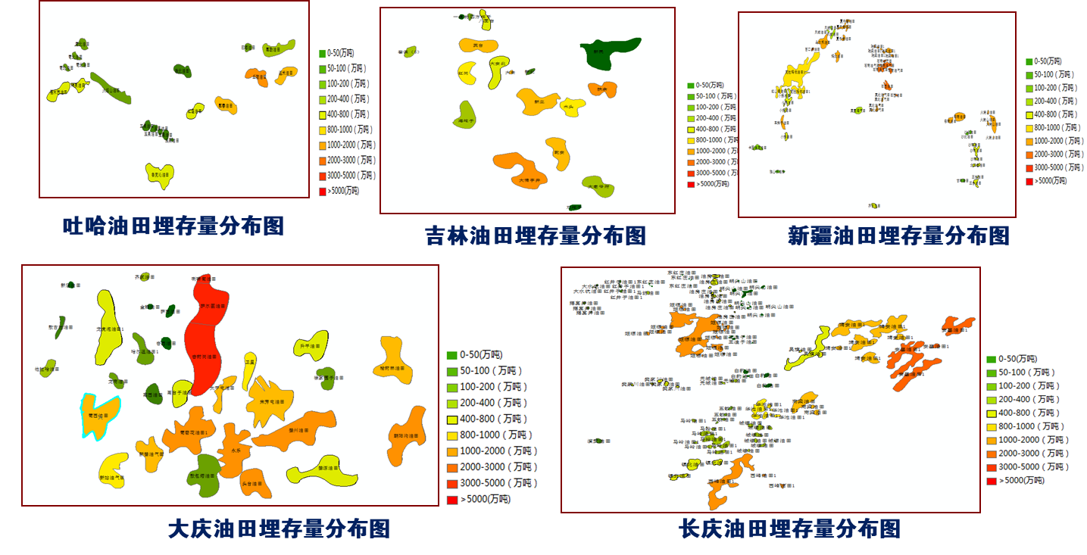
CCUS in CNPC
A total of 83 saline aquifers has the capacity for CO₂ storage of 27 billion tons.
Tuha Oilfield
Jilin Oilfield
Xinjiang Oilfield
Daqing Oilfield
Changqing Oilfield

Slide 19
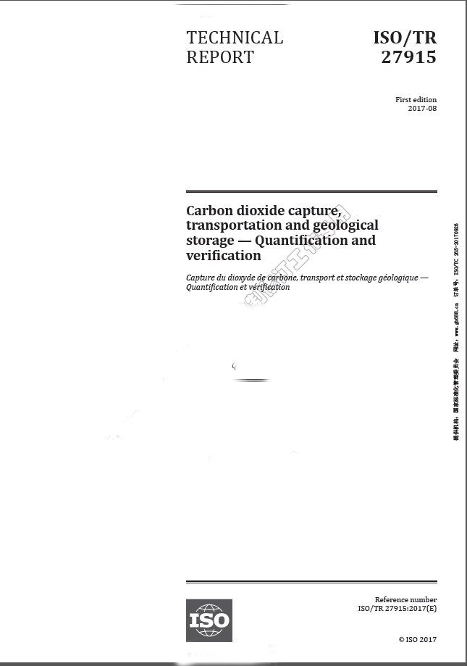
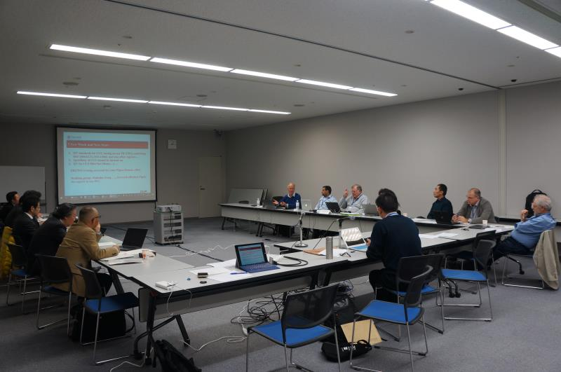
CCUS in CNPC
We also participated in the international standard “carbon dioxide capture, transportation and geological storage _ quantification and verification” （ISO/TR 27915）, providing technical foundation for emission reduction evaluation and carbon market inclusion.

Slide 20
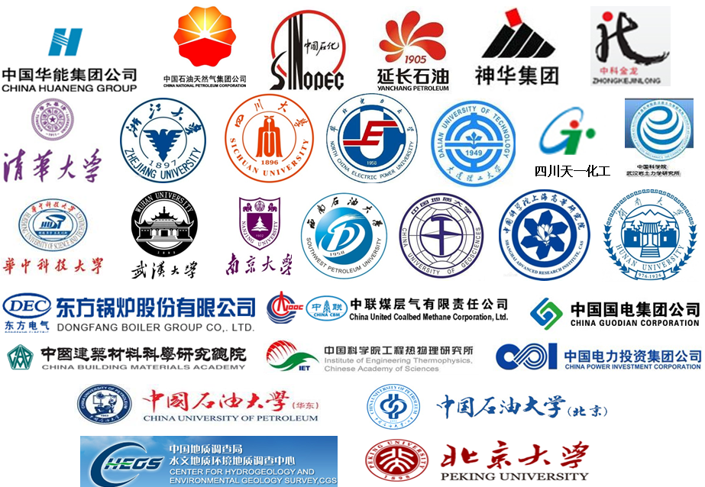
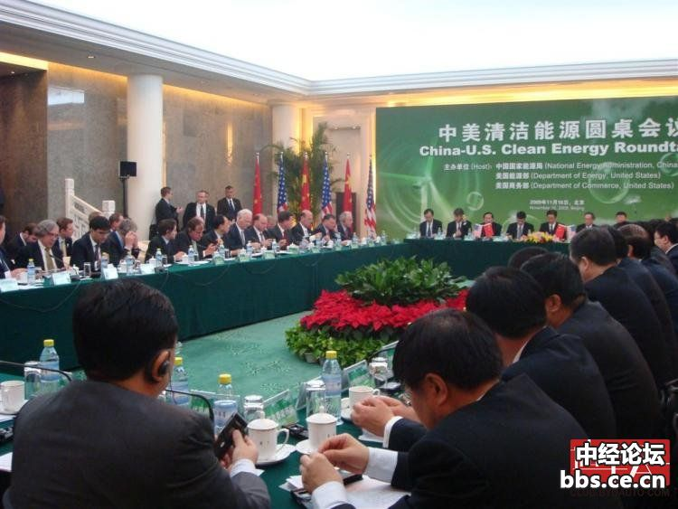
CCS-EOR in CNPC
    CNPC has established CCUS technology innovation strategic alliance with 32 enterprises and universities in China, and cooperation on CCS-EOR with US, Canada and EU, etc.
Members of China CCUS Alliance
China-U.S. clean energy round-table conference

Slide 21
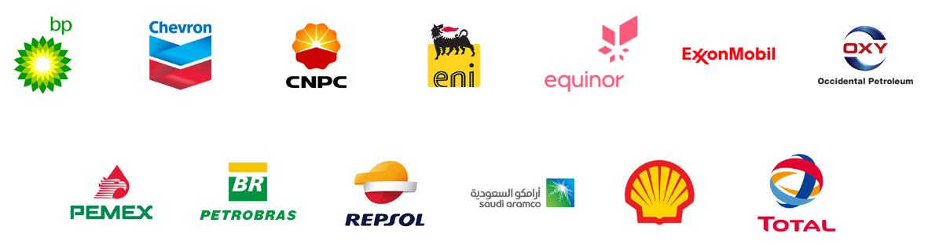
CCUS in CNPC
Workstream | Action | Co-lead | Participate | notes
carbon capture & storage（CCS） | Pathways to CCS market commercialization in a low carbon economy |  | √ | Workstream co-lead
 | Gas CCS Capture Technologies and cost reduction |  | √
 | Availability of CO2 storage capacity in key markets | √
Role of Gas | methane research to improve the understanding of global oil and gas methane emissions |  |  | Action co-lead
 | Life cycle assessment methodology for evaluating GHG mitigation options in the natural gas value chain | √
 | Support the Development and Deployment of Low-Cost Methane Detection Technology |  | √
Low emission roadmap | Low emissions roadmap and stakeholder roundtables |  | √ | Supported by Tsinghua

Slide 22

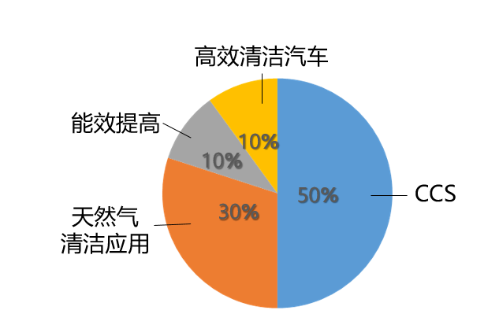
CCUS in CNPC
In January 2016, all member companies in OGCI agreed to invest 10 million US dollars a year, for 10 years
A total of 1 billion US dollars for CCUS and other countries to deal with climate change technology investment.
Energy efficient cars
High - tech venture capital
Improve energy efficiency
30%
70%
Demonstration Project Investment
Natural gas clean use
OGCI- Investment Distribution

Slide 23
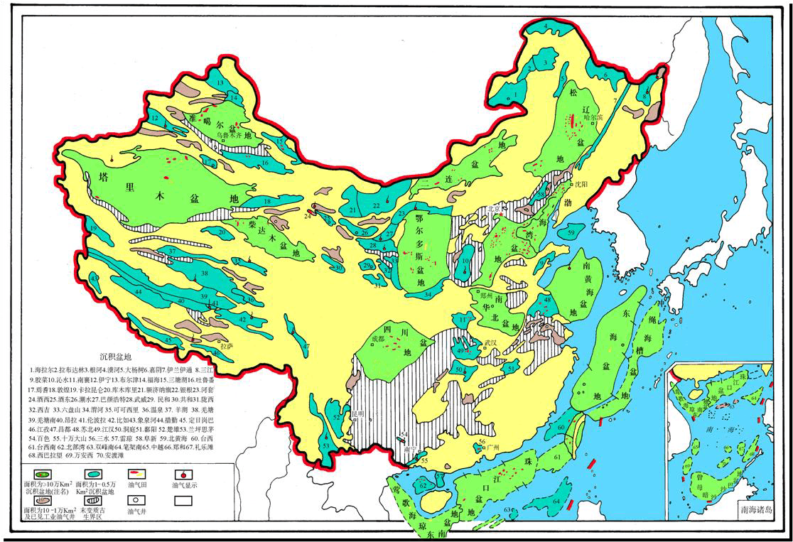
CCUS in CNPC: Perspective
    CNPC will carry out cross-industry CCS-EOR cooperation with by-product CO₂ enterprises of power plant and coal chemical.
China main sedimentary basins map

Slide 24
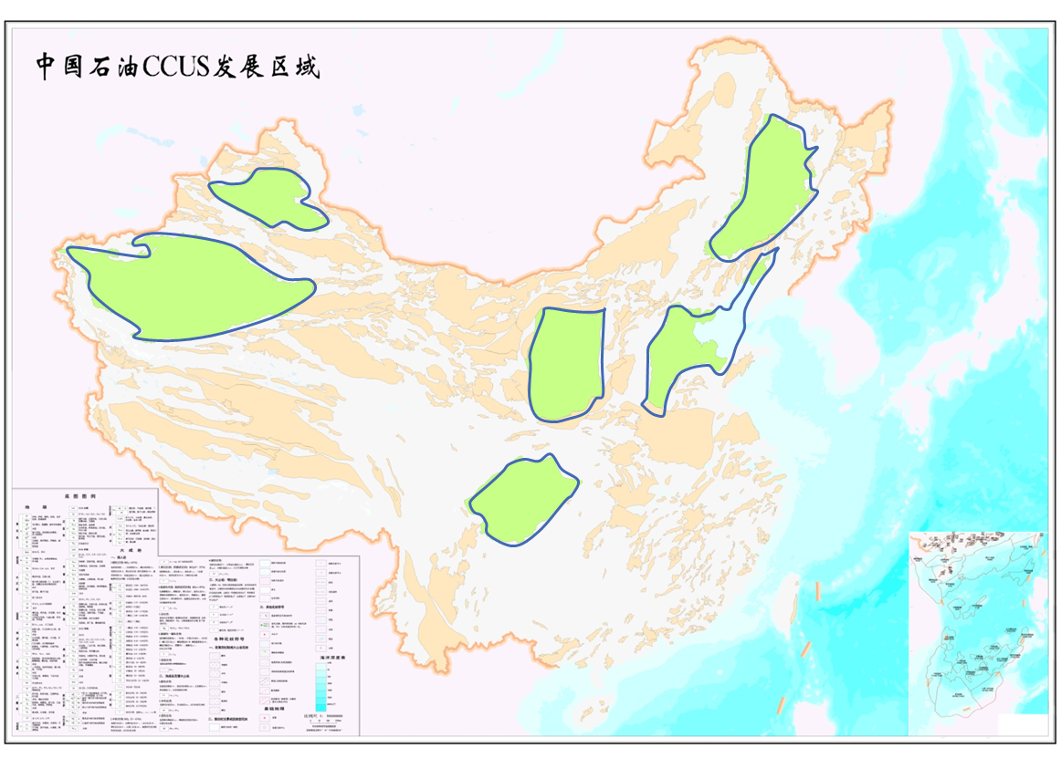
CCUS in CNPC: Perspective
    Songliao basin, bohai bay basin, ordos basin, junggar basin, tarim basin and sichuan basin as a priority areas to carry out the demonstration project .
rich oil and gas resources;
2. Good reservoir-cap combination;
CCUS Developing Areas in CNPC
1. Low porosity, low permeability;
3. Formation closed;
4. carbon source is rich and cheap
5. Transportation distance near.
1. Oil and gas resources are rich;
2. Rich carbon source;
3. The vast desert distribution;
4. The population density is small
1. Rich natural gas resources;
2. Rich carbon source.
Rich carbon source
Economically developed

Slide 25
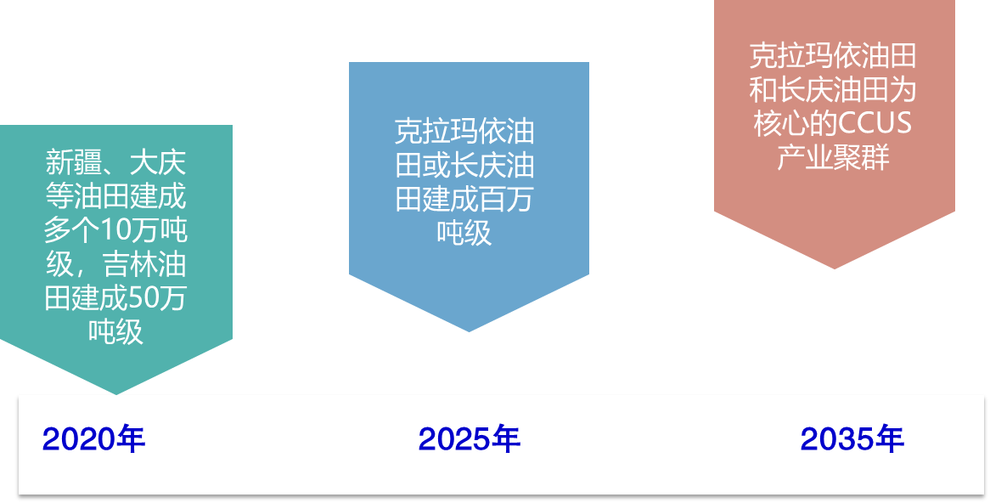
CCUS in CNPC: Perspective
Optimization and distribution of the green industry
Seek for commercialization pattern of CCUS , and promote green credit and foundation.
CCUS industrial cluster based in Xinjiang and Changqing
Xinjiang or Changqing to reach the capacity of million tons
Multiple CCUS sites with capacity of 100 thousand and 500 thousand tons in Jilin

Slide 26
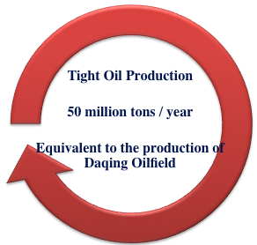
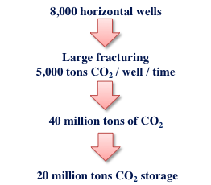
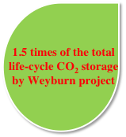
CCUS in CNPC: Perspective
    Research EOR of tight oil with CO2-based fracturing fluid
    Reach multiple targets, including water saving, the effective development of tight oil and CO₂ storage.

Slide 27
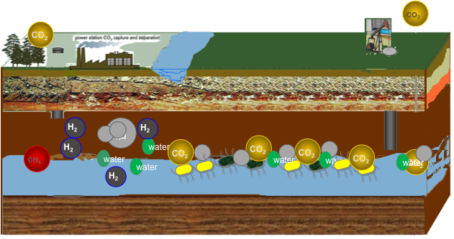
CCUS in CNPC: Perspective
    Methane can be obtained by injecting CO₂ in the abandoned reservoirs, containing organic coal and deep saline formation. It is the long-term development and application of potential technology direction of CCUS.
Synthesis methane using indigenous microorganism and organic carbon with the storage of CO₂

Slide 28
CCUS in CNPC: Upcoming Workshop
Jun. 26, 2019 Hangzhou, China
CCUS offset & market mechanism under China carbon trade system
How to develop national CCUS Trade Associations
Universal CCUS policy play book
Other important plans of OGCI Aspiration

Slide 29
Thank you!

