Slide 1
LNG development in a low carbon world
APAC CCS Forum: Developing a low-carbon economy
CHRISTOPHER CONSOLI
    Senior Consultant

Slide 2
Emission Reduction Pathways to 2°C: critical to guiding policy
Deep decarbonisation
~34 GtCO₂
Emissions peak ~2020
All sectors
Net CO₂ emissions (G_{t}CO₂)
Models: 2.6 W/m² 1.7-1.8^{O}C
Negative Emission technologies
Most models negative by 2070
Net negative emissions
Source: Global CCS Institute, 2019
Emissions Data: IIASA 2019
Current Emissions: EDGAR, 2018

Slide 3
Natural Gas Pathways Under 2°C Scenarios: distinct variations in models
Decrease:
10-50%, some ~0!
Primary Energy – Gas (EJ)
Increase:
widespread deployment of CCS critical
Source: Global CCS Institute, 2019
Emissions Data: IIASA 2019
Current Energy: BP, 2019

Slide 4
CCS and Natural Gas Under 2°C Scenarios: Can CCS fill this decline?
Primary Energy – Gas (EJ)
Gas with CCS
Gas without CCS
Source: Global CCS Institute, 2019
Emissions Data: IIASA 2019

Slide 5
Australia’s GHG Emissions - Full Economy Australia needs more commercially viable emission reduction technologies
History
2020 Target: 5% reduction on 2000 emissions
2030 Target: 26%-28% reduction on 2005 emissions
Climate Change Authority recommended National Carbon Budget 2013-2050
Net Zero emissions in 2042
11.6Gt CO₂e
Mt CO₂e
-1.5Gt CO₂e
-324Mt CO₂e in 2050
Notes:
Keeping emissions within the carbon budget recommended by the Climate Change Authority - for Aus to play it part in a 2 degree world - is an enormous challenge
Getting anywhere near it will require a rapid increase in the rate of decarbonization of the Australian economy
Likely require the use of international carbon credits
It will also require negative emission technologies - bioenergy with CCS and reafforestation. Later DAC may also be feasible by 2040.
Reducing emissions is difficult
Every option must be on the table – the absence of any option makes it more difficult and expensive

Slide 6
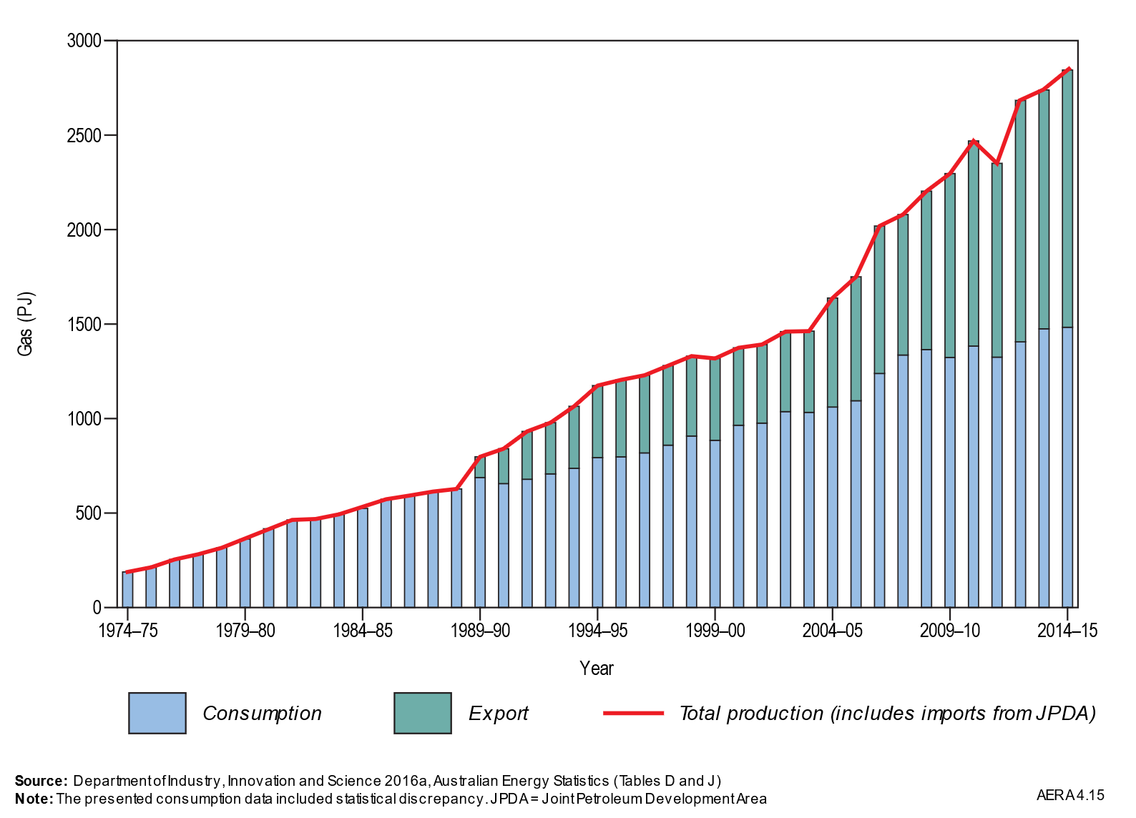
Remaining gas resources and cumulative production
LNG Facilities in Australia:
Operational: 9
Construction: 1
Feasible: 4
Advanced Development: 4
Large-scale CCS Facilities
in Australia:
Operational: 0
Construction: 1
Feasible: 0
Advanced Development: 1

Slide 7
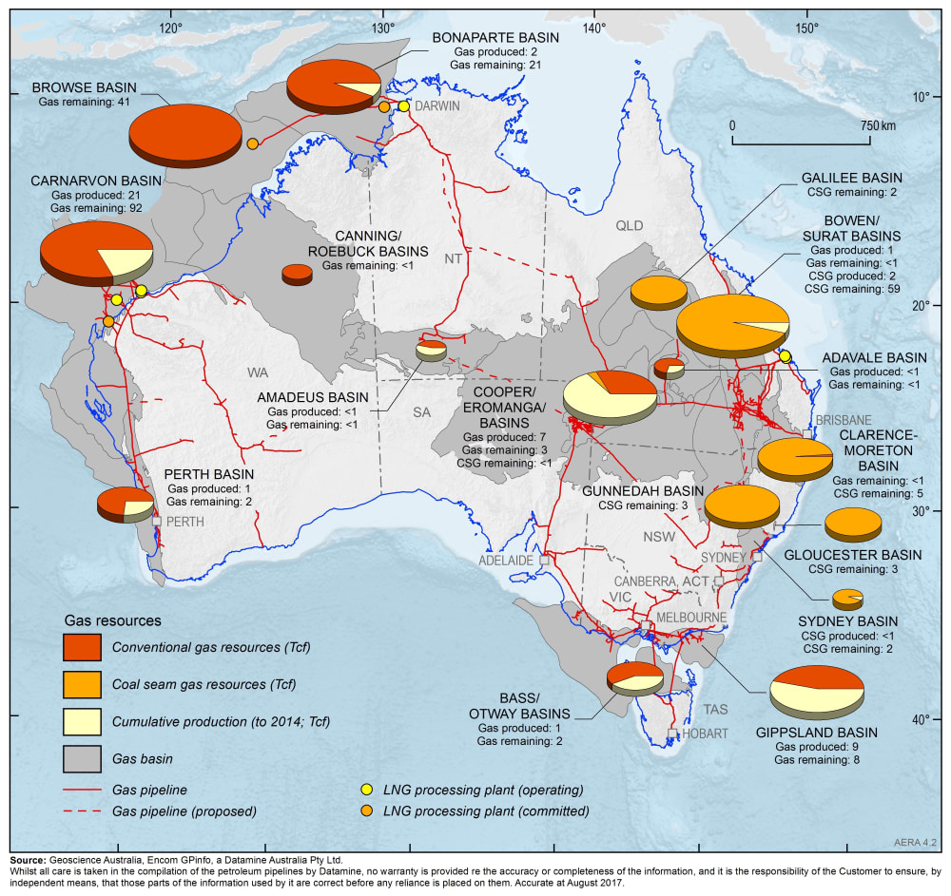
Remaining gas resources and cumulative production

Slide 8
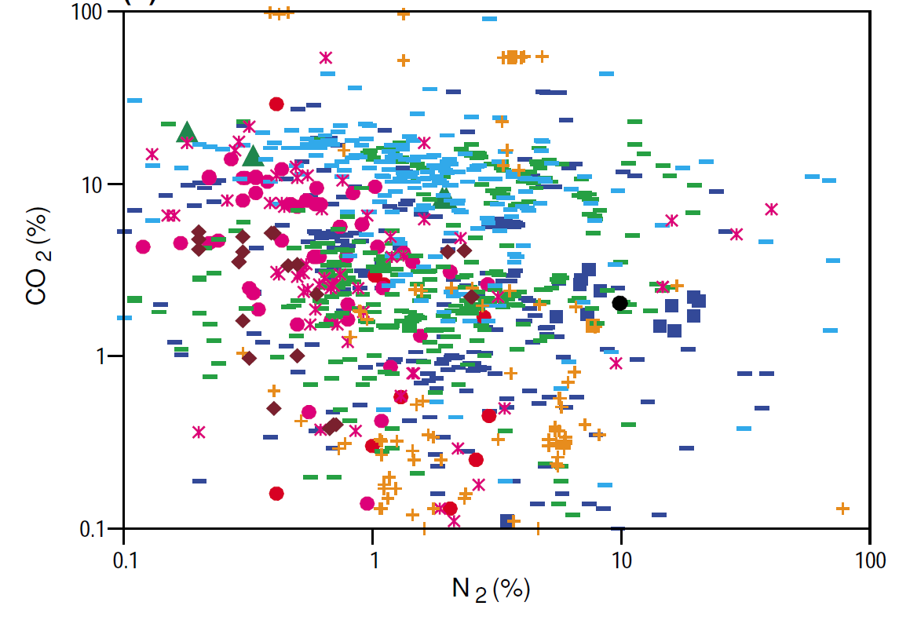
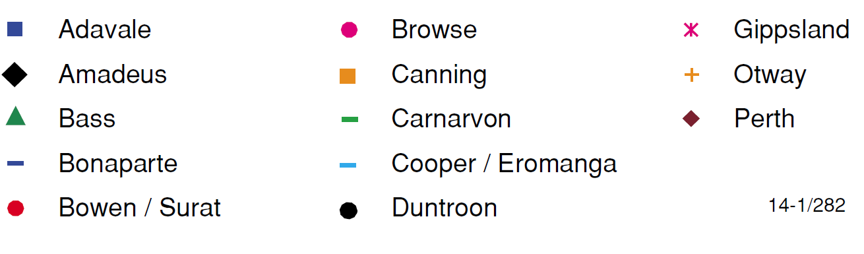
Future Gas Frontiers
1
2
High CO₂
Browse and Bonaparte
Carnarvon
Source: Boreham et al 2001

Slide 9
Australian natural gas fields and CO₂ and storage potential
Basin | Project | CO₂ Content | Storage Potential (Mt)
Northern Carnarvon | Wheatstone | 3.2 mtpa | 25,000
 | Pluto | 1.9 mtpa @ 2%
 | North West Shelf | 7.6 mtpa
 | Gorgon | 5 mpta (4 mtpa CCS) @ 14%
 | Scarborough | 0.1%
Browse | Prelude | 2.7 mtpa @ 9% | 7,000
 | Torosa, Brecknock, Calliance | 4-12%
 | Crux | 10.5%
Bonaparte | Darwin LNG + | 1.7 mtpa @ 6% | 30,000
 | Barossa/ Caldita | 13-16%
 | Evans Shoal | 28%
 | Ichthys | 7 mtpa @ 8-15%
Source: various; EIS, Greenhouse gas reporting

Slide 10
National Storage Potential of Australia
Browse
Storage Sites (GeoDisc)
Source: After CSIRO, National Carbon Taskforce, 2010

Slide 11
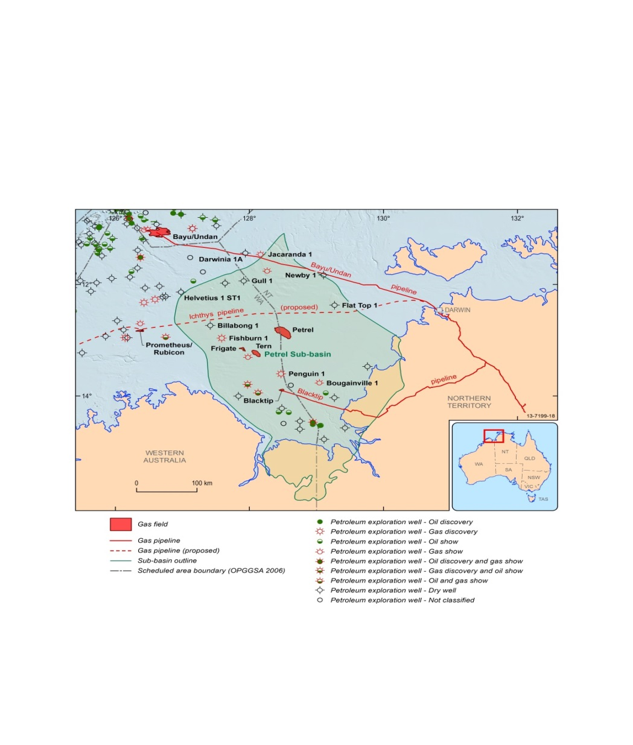
Case Study: Northern Australia Bonaparte Storage
Capture: Darwin LNG and Ichthys
Total: ~10 Mtpa
Storage: Plover Storage Formation
Total Resources:
  15 GtCO₂ (P50)
Annual Injection rate
  15 Mtpa CO₂
Injection simulation area
Storage resource area
Source: After Consoli et al. Geoscience Australia

Slide 12
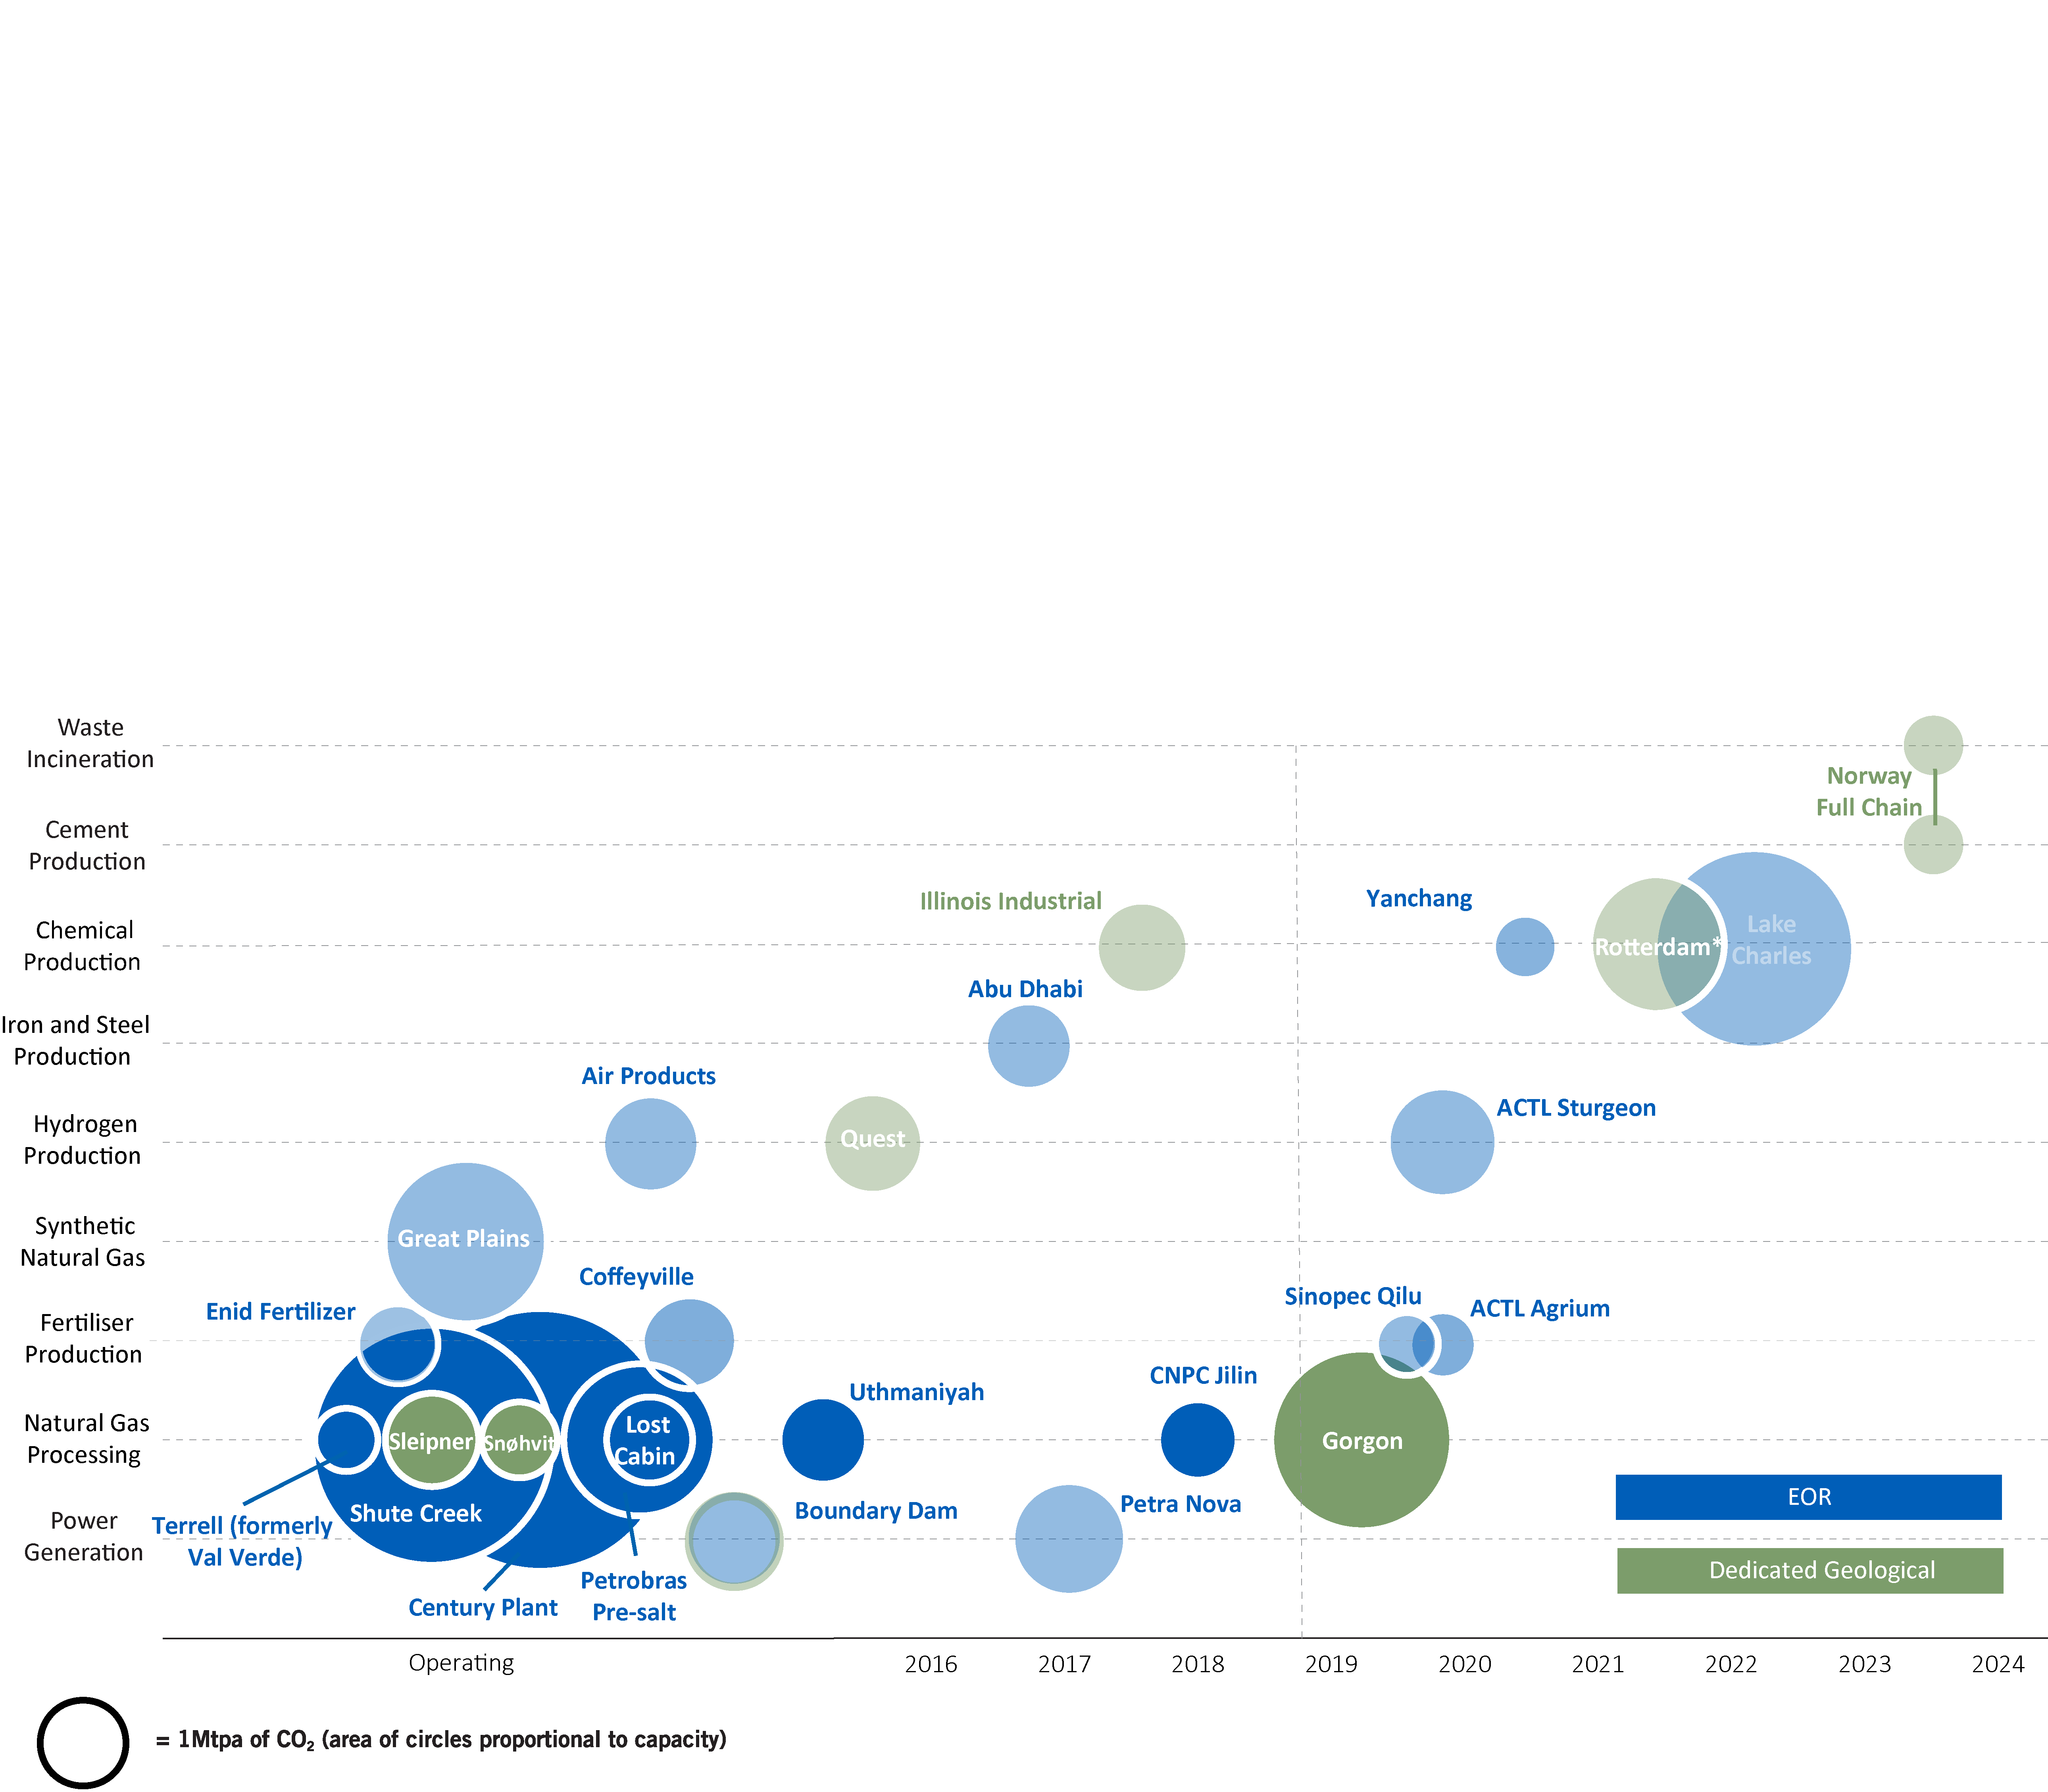
Natural Gas and CCS: Global Examples
ShuteCk
65%CO₂
Sleipner
4-9%CO₂
Snøhvit
5-6% CO₂
Snøhvit
8-15% CO₂
Jilin
20-97% CO₂

Slide 13
Thank you
globalccsinstitute.com

