Slide 1
MOONIE CO2-EOR Project
APAC CCS Forum
May 2019

Slide 2
Disclaimer
The information in this document has been provided to you for information only by Bridgeport Energy Limited a wholly owned subsidiary of New Hope Corporation Limited (“NHC”) and is subject to change without notice. Nothing contained in this document constitutes investment, legal, tax or other advice. The information in this document does not take into account your investment objectives, financial situation or particular needs. Before making an investment decision, you should consider, with or without the assistance of professional securities adviser, whether an investment in NHC is appropriate in the light of your particular investment needs, objectives and financial circumstances.
Nothing in this document should be considered a solicitation, offer or invitation to buy, subscribe for or sell any security in the United States of America (“US”) or in any place in which, or to any person to whom, it would be unlawful to make such an offer or invitation. The distribution of this document outside Australia may be restricted by law. Persons who come into possession of this document who are not in Australia should seek advice on and observe any such restrictions. Any failure to comply with such restrictions may constitute a violation of applicable securities laws.
Neither this document nor any copy hereof may be transmitted in the US or distributed, directly or indirectly, in the US or to any US person including (1) any US resident, (2) any partnership or corporation or other entity organised or incorporated under the laws of the US or any state thereof, (3) any trust of which any trustee is a US person, or (4) and agency or branch of a foreign entity located in the US.
By accepting this document you agree to be bound by these limitations. NHC has prepared this document based on information available to it. Although reasonable care has been taken to ensure that the facts stated and opinions given in this document are fair and accurate, the information provided in this document has not been independently verified. Accordingly, no representation or warranty, express or implied is made as to the fairness, accuracy, completeness or correctness of the information and opinions contained in this document. To the fullest extent permitted by law, none of NHC, its directors, employees or agents or any other persons accepts any liability for any loss whatsoever arising from any use of this document or its contents, or otherwise arising in connection therewith.

Slide 3
Overview of Presentation
Moonie background, location and production history
Analogue pre-screening
CO₂-EOR Pilot Project concept
Reservoir simulation modelling
Sourcing CO₂
Government Subsidy Options
Australian Carbon Credit Units
Tax Concession

Slide 4
Moonie Oil Field Background & History
developed 1964, the first commercial oil field in Australia PL1(1)
acquired by Bridgeport in 2016 from Santos
production to date: 25 Mbbls, currently producing approximately 135 BOPD with average water > 99%
sweet light (35ºAPI gravity) crude,
under-saturated at reservoir conditions, so some associated gas
composition is effectively unchanged after 55 years production
strong water drive effectively providing secondary recovery
minimal decline from the original reservoir pressure of 2520 psig
BEL is well progressed on approvals for a tertiary recovery production phase commencing 2022
Finalising CO₂ source, good progress on PCC plant
Working Environmental Authority amendments under P&G Act 2004
Designing infield modifications to existing infrastructure (48 wells / CPF)

Slide 5
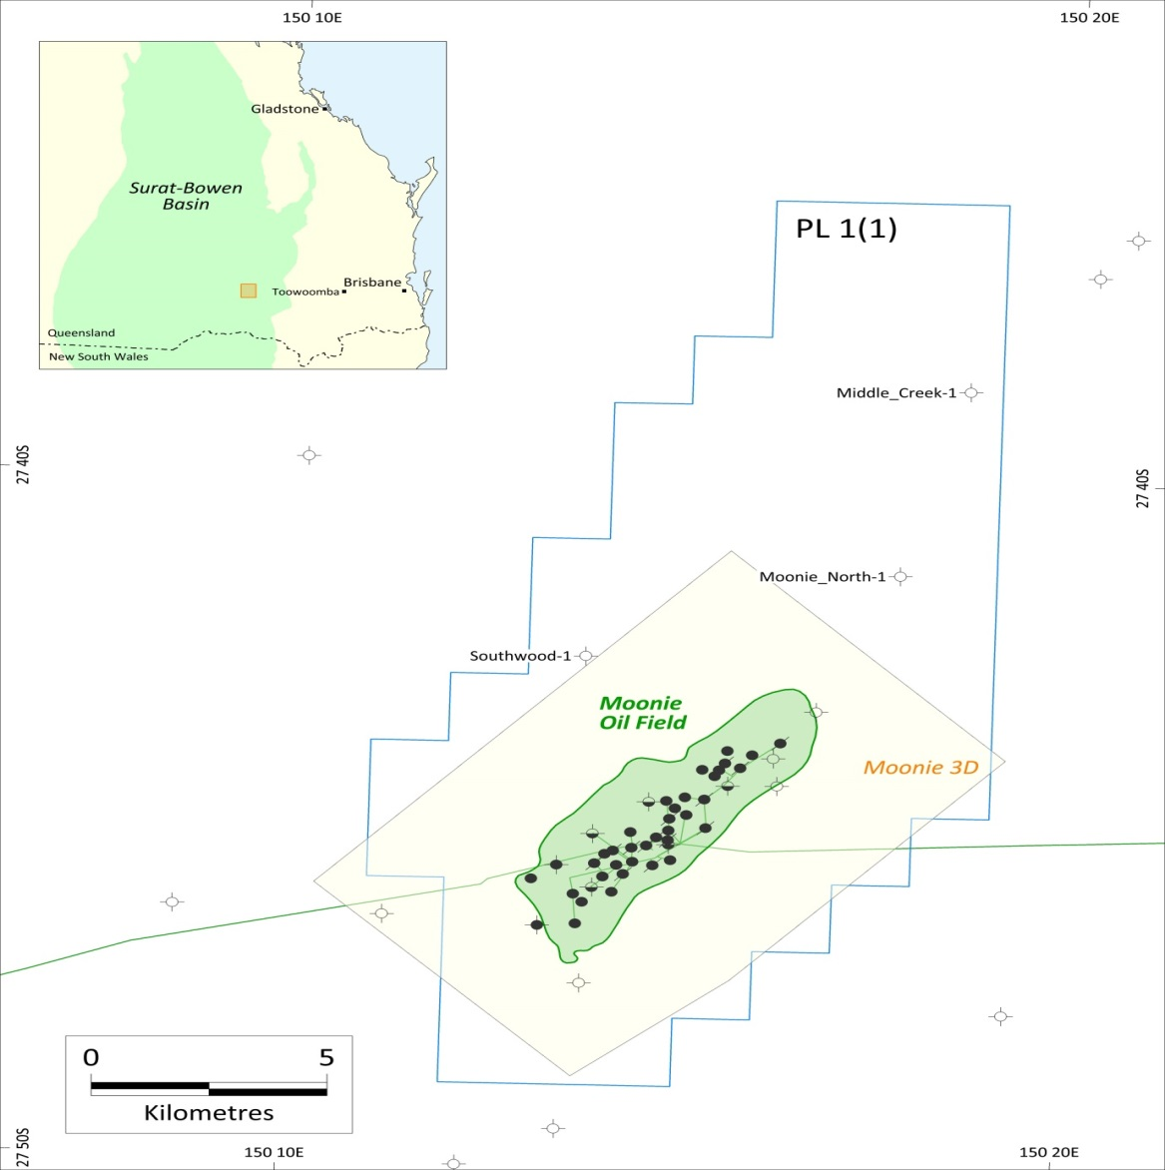
Location
Moonie oil field
170km west of Toowoomba, Queensland
Precipice formation is 1,750mRT deep
48 wells in field most available for injection/production
crestal injectors planned with flank producers
sound top seal and well integrity will be checked during tertiary phase on each well

Slide 6
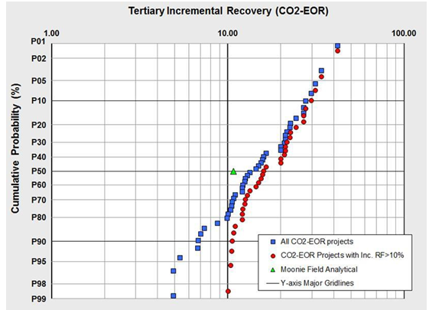
Analogue EOR Pre-Screening
Moonie petrophysical and fluid properties helped to identify EOR analogues in the USA (140 similar field types)
Results plotted to left estimated 10.2% of Original Oil in Place (64Mbbls) was achievable
Pre-screening result prompted decision to
Construct a reservoir model
Undertake lab and detailed simulation work
Commence hunt for CO₂ sources
Source MI3 Petroleum Engineers

Slide 7
Wyoming Analogues

Slide 8
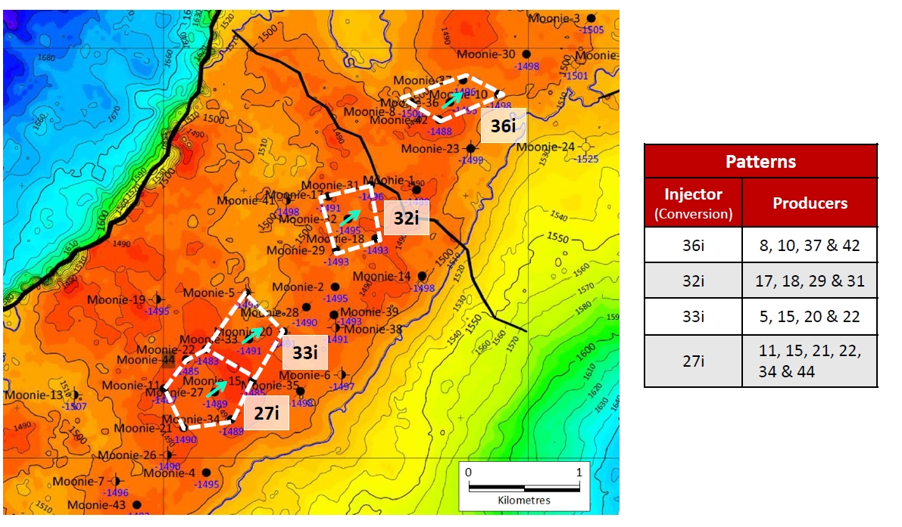
Reservoir Simulation Modelling
Legacy cores sent to USA for establishing petrophysical and fluid rel perms
Core data turned into digital model with EXA
Physical data used to populate reservoir model
Four injector-producer spot patterns considered potential pilot areas
Moonie #27 most attractive option technically and commercially

Slide 9
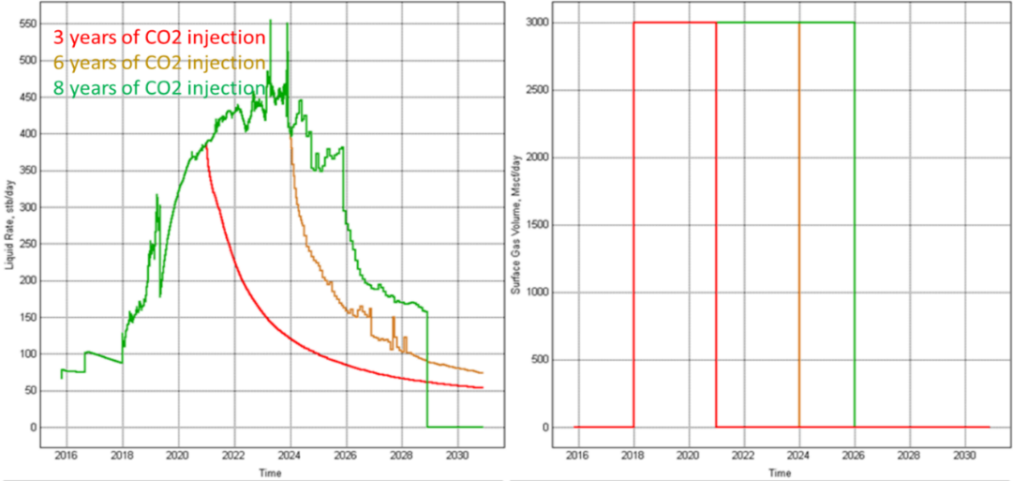
#27 Pilot Prodn & Injectn Rates
Injection of 3 mmSCFD for 3, 6 and 8 years achieves cumulative recoveries of 0.7, 1.13, 1.34 Mbbls respectively with the bulk of the injected CO2 being sequestered.
Notes:
A number of simulations were performed in order to asses the sensitivity of oil production and CO2 geosequestration potential to critical operational parameters
These two parameters are injection rate and injection time
Four different cases were created

Slide 10
Sourcing CO₂
Planning reliable long term industrial quality CO₂ source from post combustion capture (PCC) plant to be built in SE Queensland. All other options considered either unreliable are unreasonably costly.
Front End Engineering Design (FEED) for PCC plant of 120,000 tonnes/year (6 mmSCFD) completed.
Supported by COAL21 (in its pursuit of low emission options)
CO₂ from plant likely to also be used for a CCS research project
Plant FID Q3 2019 and expected to be operational by Q1 2022
CO₂ trucking planned from PCC plant to Moonie for phase 1, phase 2 by pipeline

Slide 11
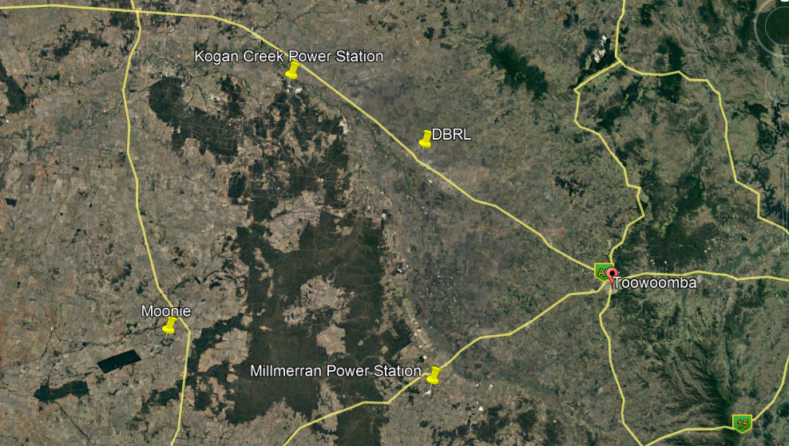
Possible Sources of CO₂

Slide 12
Indicative Full Field Recovery
Purchased CO₂ requirements >8M tonnes with peak rates of 1 M tonnes/annum
Post EOR sequestration would be considerably more in order of 15-20 Mtonnes (pressure dependent)
Notes:
A number of simulations were performed in order to asses the sensitivity of oil production and CO2 geosequestration potential to critical operational parameters
These two parameters are injection rate and injection time
Four different cases were created

Slide 13
OIL Business Sustainability is via CCUS
81-1/2% of GHG Emissions come from Oil Combustion and Use (balance reservoir to fuel tank)
Combustion is from: power generation (3rd world countries), heavy transport (planes ocean going vessels, trains and trucks), light transport (passenger vehicles), plastics and plastic products manufacture
World oil use split is approximately:1/3 plastics and plastics manufacturing, 1/3 heavy transport, 1/6 light transport, 1/6 power generation.
Oil consumption is increasing as third world countries move up the social progress index (India and China leading) from 0.5L/day per person to 40-50L/day per person. 600million barrels of increased demand in 2018 alone.
The only way to reduce Emissions is by:
Moving to EV’s, electric trains and trucks and non oil generated power where there is infrastructure and sufficient clean energy supply (progressing in Australia but a lot to be done, let alone India and 3rd world countries)
Moving to gas fired ships
AND Using CO₂ from thermal coal fired power plants and sequestering 1mT per barrel of oil produced (CCUS)
Greener than Ethanol fuel (which emits CO₂ for each barrel produced) – yet people buy E10??

Slide 14
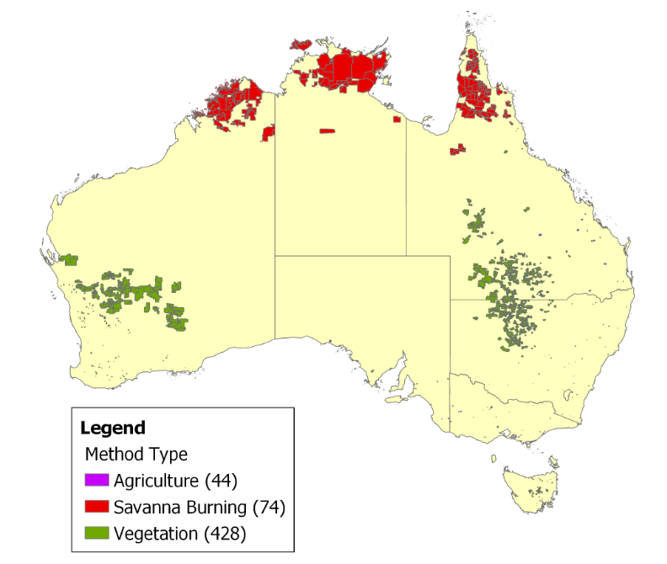
Federal Subsidy Options
New tech generally requires a period of subsidies, whether PV panels, windpower or now CCUS
First approach by BEL was for:
Australian Carbon Credit Units (ACCU)
ACCU funding has been directed to avoidance and conversion rather that sequestering CO₂

Slide 15
Federal Subsidy Options
Second approach was to the Clean Energy Regulator:
Possibly ERF’s first “Facilities” eligible emission reduction activity
Subsequent advice was that CO₂-EOR did not qualify
No legislation in place
UNFCCC had not approved CO₂-EOR
CO₂ might partially leak from Moonie
approval unlikely as the injected CO₂ would produce fossil fuels
GCCSI assessment for BEL in May 2018 concluded
CCS is able to generate emission reduction credits
CO₂ -EOR while CCS, is not recognised as a Clean Development Mechanism (CDM) and is not an eligible emission reduction activity and cannot generate credits
NGER would require users to report CO₂ in EOR operations as an emission (yet N America does not?)
Approaches to DIIS and DEE did not help

Slide 16
Federal Subsidy Options
BEL considers that a tax concession similar to the USA 45Q scheme is best
Rewards positive CO₂ abatement action plus facilitates installation of PPC plants at TCF generators
Jobs at the power plant and jobs at the oilfield
It is NOT a carbon tax and attracts bipartisan support
Income tax & royalties from incremental crude production is realised which otherwise may not have been produced (offsets tax concession)
MCF of CO₂/bbl | 8 | 9 | 10 | 11 | 12
Royalty 10% Income tax 30% per barrel:
Crude Price $100/bbl | $29.63 | $29.09 | $28.54 | $27.99 | $27.45
Federal Tax Concession @ $35/tonne | -$14.78 | -$16.62 | -$18.47 | -$20.32 | -$22.16
Net Federal Benefit @$100/bbl | $14.85 | $12.47 | $10.07 | $7.67 | $5.29
Indicative A$ price per barrel of oil produced

Slide 17
“45Q” contribution to the Future
Will be a significant factor in the decision to expand the Millmerran PCC plant to capture up to 40% of emissions ($4-600million project)
The Moonie project will initiate serious interest in Australian CCUS
Without a tax concession, there is little interest in pursuing larger offshore production and sequestration opportunities as below
The only requirement is federal government implementation of a tax concession around CO₂ which nearly all OECD countries have in place to help levelise the cost of energy

