Slide 1
CCUS in SINOPEC
LUN Zengmin, CUI Maolei, ZHOU Bing
Notes:
the developing of EOR technique in SINOPEC, on behalf of the research group, especially Professor Lun and Dr. Cui
PEPRIS: Petroleum exploration and production research institute of SINOPEC

Slide 2
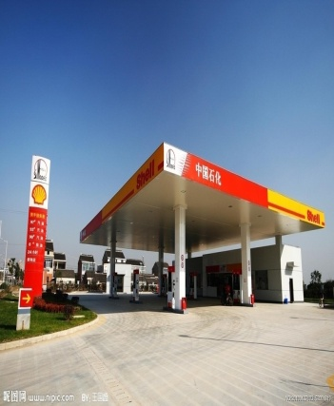
Brief introduction on SINOPEC
SINOPEC Group is the largest integrated national energy and petrochemical company in China.
E&P
Refinery
  The 2rd largest oil & gas producer in China
  The 2rd largest refinery in the world
  The 4th largest ethylene producer in the world
Sale
Petrochemical

Slide 3

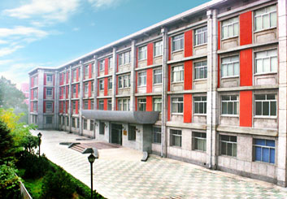
Brief introduction on PEPRIS
Petroleum Exploration and Production Research Institute is a secondary unit of SINOPEC Group. Its business mainly includes the development of technology, supporting the E&P of oil field, strategy research, etc.
Oil&Gas Planning Office
Strategy Research Office
Oil&Gas Exploration Office
Geophysical Research Office
Unconventional Resource Office
Enhance Oil Recovery Office
…

Slide 4
Contents
1.
China’s CCUS Policies and Actions
2.
SINOPEC CCUS Strategy
3.
SINOPEC CCUS Projects
4.
SINOPEC CCUS Technology

Slide 5
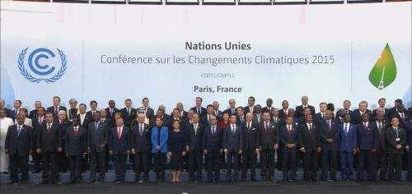
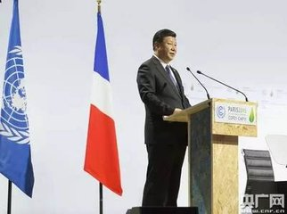
China’s CCUS Policies and Actions
China stands firm on reducing CO₂ emissions. At the Paris Climate Conference in December 2015, President Xi pledged to reduce carbon dioxide emissions per unit of GDP will be lowered by 60~65% per by 2030, compared with 2005.
中国能源结构变化趋势(国家统计局)

Slide 6
China’s CCUS Policies and Actions
Governmental Policies: Since 1990s, a series of CCUS policies and regulations were formulated to promote the development of CCUS technology

Slide 7
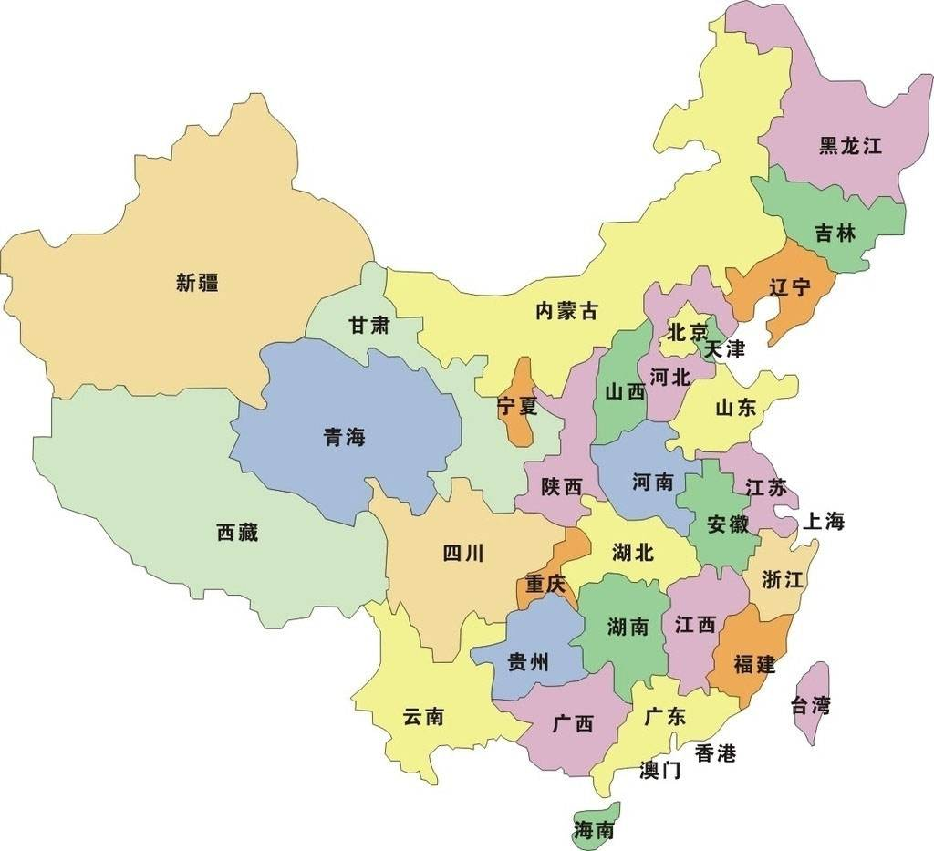

China’s CCUS Policies and Actions
Governmental Policies: Provincial governments responded positively & actively
16 Provinces and cities have issued policies to promote the development of CCUS;
20 CCUS related regulations & policies were published by local governments of :
Beijing (2), Shanghai (3), Shaanxi (2), Ningxia (2), and Henan (1), Hubei(1), Jiangsu(1), Anhui(1), Zhejiang(1), Hunan(1), Jilin(1), Jiangxi(1), Guangdong(1), Heilongjiang(1), Chongqing(1)

Slide 8
China’s CCUS Policies and Actions
Pilot & demonstration projects: The Ministry of Science and Technology has funded a series of national R&D programs to carry out systematic theoretical study and applied technology research, and to promote the application of CCUS.
CCUS Development
University
Research
Institute
Industry
Fundamental research
National funding
Technology prototype and Pilot test
973 Project
Applied technology
863 Project
Industrial Application
Industrial support
973 Project
863 Project
National Special fund

Slide 9
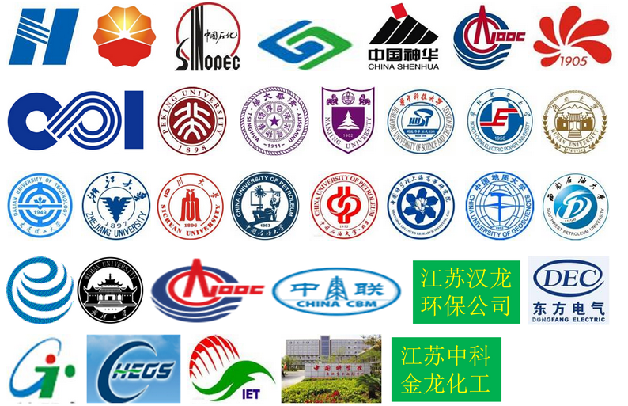
China’s CCUS Policies and Actions
Support from Oil & Gas Industry: A strategic alliance of CCUS industry technology innovation was established by enterprises, schools and colleges in order to promote the innovation and development of CCUS technology and industry in China.

Slide 10
China’s CCUS Policies and Actions
Support from Oil & Gas Industry: Chinese companies are actively promoting the development and application of CCUS technology, and carried out more than 20 CCS pilot projects.
CO₂ Capture | Shengli Power Plant Flue gas Capturing, SINOPEC
 | Tail Gas capture from Zhongyuan Chemical Plant, SINOPEC
 | Recovery of High carbon Natural Gas from Songnan Gas Field, SINOPEC
CO₂ EOR | CO2 flooding Project of Shengli Oilfield, SINOPEC
 | CO2 flooding Project of Zhongyuan Oilfield, SINOPEC
 | CO2 flooding Project of Caoshe Oilfield, SINOPEC
 | CO2 flooding Project of Yaoyingtai Oilfield, SINOPEC
 | Jilin oilfield CO₂-EOR, CNPC
 | Daqing oilfield CO₂-EOR, SINOPEC
 | Yanchang oilfield CO₂-EOR, Yanchang Petroleum
CCUS | CO₂ utilization in Chemical Engineering, Zhongkejinlong
 | Beijing thermal power plant CO₂ Capture, Huaneng group
 | degradable plastics, CNOOC
 | Shidongkou CO₂ Capture, Huaneng group
 | Shuanghuai Power Plant CO₂ Capture, State Power Investment
 | Clean Coal Energy Power system
 | Coal Oil and CCUS, Shenghua Group
 | Microalgae carbon sequestration and bioenergy project, ENN Group
 | Green Coal Power IGCC Power Plant CCUS Demostration Project, Huaneng Group
 | 35MWt Oxygen-enriched Combustion Technology, Huazhong University of Science and Technology
SINOPEC
CNPC

Slide 11
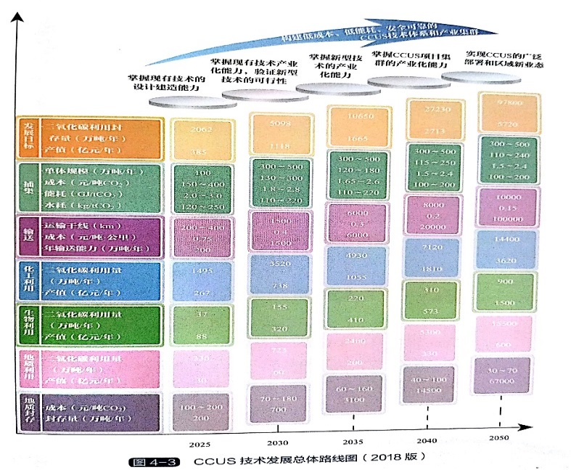
China’s CCUS Policies and Actions
China CCUS Roadmap:
2015-2030: to acquire the ability of CCUS industrialization and verify the feasibility of new technology;
2030-2040: to achieve CCUS industry cluster and to conduct commercial CCUS project;
2040-2050: to realize the extensive deployment of CCUS
Asia Development Banl,2015
China MOST, 2018

Slide 12
Contents
1.
China’s CCUS Policies and Actions
2.
SINOPEC CCUS Strategy
3.
SINOPEC CCUS Projects
4.
SINOPEC CCUS Technology

Slide 13
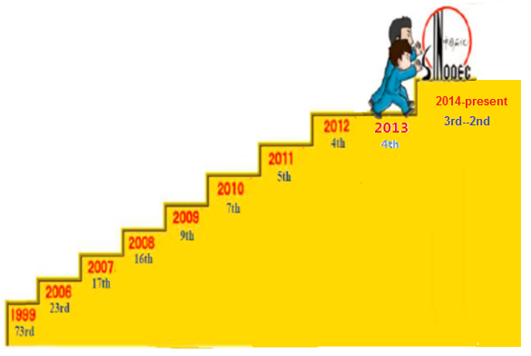
SINOPEC low-carbon strategy
Green and low-carbon strategy, as one of the core strategies, enables SINOPEC to develop rapidly and sustainably.
Resource strategy
Integration strategy
Low carbon strategy
Internationalization strategy
Market strategy
Differentiation strategy
Global Fortune 500 Tops

Slide 14
SINOEPC low-carbon activities
In 2018, Sinopec has launched a Green Enterprise Action Plan. Green and low-carbon activities promote the progress to be the resource-saving and environment-friendly enterprise
Blue sky & Clear water action
870 projects and 20.92 billion RMB
Xiongan mode for geotherm
Heat supply: 5╳10⁷ m²
substitutable coal: 1.42 million tonnes,
CO2 mitigation: 3.70 million tonnes
Green enterprise action plan
2018
2011
2013
2014
2016
2017
Green & low carbon strategy
To be one of the core strategies
Energy efficiency multiplier program
1930 projects, saving coal 3.37 million tonnes
Shale gas achievement
Fuling shale gas field with the productivity of 10 billion m³, and the proved reserves of 600.8 billion m³

Slide 15


SINOEPC CCUS strategy
long-range perspective
2030-2050
Industrial capacity building
Industrial application for CO2 EOR and storage
Larger scale demonstration project for CO₂ utilization and storage
Industrial application
Diversification
Scalization
Commercialization
long-medium term
2020-2030
Technical capacity building
Prior development to CO2 EOR and storage
Technical reserves for CO2 utilization and storage
CO2 source and sink match planning
Short term
Present-2020

Slide 16
Contents
1.
China’s CCUS Policies and Actions
2.
SINOPEC CCUS Strategy
3.
SINOPEC CCUS Projects
4.
SINOPEC CCUS Technology

Slide 17
SINOPEC CCUS R&D Projects
CCUS R&D projects have been conducted since 1990s, which accumulate abundant experience.
Difficulty
Mineralization
EGR
Microalgae oil
Utilization
EWR
Xianhe Oilfield
Pucheng
Gao 899
Yaoyingtai
Gao 89
Zhangjiaduo
Zhenglizhuang Oilfield
EOR
Caoshe
Fuming
Chujialou
Shengli Power Plant
Qilu Petrochemical
Shengli Power plant
Zhongyuan
Petrochemical plant
Capture
Songnan natural
gas proceesing
Zhongyuan
Petrochemical plant(II)
1990 2000 2010 2015年 2020

Slide 18
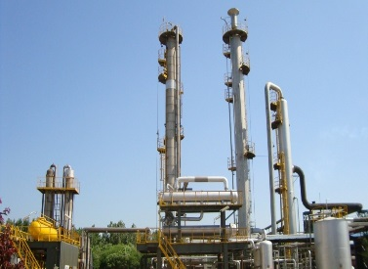
Pucheng Case (Zhongyuan Oilfield)
Source: Zhongyuan Petrochemical plant
Capture method: MEA
CO₂ source: 16.6%
Capture capacity: 20,000 t/a
Accumulative injection amount： 550 thousands tons
Reservoir type: Water-flooded abandoned reservoir, Pucheng oilfield
Permeability: 696 ╳10⁻³µm²
Temperature: 85℃
Water cut: 98%
Injection Scenario: CO₂ WAG miscible
Well: 22 injectors and 38 producers
Incremental RF: 9.9%

Slide 19
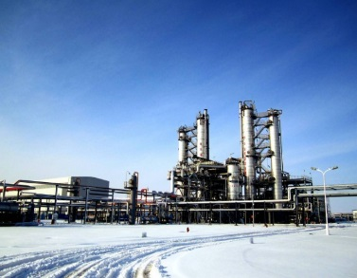
Yaoyingtai Case (Dongbei oilfield)
Source: Songnan natural gas processing
Capture method: MDEA
CO₂ source: 23%
Capture capacity: 500,000 t/a
Accumulative injection amount: 289 thousand tons
Reservoir type: low permeability high water cut reservoir, Yaoyingtai oilfield
Permeability: 1.9 ╳10⁻³µm²
Temperature: 97.5℃
Injection Scenario: CO₂ immiscible
Well: 39 producers and 12 injectors
Incremental RF: 6.27%

Slide 20
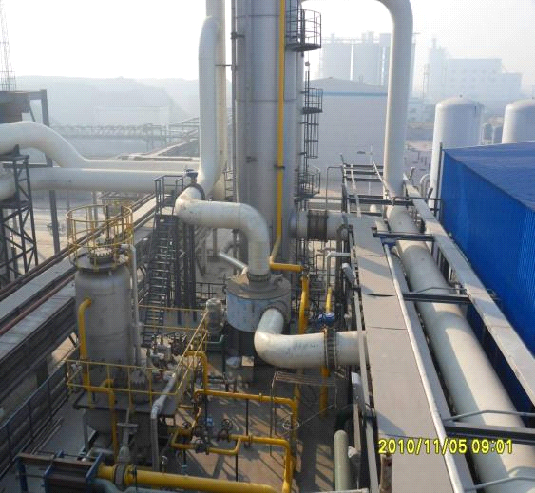
Gao 89 Block Case (Shengli Oilfield)
Source: Shengli Power Plant
Capture method: MSA
CO₂ source: 14%
Capture capacity: 40,000 t/a
Accumulative injection amount: 269.9 thousands tons
Reservoir type: low permeability reservoir, Gao 89 block, Shengli oilfield
Permeability: 4.7 ╳10⁻³µm²
Temperature: 97.5℃
Injection Scenario: CO₂ near-miscible
Well: 15 producers and 11 injectors
Incremental RF: 12.7%

Slide 21
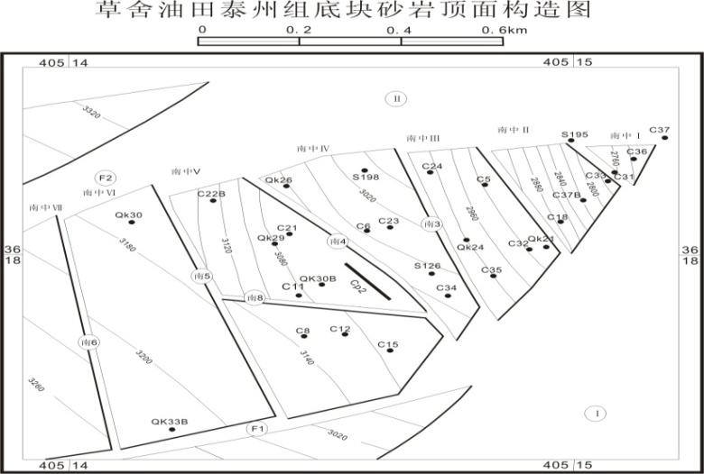
Caoshe Case (Huadong Oilfield)
100
Side injection
CO₂-EOR from new wells
80
CO₂-EOR from old wells
2007-6
2006-10
60
Fracturing
2005-7
2006-2
waterflooding
& deepening
40
新井注气增油(t/d)
2005-7
新井投产产油（t/d)
20
老井CO2增油(t/d)
压裂+深抽增产(t/d)
无措施递减预测(t/d)
0
2001年10月
2002年10月
2003年10月
2004年10月
2005年10月
2006年10月
2007年10月
2008年10月
2009年10月
2010年10月
2011年10月
2012年10月
2013年10月
Source: Natural CO₂ gas produced from Subei basin
Accumulative injection amount: 196 thousand tons
Reservoir type: Taizhou formation, Caoshe Oilfield, Subei Basin
Permeability: 24.77╳10⁻³µm²
Temperature: 110℃
Formation Pressure: 32MPa
Injection Scenario: CO₂ miscible
Well: 15 producers and 5 injectors
Incremental RF: 7.89%

Slide 22
CO₂ EOR and storage Cases
Reservoir type: high water cut, low permeability, tight.
Project Number: 26
Incremental injection amount: 1.77×10⁶ tons
Incremental oil recovery: 28×10⁴ tons
Oil exchange rate: 0.16 t/t CO₂.
Tahe Oilfield
Baolang oilfield
Dongbei
Shengli Oilfield
Honghe oilfield (Huabei)
Zhongyuan oilfield
Huadong oilfield
Jiangsu oilfield

Slide 23
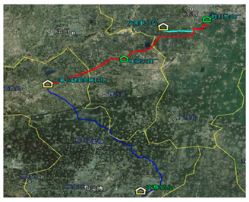

CCS-EOR industrial bases
Three industrial bases
--Shengli Oilfield
--Zhongyuan Oilfield
--Subei basin (Huadong & Jiangsu)
Shengli Power Plant
(project appraisal)
CO₂ EOR Pilot Tests
CO2 PILOT TESTS
Qilu petrochemical coal gas(partial implementation
SHU101-CNPC
HONG87-CNPC
FANG48-CNPC
HEI59-CNPC
)
YAOYINGTAI-SINOPEC
HONGHE-SINOPEC
PUCHENG-SINOEPC
GAO 89-SINOPEC
Two large scale projects
--Shengli Power Plant: 1.0 million t/a
--Qilu Refinery plant: 0.6 million t/a
FUMING-SINOPEC
CHUJIANGLOU-SINOPEC
CAOSHE-SINOPEC

Slide 24
Contents
1.
China’s CCUS Policies and Actions
2.
SINOPEC CCUS Strategy
3.
SINOPEC CCUS Projects
4.
SINOPEC CCUS Technology

Slide 25
Full-chain CCS-EOR technologies
Capture
transport
EOR & storage
Recycle & utilization

Slide 26
CO₂ Capture Technology
New capture solvents have been developed to tackle the issues of corrosion, higher energy consumption, amine loss.
Solid adsorption
Membrane separation
Solvent absorption
Ionic liquid method
Low temperature distillation
Carbon Capture Solvent
Notes:
the absorption mechanism of polyamino weak base
the antioxidant degradation mechanism of reaction chain blocking
Polyamino capture solvent:
high efficiency
low energy consumption
anti degradation
low corrosion
Capture process
absorption heat pump + MVR
reduce the energy consumption
reduce the circulating water consumption

Slide 27
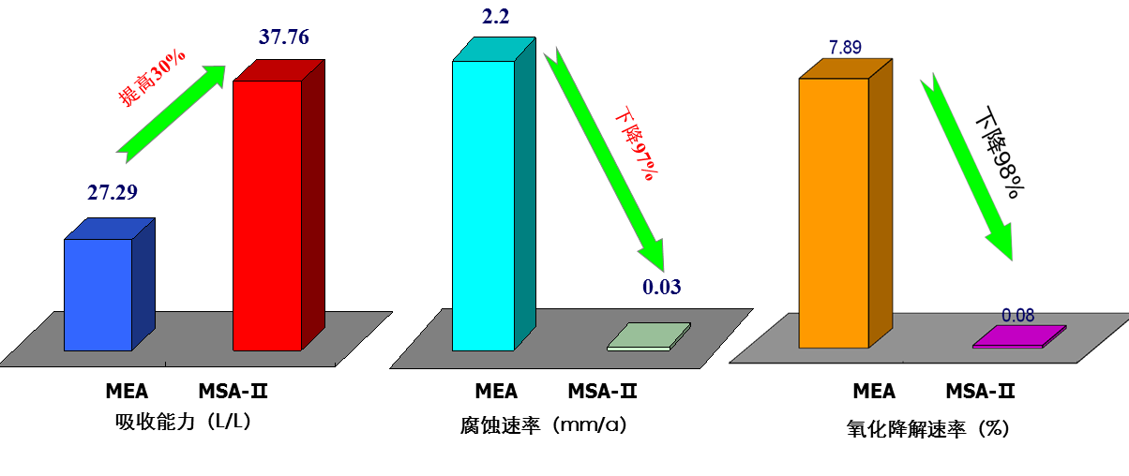
CO₂ Capture Technology
Self-developed product of MSA-II solvent has a more superior performance than the normal MEA.
Increase by 30%
Decrease by 97%
Decrease by 98%
Absorption capacity (L/L)
Corrosion rate (mm/a)
Oxidation degradation rate(%)
Notes:
中国石化在二氧化碳捕集与利用领域具有50多年的研发历史，

Slide 28
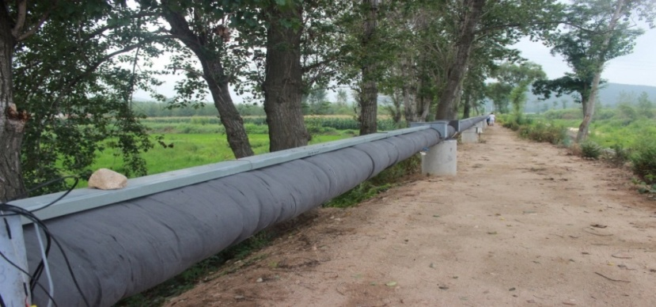
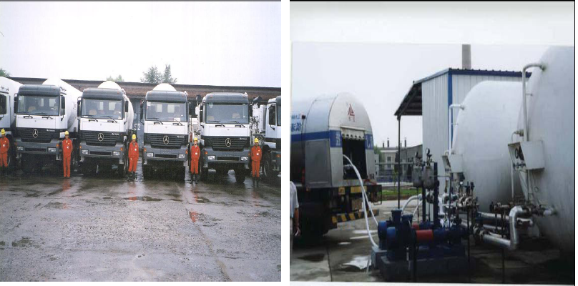
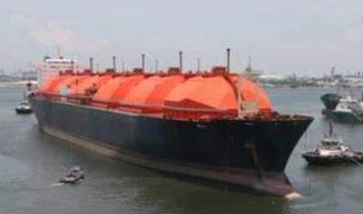
CO₂ Transportation
Three CO₂ transportation ways have been successfully tested in CO₂ EOR pilot tests.
CO₂ Pipeline in Shengli oilfield
--20km, gas phase transport
CO₂ Truck in Zhongyuan oilfield
--low temp., liquid phase transport
CO₂ ship in Huadong oilfield
--low temp., liquid phase transport
Shengli oilfield--pipeline
Zhongyuan Oilfield--truck
Huadong oilfield--ship

Slide 29
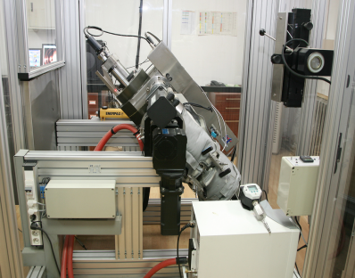
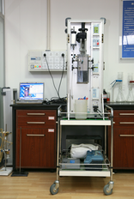
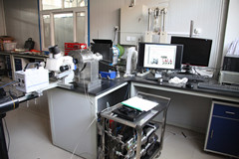
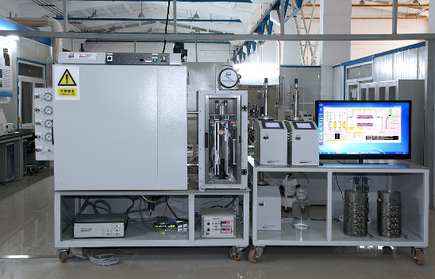
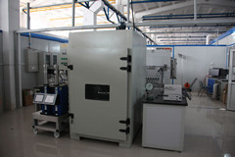
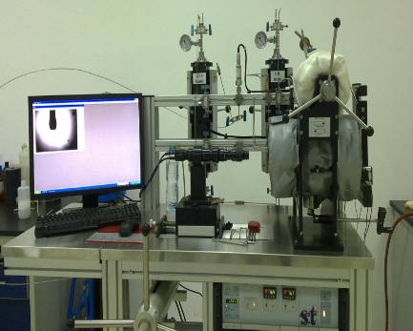
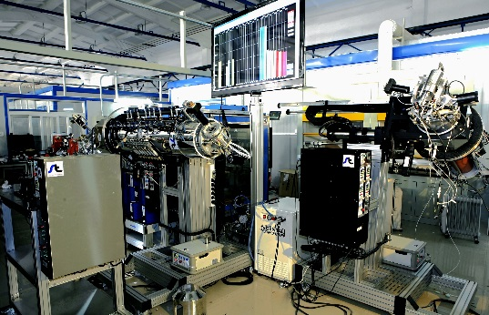
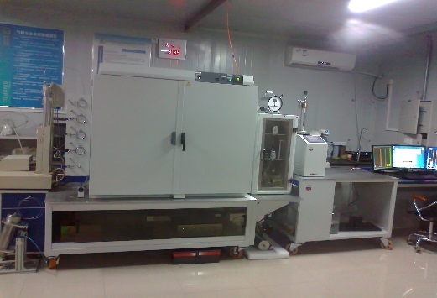
CO₂ EOR and Storage Technology
CO₂ EOR Laboratory
Phase behavior
Miscibility and Micro-visualization
PVT
Capillary viscometer
Micro-physical simulation system
Slim-tube device
Interfacial tension and diffusion
Multiphase flow
Interfacial tension
Diffusion coefficient
Interfacial tension device
Multipoint Long core holder
Foam flooding system

Slide 30
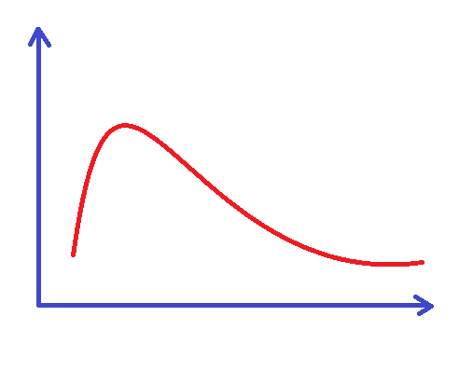
CO₂ EOR and Storage Technology
Numerical simulation integrated CO₂ EOR and storage
CO₂ partition coefficient
Hysteresis effect
CO₂ mineralization
Optimizing parameter
EOR
Storage
1
2
Oil rate
ω₁ =0.9
ω₂ =0.1
ω₁ =0.5
ω₂ =0.5
ω₁ =0.1
ω₂ =0.9
3
Mid-term: EOR and storage
initial stage: EOR
later stage: storage
Injection time
CO2 storage mechanisms in EOR
Full life circle of CO₂ EOR and storage

Slide 31
CO₂ EOR and Storage Technology
Chemical enhancement CO₂ EOR technologies
MMP reduction agent
CO₂ MMP Reducer
CO₂ emulsifier
CO₂ foam
CO₂ particle
CO₂ gel
CO₂ thickener
—ethers regulator
—oil soluble surfactant (Isobutyl citrate)
—Supercritical CO₂ soluble surfactant with auxiliaries
CO₂-chemical enhancement system
Mobility control agents
—CO₂ thicker
—CO₂ emulsifier
—CO₂ foam agent
—CO₂ particle gel
—CO₂ gels
stepping control to improve sweep efficiency
Notes:
Low P
Heterogeneity
Poor quality

Slide 32
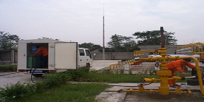
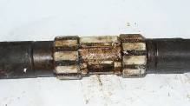
CO₂ EOR and Storage Technology
Injection-production and anti-corrosion technology
wellhead
Multiphase flow
Critical point
(bubble point)
anti-corrosive chemical agent
Single phase flow
formation
Multiphase flow simulation in wellbore
coupon corrosion test

Slide 33
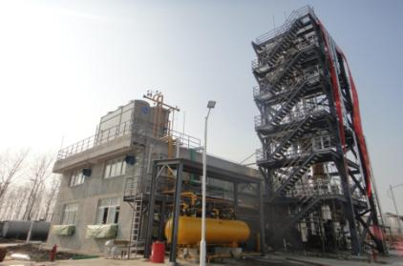
CO₂ EOR and Storage Technology
CO₂ recycle and reinjection technology
Features:
CO₂ purity > 96%
Moisture < 200ppm
Low energy consumption: 150kw.h/tCO₂
Membrane separation with simple operation and low investment
diagram map of rectification with low temperature stripping

Slide 34
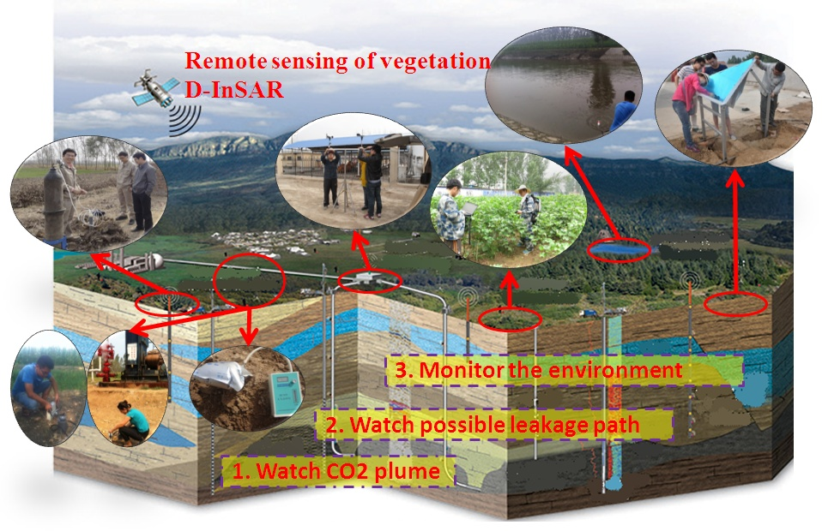
CO₂ EOR and Storage Technology
CO₂ monitoring and safety evaluation

Slide 35
CO₂-EOR of tight sandstone reservoir
Prospects for EOR
By now, CO₂ is one of the best way to enhance recovery in China.
China has over 10 billion tons resource in tight reservoirs, which are suitable for CO₂ EOR.
Yanchang formation in Ordos
The Permian in Jungle
middle-lower Jurassic
Shahejie formation in Bohai Bay
Qingshan Formation in Songliao

Slide 36
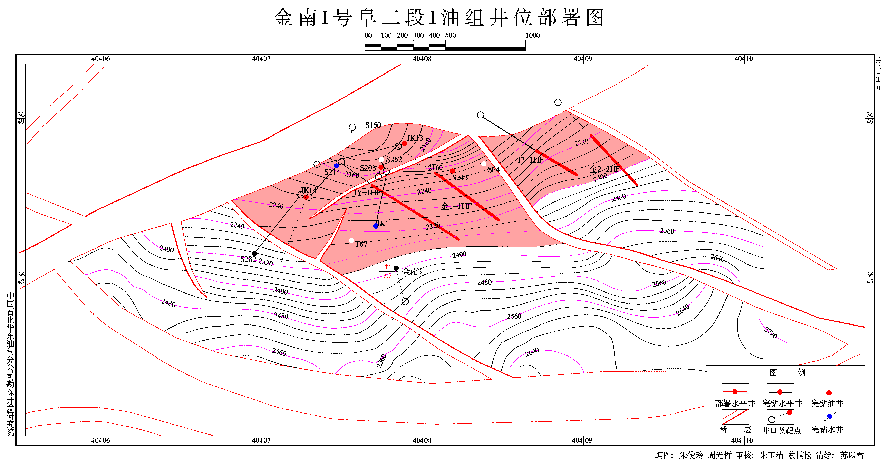
CO₂-EOR of tight sandstone reservoir
Overview of target formation：
Jinnan oil field lies in the North Jiangsu Basin
4 staged fractured horizontal wells were drilled in two tight oil areas
CO₂ injection was implemented in 2014.
Wellsite map of GroupⅠin Jinnan formation

Slide 37
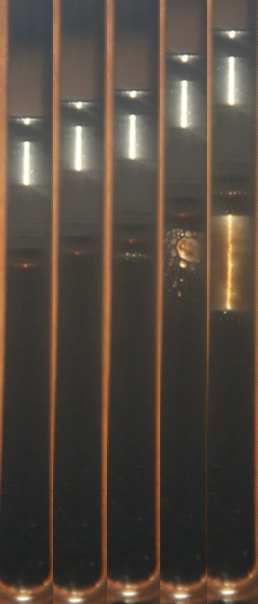
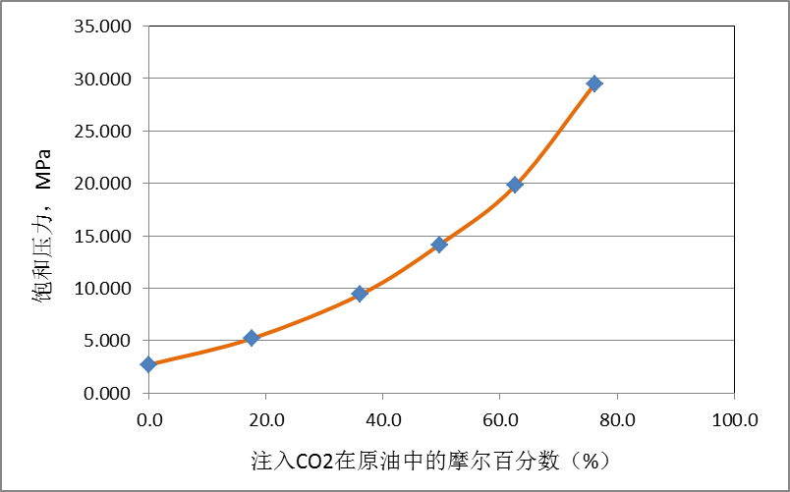
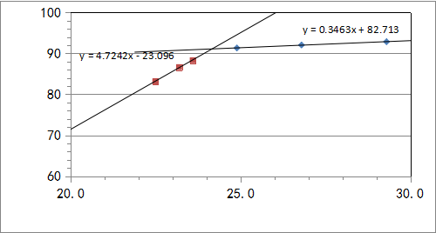
CO₂-EOR of tight sandstone reservoir
CO₂-EOR displacement mechanism
Bubble point increased, oil viscosity decreased, oil swelling
Be benefit for oil recovery as the increasing of CO₂ injection volume.
Immiscible displacement
Bubble point pressure, MPa
Bubble point Pressure— CO₂ injection
Oil viscosity— CO₂ injection
Oil viscosity, mPa·s
CO₂ mole, %
CO₂ mole, %
Oil volume factor— CO₂ injection
Bubble point
Oil volume factor
Oil recovery
PVT visualized device of HPHT
CO₂ injection pressure, MPa
CO₂ mole, %

Slide 38
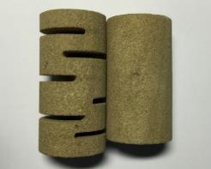
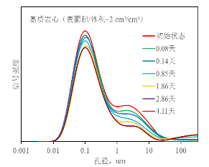
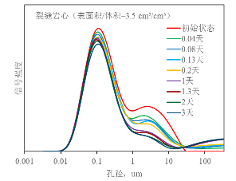
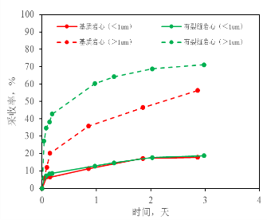
CO₂-EOR of tight sandstone reservoir
CO₂-EOR mechanism
CO₂ diffusion and extraction effect (NMR)
The fractures in matrix provide large contact area between oil and CO₂, playing an important role in CO₂ diffusion and extraction effect to enhance oil recovery.
Pore diameter,

Slide 39
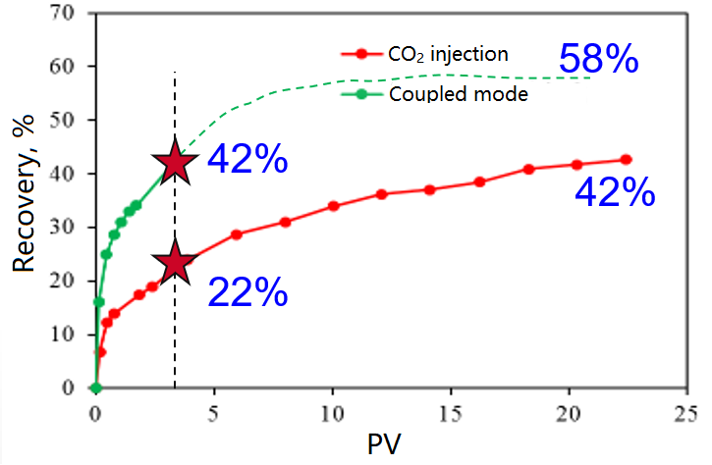
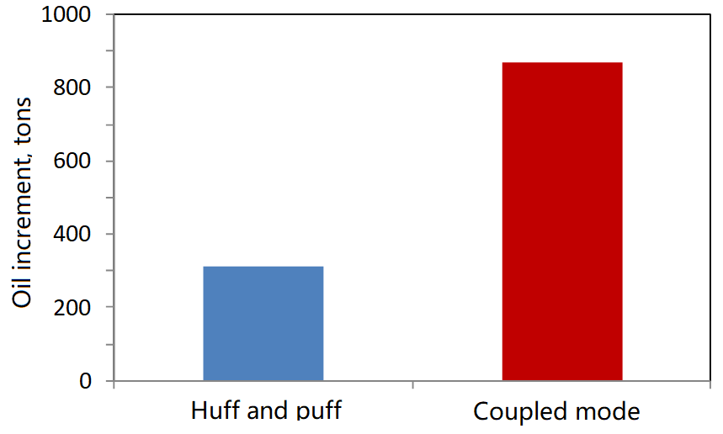
CO₂-EOR of tight sandstone reservoir
CO₂-EOR mode
Coupled huff and puff with well patterns
The fractures in matrix provide large contact area between oil and CO₂, playing an important role in CO₂ diffusion and extraction effect to enhance oil recovery.
Physical simulation
Numerical simulation

Slide 40
CO₂-EOR of tight oil reservoir
pilot test
Obvious effect of EOR
Total injection of CO₂：4406 tons
Increased oil production： 4692 tons
Oil/CO₂：1.06 ton/ton
EOR：4.7%.

Slide 41
CO₂ EWR and storage technology
Case study on Ordos basin shows a big potential for CO₂ EWR and storage.

Slide 42
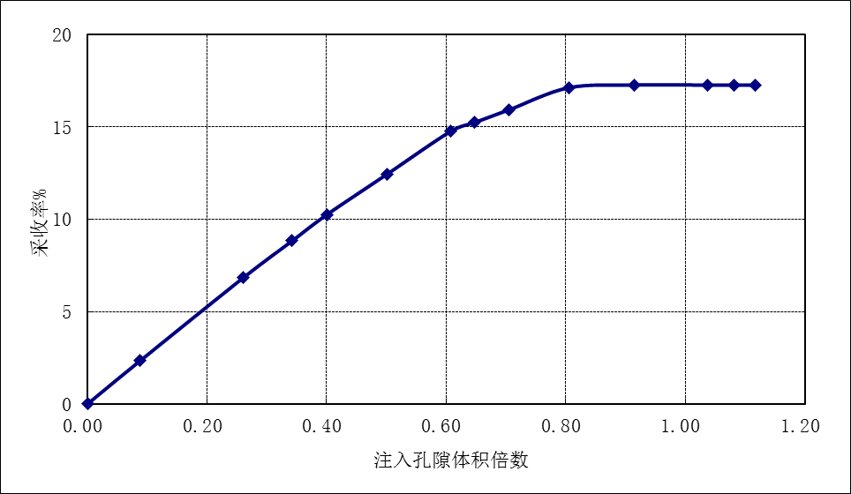
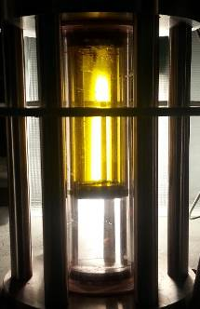
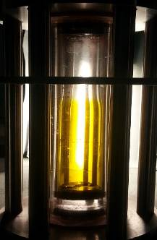
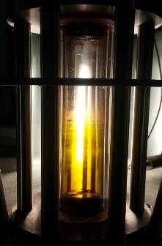
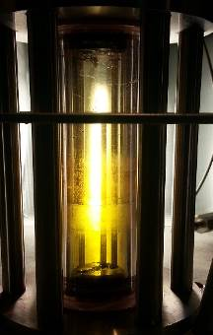
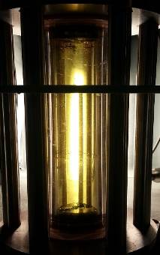
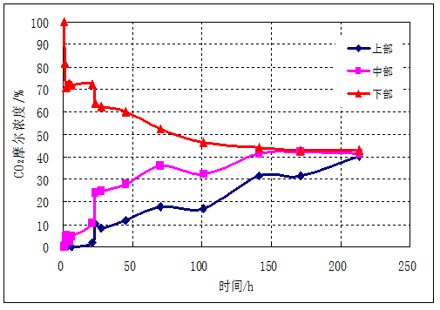
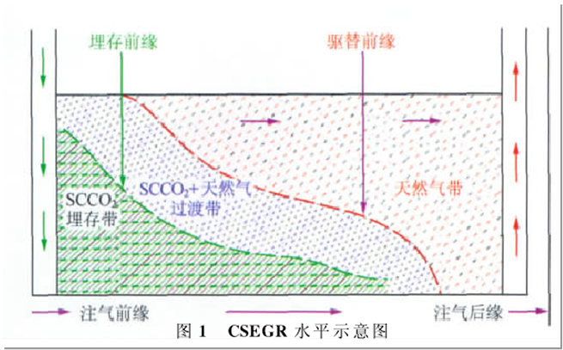
CO₂ EGR and storage technology
CO₂ EGR mechanisms indicate the technical feasibility to integrate EGR and storage
Recovery factor,%
Incremental RF: 17.3%
Pre injection 2h 20h 42h
Injection pore volume
Storage front
displacement front
CO2 concentration,%
SCCO2+Natural gas zone
Natural gas zone
SCCO2 Storage zone
Time, h
CO₂-CH₄ diffusion process (25MPa, 85℃)
Gas injection front
Gas injection trail edge

Slide 43
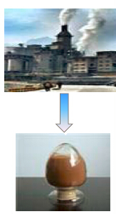
CO₂ chemical utilization technology
Bio-refinery and CO₂ utilization
-Biomass+CO₂ succinic acid, butanediol, et.
-Every 1kg succinic acid generates, 0.37kg CO₂ can be sequestrated.
-Succinic acid, butanediol can be utilized to produce biological engineering plastics.
Research on CO₂/CH₄ dry reforming
-Primary reaction：CO₂+CH₄——2CO+2H₂
-Secondary reaction：H₂+CO₂——CO+H₂O

Slide 44
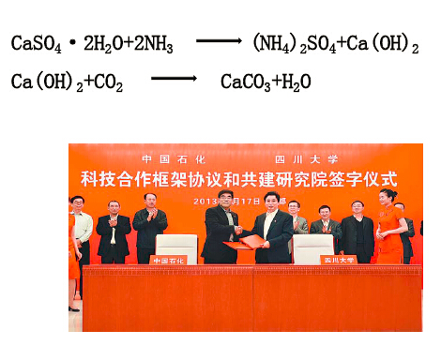
CO₂ mineralization utilization technology
A series of techniques on CO₂ mineralization have been proposed, including solid waste phosphogypsum, tail gas CO₂ mineralization phosphogypsum.
SINOPEC is cooperating with Sichuan University.

Slide 45


CO₂ biology utilization technology
CO₂ microalgae oil
In 2009, the study on microalgae oil was launched. In 2010, microalgae cultivation laboratory was established, and some researches on microalgae-cultivation-oil were carried out .
Demonstration unit in refinery
CO₂ emissions demonstration unit in Shijiazhuang refinery with 500m³ of microalgae was completed, and put into trail operation.

Slide 46
CONCLUSIONS
CCUS has been an indispensable part of green-low carbon strategy to promote the sustainable development for SINOPEC.
SINOPEC has implemented many demonstration projects in diversification and full chain, including capture, transportation, EOR, utilization and storage.
SINOPEC has the technical competence to promote the development of CCUS in China.

Slide 47
Thanks for your attention!
LUN Zengmin
Lunzm.syky@sinopec.com
CUI Maolei
Cuiml.syky@sinopec.com
ZHOU Bing
Zhoubing.syky@sinopec.com

