Slide 1
Guloren Turan, GM Advocacy and Comms
Jeff Erikson, GM Client Engagement

Slide 2
@GlobalCCS
Live: #StatusCCS2020

Slide 3
Agenda
Keynote
Tina Bru - Minister of Petroleum and Energy, Government of Norway
Report Findings and Q&A
Guloren Turan - GM of Advocacy and Communication, GCCSI
Jeff Erikson - GM of Client Engagement, GCCSI
Panel Discussion
Jamie Gentoso – CEO, LafargeHolcim US
Zoë Knight - Managing Director, Group Head HSBC Centre of Sustainable Finance, HSBC Holdings PLC
Torbjørg Klara Fossum - VP Global CCS Solutions, Equinor ASA
Vianney de Buchet – VP Energy Transition Europe, Air Liquide
Jamie Burrows – Client Engagement Manager, GCCSI (Moderator)
#StatusCCS2020

Slide 4
ASKING QUESTIONS
We will collect questions during the presentation.
Moderator will pose these question to the presenters after the presentation.
Please submit your questions directly into the GoToWebinar control panel.

Slide 5
Keynote remarks
Tina Bru
Minister of Petroleum and Energy
Government of Norway
#StatusCCS2020

Slide 6
THE GLOBAL STATUS OF CCS
In 2020, the pipeline of operational and under development CCS facilities continued to grow third year in a row.
Number of countries, cities and companies committing to net-zero climate targets increased in 2020 despite the adversities faced, accelerating CCS development.
Policy and funding support for CCS continued its momentum, most notably in the US, UK, Norway, EU, Japan and Australia.
Three factors are enhancing the business case for CCS around the world:
Enhanced tax credit in the US
Hubs and clusters
Hydrogen, as the fuel of the future
Despite the progress in 2020, to achieve net-zero emissions, CCS capacity must increase more than a hundredfold by 2050.

Slide 7
GLOBAL CCS facilities update
MATURING INDUSTRY RESULTS IN UPDATED CLASSIFICATION SYSTEM
New system introduced : classifies CCS facilities as ‘Commercial’ or ‘Pilot and Demonstration’.
65 commercial CCS facilities operational or under development: 26 operating, three under construction, 34 under development, 2 with operations suspended.
17 totally new commercial facilities added in 2020; 12 of these are in the US.
All facilities (operational and under development) have cumulative maximum capture capacity of around 115 million tonnes of CO₂ per annum.
Almost 40 million tonnes of CO₂ captured annually from 26 commercial CCS facilities currently in operation.

Slide 8
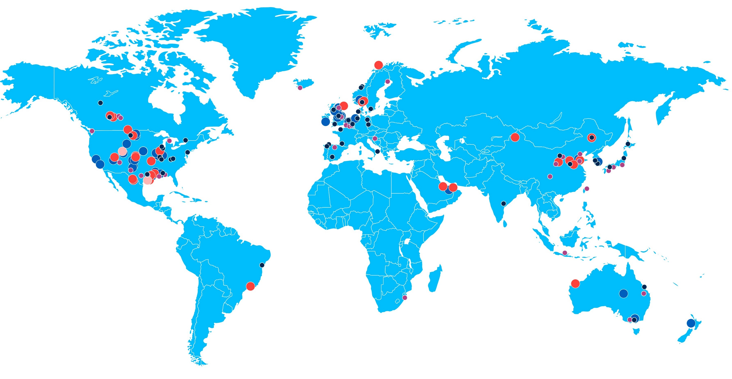
CCS FACILITIES: OPERATIONAL & VARIOUS STAGES OF DEVELOPMENT

Slide 9
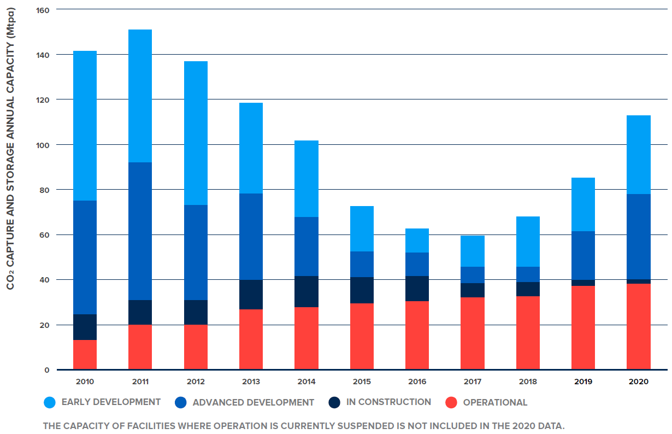
Upward Momentum continues: COMMERCIAL CCS FACILITIES pipeline
33%
Notes:
NOTE
As at November 2020 and **does not include** the two suspended facilities, only the 26 In Operation (38.76 Mtpa)
Exact cumulative total capacity shown on this chart is 113.67 Mtpa (if you add the two with suspended operations it is 115.37 Mtpa)

Slide 10
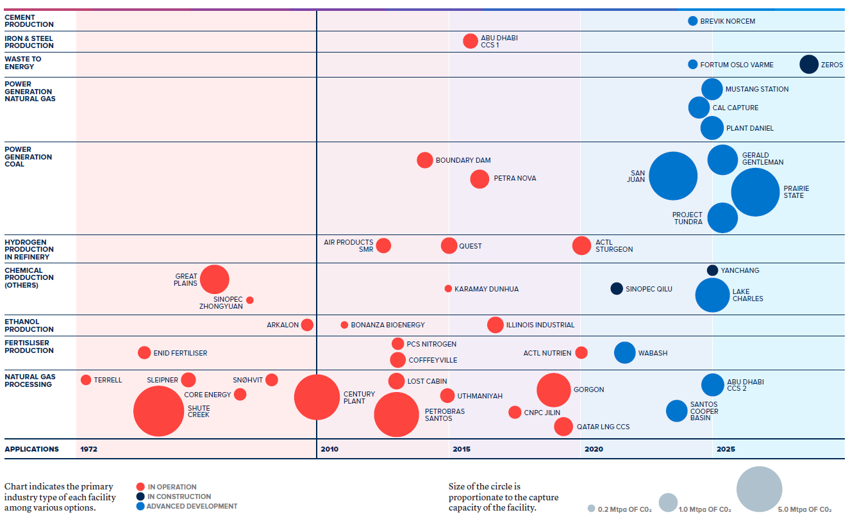
COMMERCIAL CCS FACILITIES IN VARIOUS POWER AND INDUSTRIAL APPLICATIONS
OPERATION SUSPENDED
Notes:
Important to note that this does not include facilties in early development (another 20). Also point out the big bump in both coal power and gas power plants in development.

Slide 11
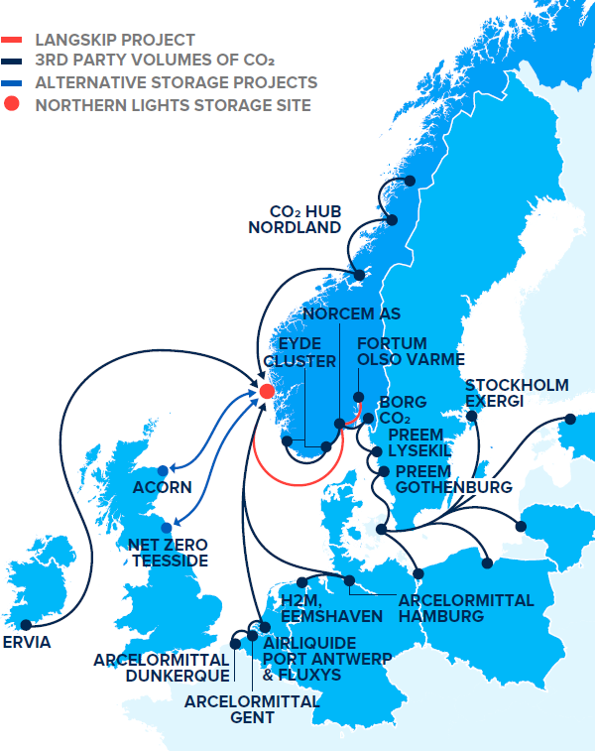
CCS hubs
Hubs and clusters are taking ofF globally
Multiple industrial point sources of CO₂ connected to a CO₂ transport and storage network.
Access to large geological storage resources with the capacity to store CO₂ from industrial sources for decades.
Economies of scale deliver lower unit-costs for CO₂ storage.
Synergies between multiple CO₂ sources and the storage operator reduce cross chain risks and support commercial viability.
Northern Lights Project – Potential Sources Of CO2
Notes:
Northern Lights, the transport and storage component of the Langskip project,

Slide 12
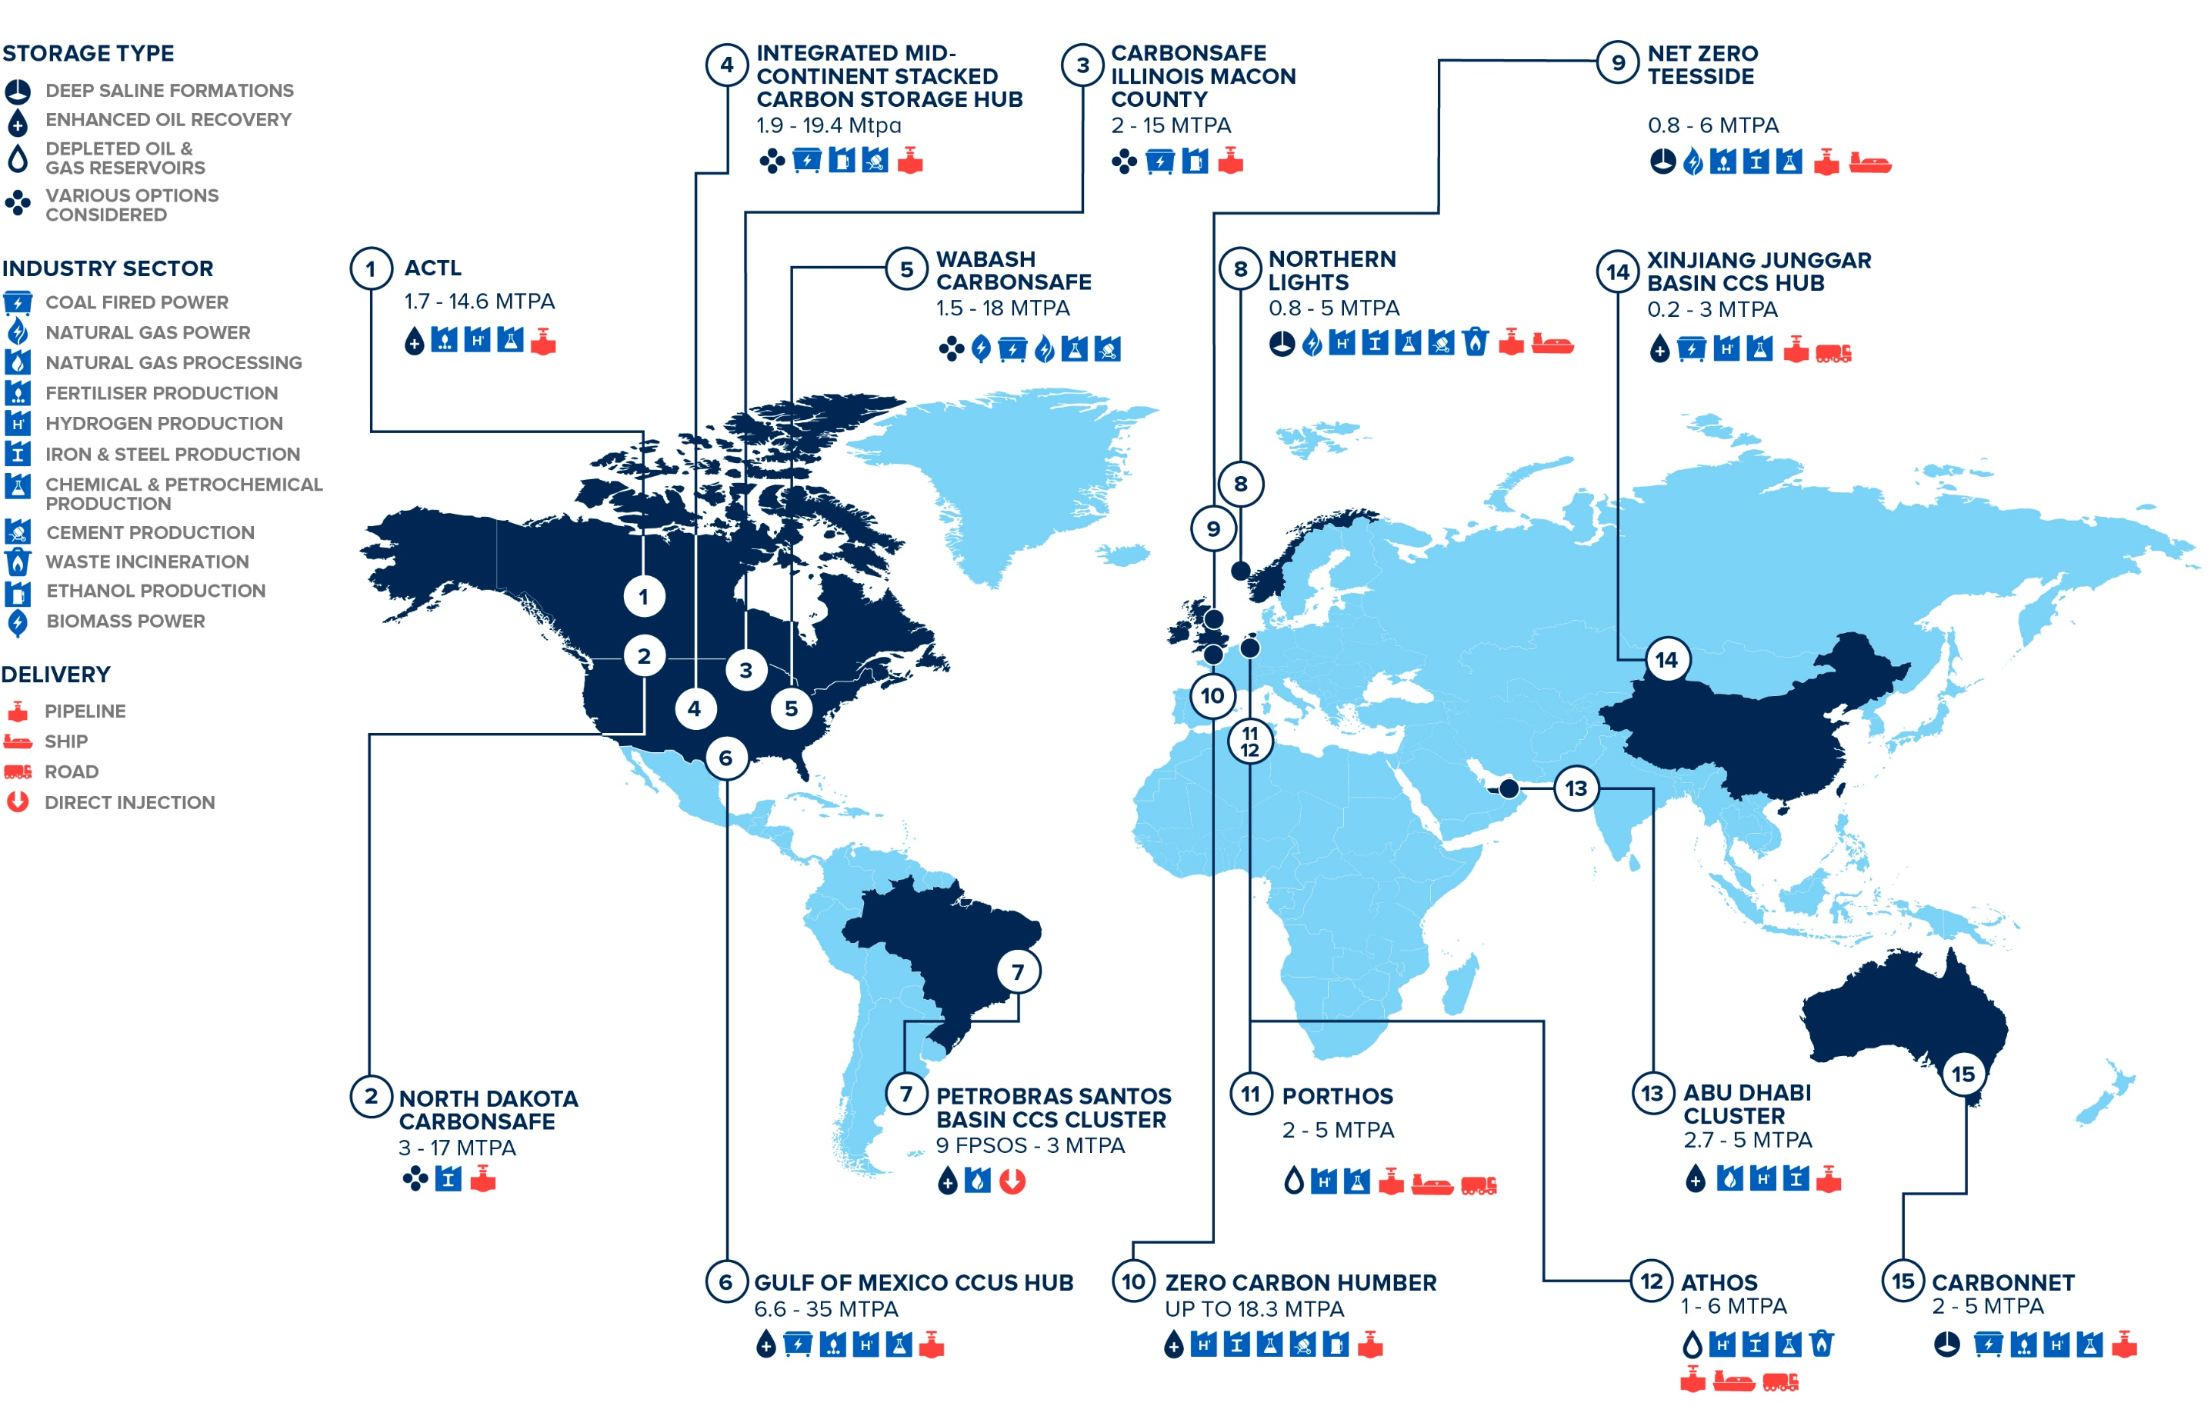
CCS HUBS AND CLUSTERS: OPERATING OR IN DEVELOPMENT
Notes:
Europe: The Norwegian Langskip (Longship) project will have the capacity to store CO2 for across Europe in three years’ time
North America: CarbonSAFE CO2 storage sites will provide significant storage resources for U.S commercial facilities. This is a project by DOE to assess potential storage sites that addressed a knowledge gap and is enabling potential projects to advance.
United Kingdom: The U.K’s purposed Zero Carbon Humber (ZCH) initiative aims to decarbonise the regions industrial centre

Slide 13
Regional highlights

Slide 14
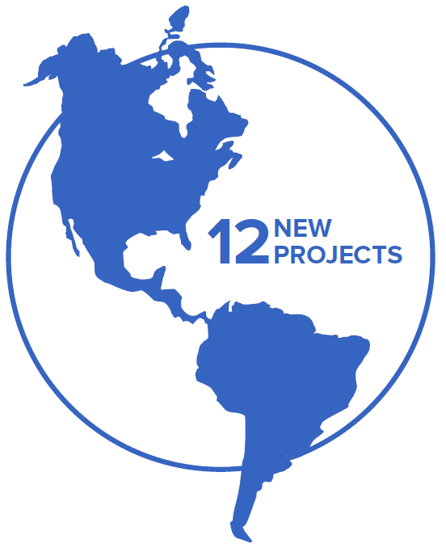
AMERICAS
New projects and policy progress in the region
12 new commercial CCS projects added to our database in the Americas in 2020. 36 commercial facilities operating or in development, plus two currently idled.
US: New projects largely incentivised by 45Q tax credit and the California Low Carbon Fuel Standard (LCFS). U.S Congress allocated $217.8 million for CCUS development.
Canada: Alberta Carbon Trunk Line began operating; a hub and cluster that saw over $550 million in provincial and federal funding.
Brazil: Offshore projects in Brazil continue, capturing over 14M tonnes of CO₂ to date.

Slide 15
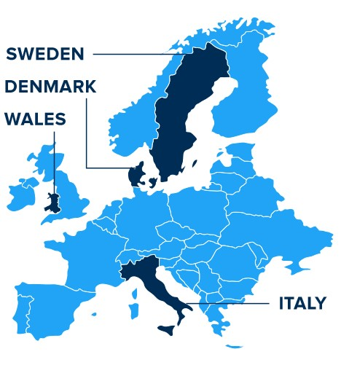
EUROPE
ccs momentum across europe
14 commercial facilities in operation or various stages of development across Europe.
New European jurisdictions have entered the CCS market: Wales, Denmark, Sweden and Italy.
First call for projects under the EU’s €10 billion Innovation fund; expected to be a major source of funding for CCS across the EU.
The United Kingdom is set to establish the first net zero industrial cluster, with 1 billion pounds allocated to support CCS development.
The Norwegian Government has moved forward with $1.8 billion investment to further CCS development.

Slide 16
ASIA PACIFIC
THE EMERGING POWERHOUSE FOR CCS DEPLOYMENT
10 CCS facilities in operation or in development across APAC countries.
Regional collaboration between governments has boosted storage potential and knowledge, including bilateral agreements with Australia and Singapore.
Singapore, Malaysia, and Australia have newly established CCS strategies.
The Australian government has established a $50 million CCUS development fund.

Slide 17
GULF COOPERATION STATES
GCC states emerging as important for ccs development
3 CCS facilities in operation in the Gulf States, capturing 3.7 Mtpa of carbon dioxide.
Circular carbon economy: CO2 emissions are managed through a holistic approach to climate mitigation, including carbon removal.
The development of up to 30 GT of storage to support the region’s climate plans.
Saudi Arabia and the UAE have the largest emissions in the region, with power generation the biggest contributor.

Slide 18
CCS: vital to net-zero
ACHIEVING COST-EFFECTIVE NET-ZERO EMISSIONS WITH CCS
Achieving deep decarbonisation in hard-to-abate industry.
Enabling the production of low-carbon hydrogen at scale.
Providing low carbon dispatchable power.
Delivering negative emissions.
Notes:
Four main ways to achieve cost-effective net-zero emissions through CCS investment
ACHIEVING DEEP DECARBONISATION IN HARD-TO-ABATE INDUSTRY
The cement, iron and steel, and chemical sectors emit carbon due to the nature of their industrial processes
and have high-temperature heat requirements. They are among the hardest to decarbonise. Several reports1
conclude that achieving net-zero emissions in industries like these may be impossible and, at best, more
expensive without CCS. CCS is one of the most mature and cost-effective options for deep decarbonisation
of hard-to-abate industry.
ENABLING THE PRODUCTION OF LOW-CARBON HYDROGEN AT SCALE
To decarbonise hard-to-abate sectors and reach net-zero emissions, global hydrogen production must grow
significantly, from 70 million tonnes per annum today2 to 425–650 million tonnes a year by mid-century.
Coal or natural gas with CCS is currently the most cost-effective way to produce low-carbon hydrogen. It is
likely to remain so in regions where large amounts of affordable renewable electricity for hydrogen production
with electrolysis is not available, and fossil fuel prices are low.
DELIVERING NEGATIVE EMISSIONS
Residual emissions in hard-to-abate sectors need to be compensated for. CCS provides the foundation for
technology-based carbon dioxide removal, including bioenergy with CCS (BECCS) and direct air capture (DAC).
While carbon dioxide removal is not a silver bullet, every year that passes without significant reductions in CO2
emissions, makes it more necessary.
PROVIDING LOW CARBON DISPATCHABLE POWER
Decarbonising power generation is crucial to achieving net-zero emissions. CCS equipped power plants supply
dispatchable and low-carbon electricity, as well as grid-stabilising services, such as inertia, frequency control
and voltage control. Therefore, CCS complements renewables, helping make the low-carbon grid of the future
resilient and reliable.

Slide 19
CCS: vital to net-zero
significant ccs policy vital to achieve global climate targets
To achieve net-zero emissions, CCS capacity must increase more than a hundredfold by 2050.
Stronger policy to incentivise rapid CCS investment is overdue.
Policy priorities include:
Creating conditions for investment
Facilitating development of CO₂ infrastructure
Clarifying key legal and regulatory issues
Notes:
Creating conditions for investment
Placing a value on emission reductions (eg. carbon taxes, emissions trading and tax credits) and direct support (eg. grants) for early CCS projects
Facilitating development of CO2 infrastructure
Coordinating and underwriting the development of industrial hubs and clusters and qualified storage sites
Clarifying key regulatory and policy issues
Robust policy frameworks needed to reduce cross-chain, and long-term liability risks.

Slide 20
The Global Status of CCS 2020 Report can be downloaded from https://www.globalccsinstitute.com/resources/globalstatusreport/

Slide 21
Questions & Answers

Slide 22
Panel Discussion
Jamie Gentoso – CEO, LafargeHolcim US Cement
Zoë Knight - Managing Director, Group Head HSBC Centre of Sustainable Finance,
HSBC Holdings PLC
Torbjørg Klara Fossum - VP Global CCS Solutions, Equinor ASA
Vianney de Buchet – VP Energy Transition Europe, Air Liquide
Jamie Burrows – Client Engagement Manager, GCCSI (Moderator)

Slide 23
Closing
The Global Status of CCS 2020 Report can be downloaded from: https://www.globalccsinstitute.com
Webinar recording available through Institute website:
https://www.globalccsinstitute.com/resources/audio-and-visual-library/
Follow us on Social media: Global CCS Institute
@GlobalCCS
To learn more about Institute membership or our consultancy capabilities please e-mail: info@globalccsinstitute.com
Thank you for your attention

Slide 24
The Global Status of CCS 2020 Report can be downloaded from https://www.globalccsinstitute.com/resources/globalstatusreport/

